Slide 1
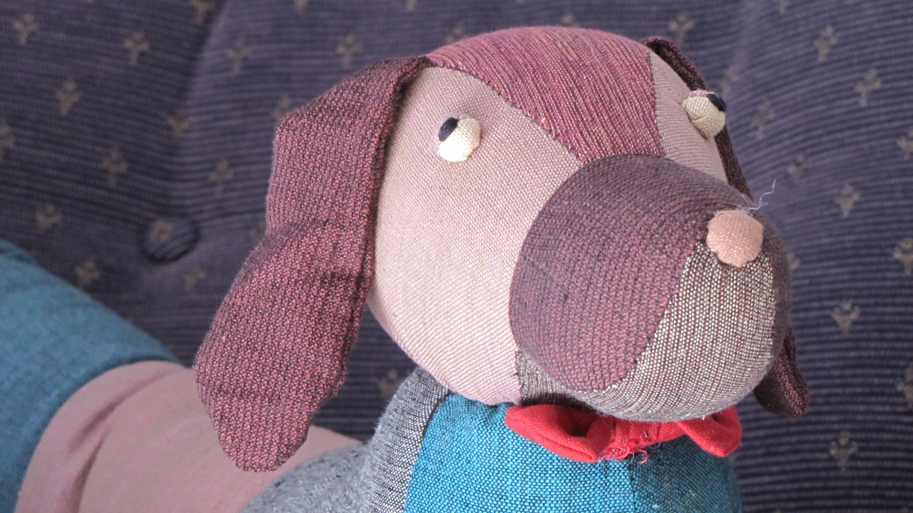
Where is Cumberland?
By David W. Lankshear

Slide 2
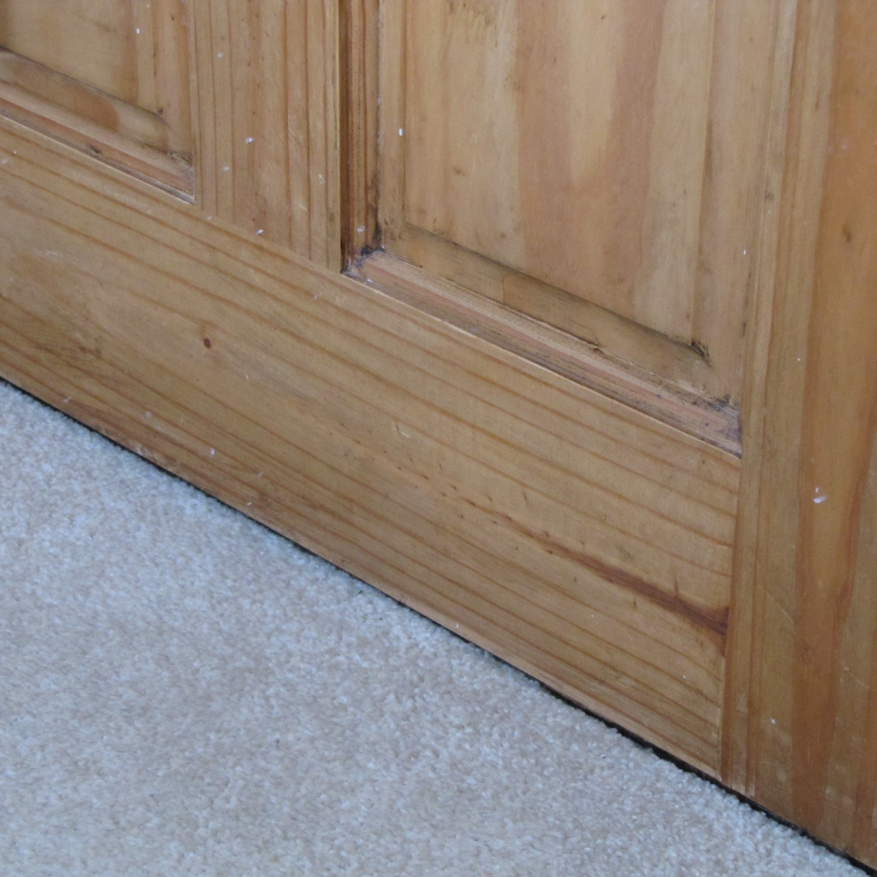
Cumberland was lost. He was not by his door. Everyone looked for him.

Slide 3
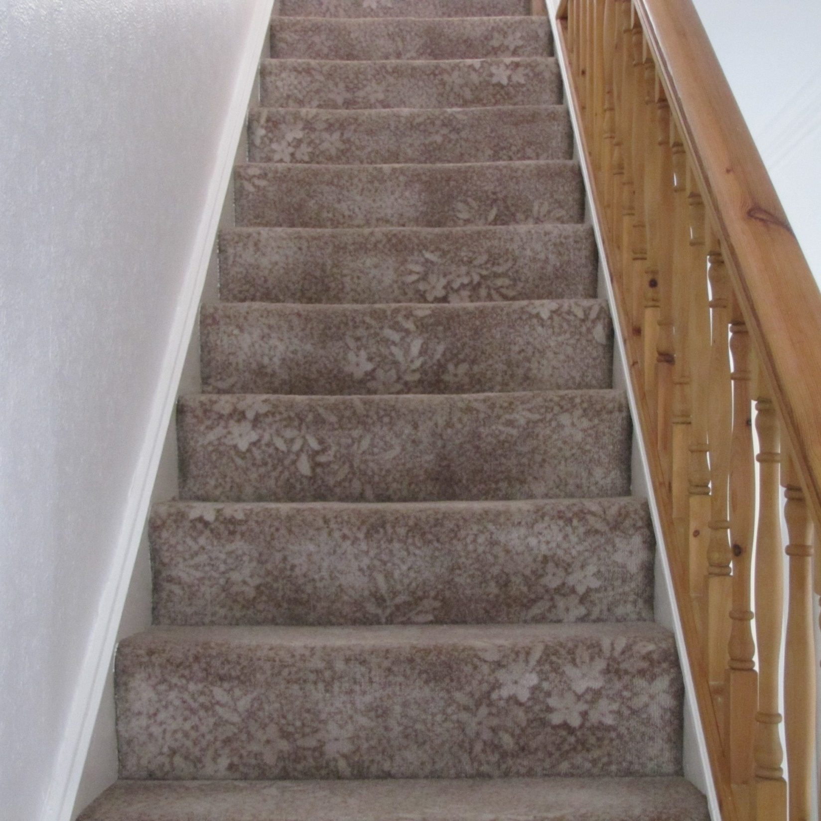
Cumberland was lost. He was not on the stairs. Everyone looked for him.

Slide 4
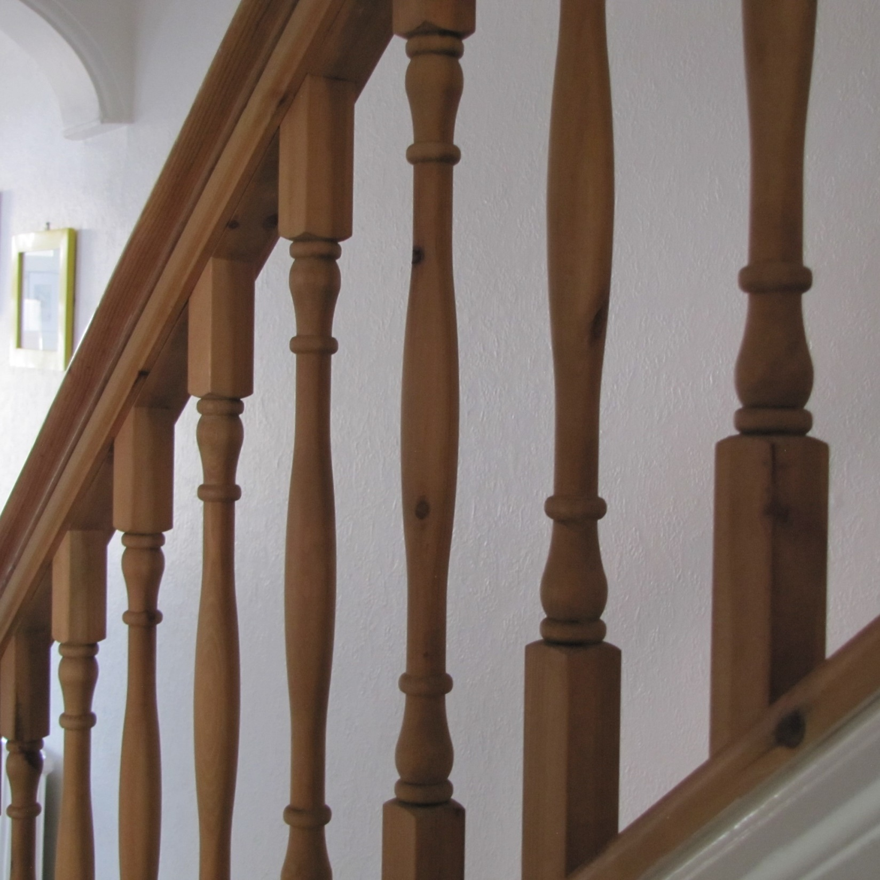
James had a think and went to look for Cumberland in the bannisters. Cumberland was not there.

Slide 5
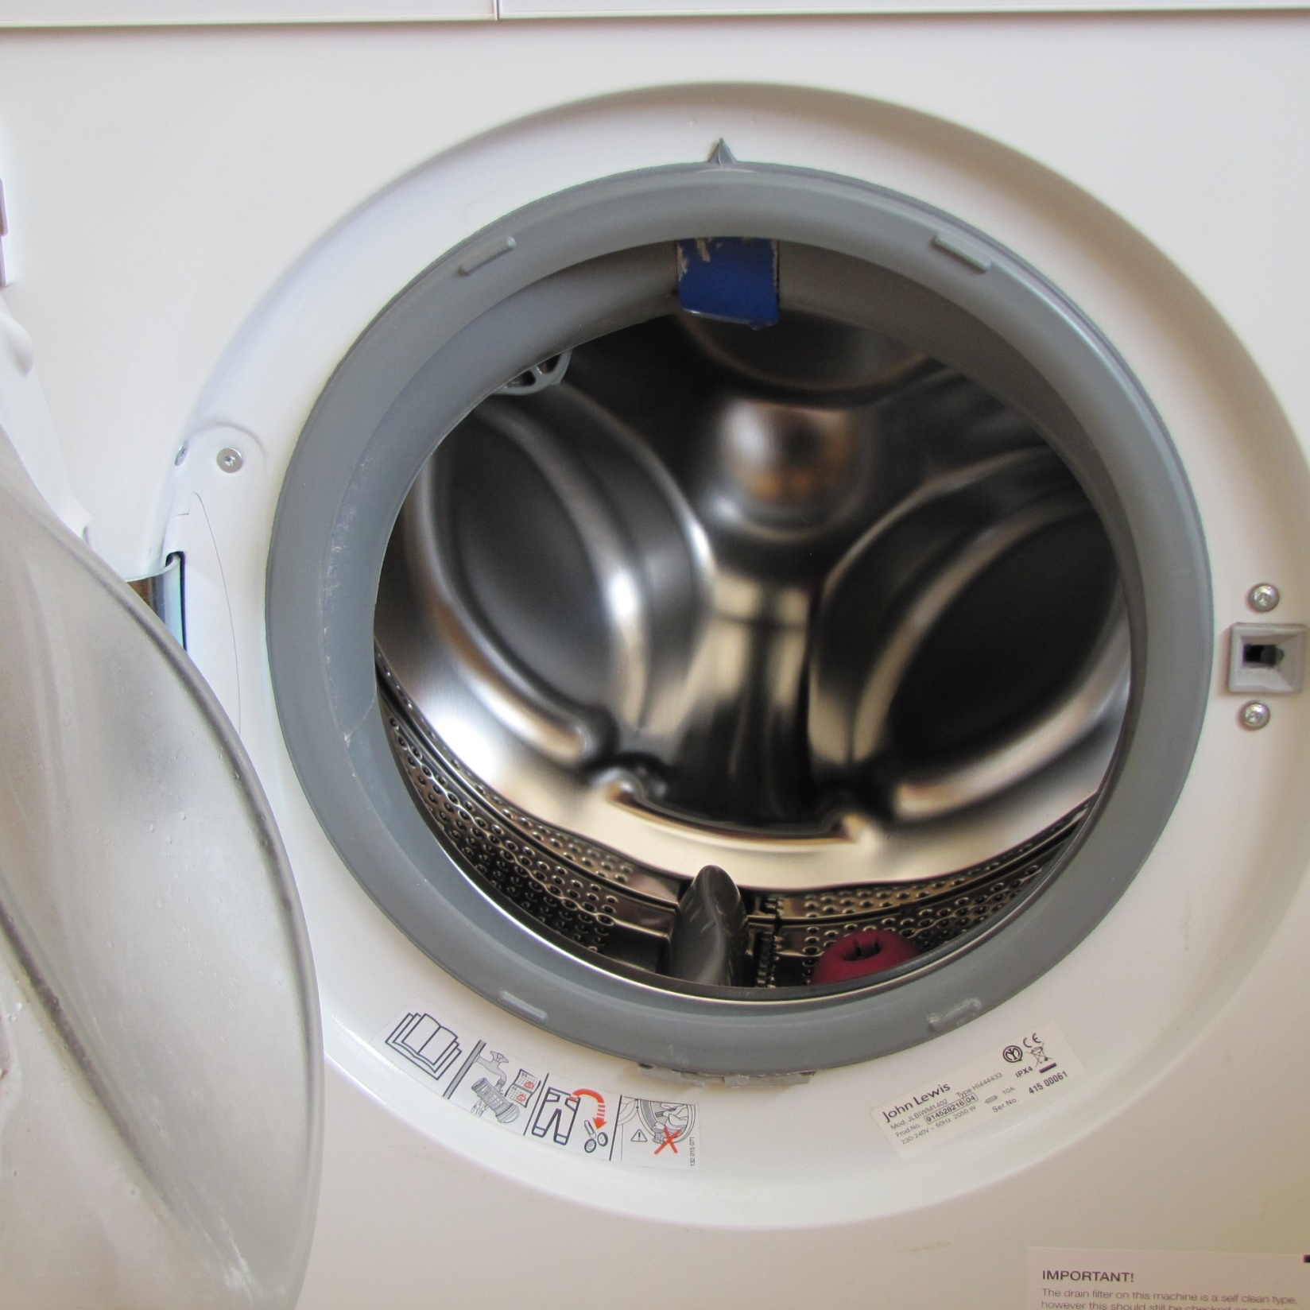
James looked for Cumberland in the washing machine. Cumberland was not there.

Slide 6
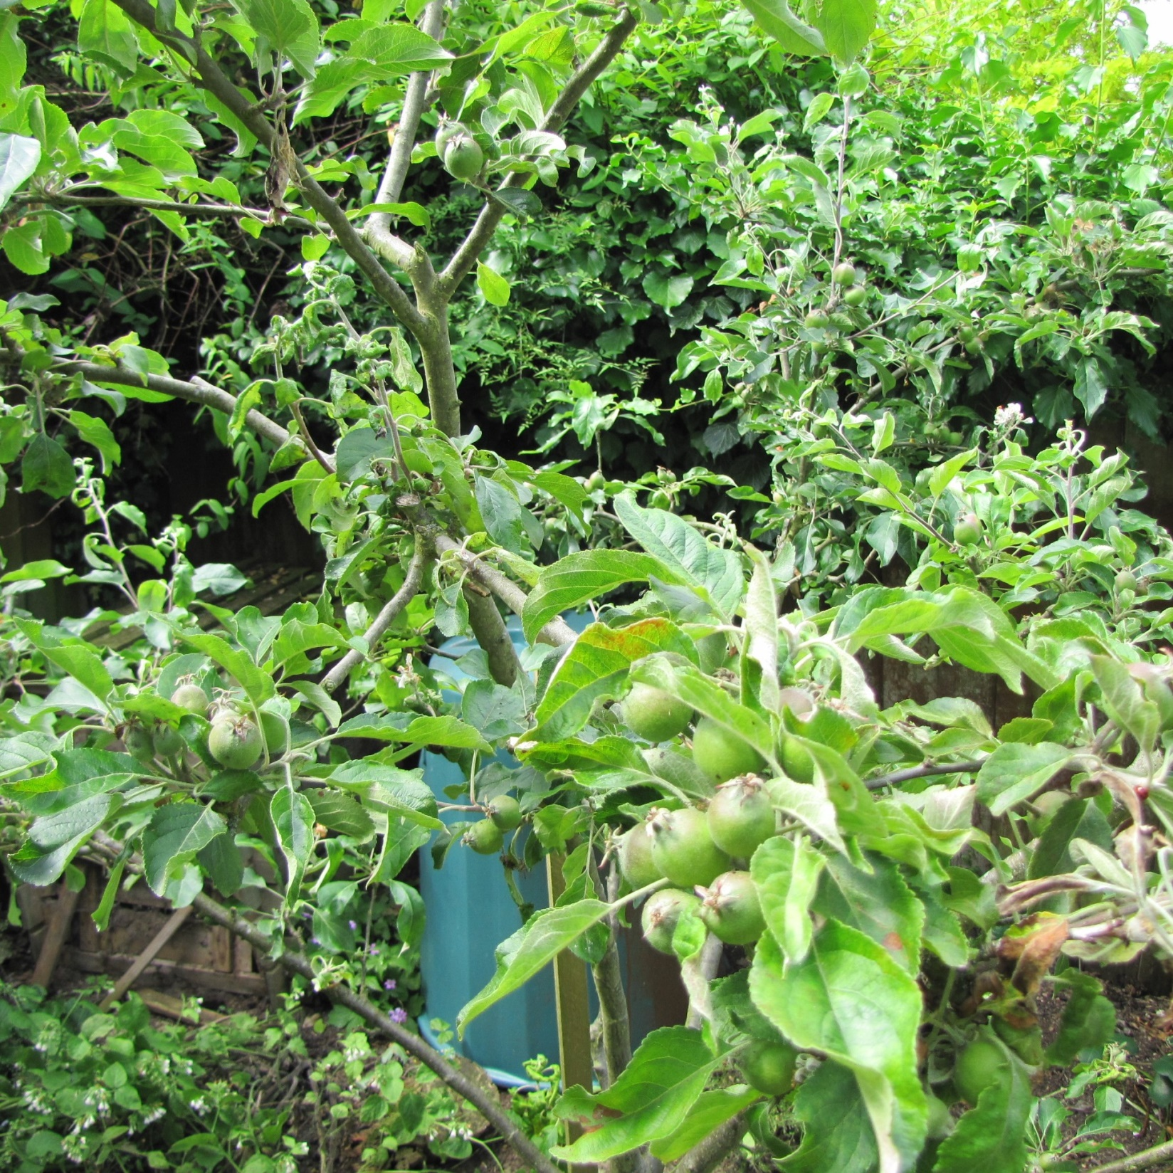
Fran had a think and went to look for Cumberland in the apple tree. Cumberland was not there.

Slide 7
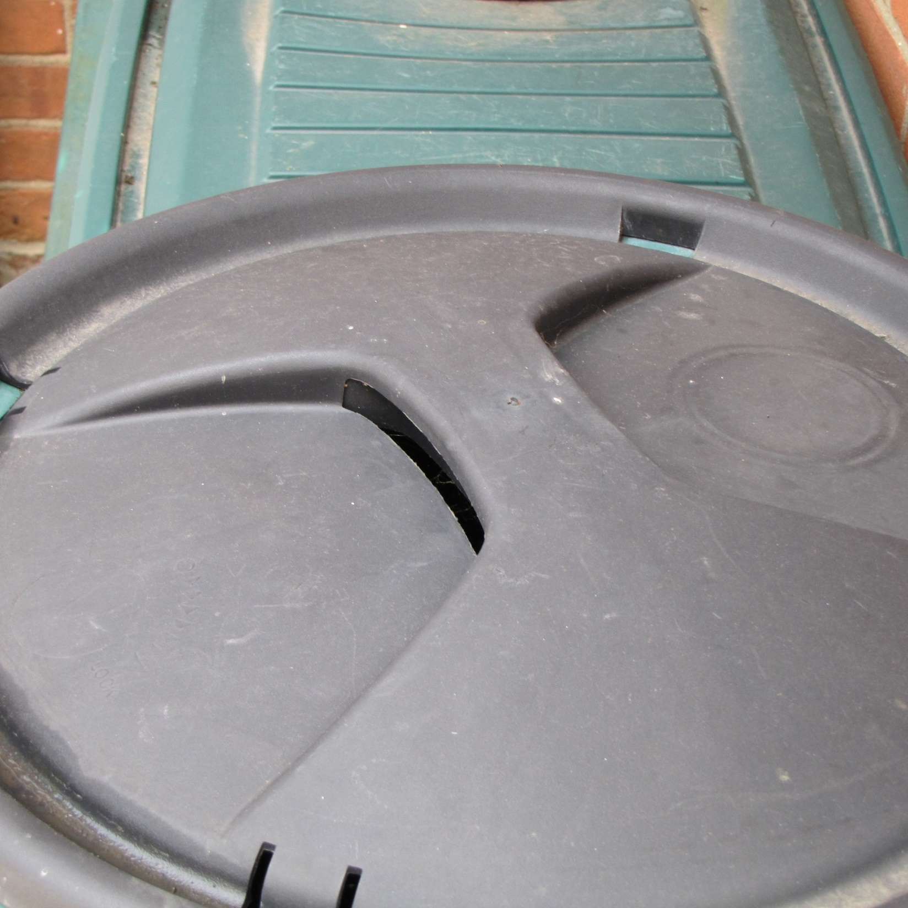
Fran looked for Cumberland on the water butt. Cumberland was not there.

Slide 8
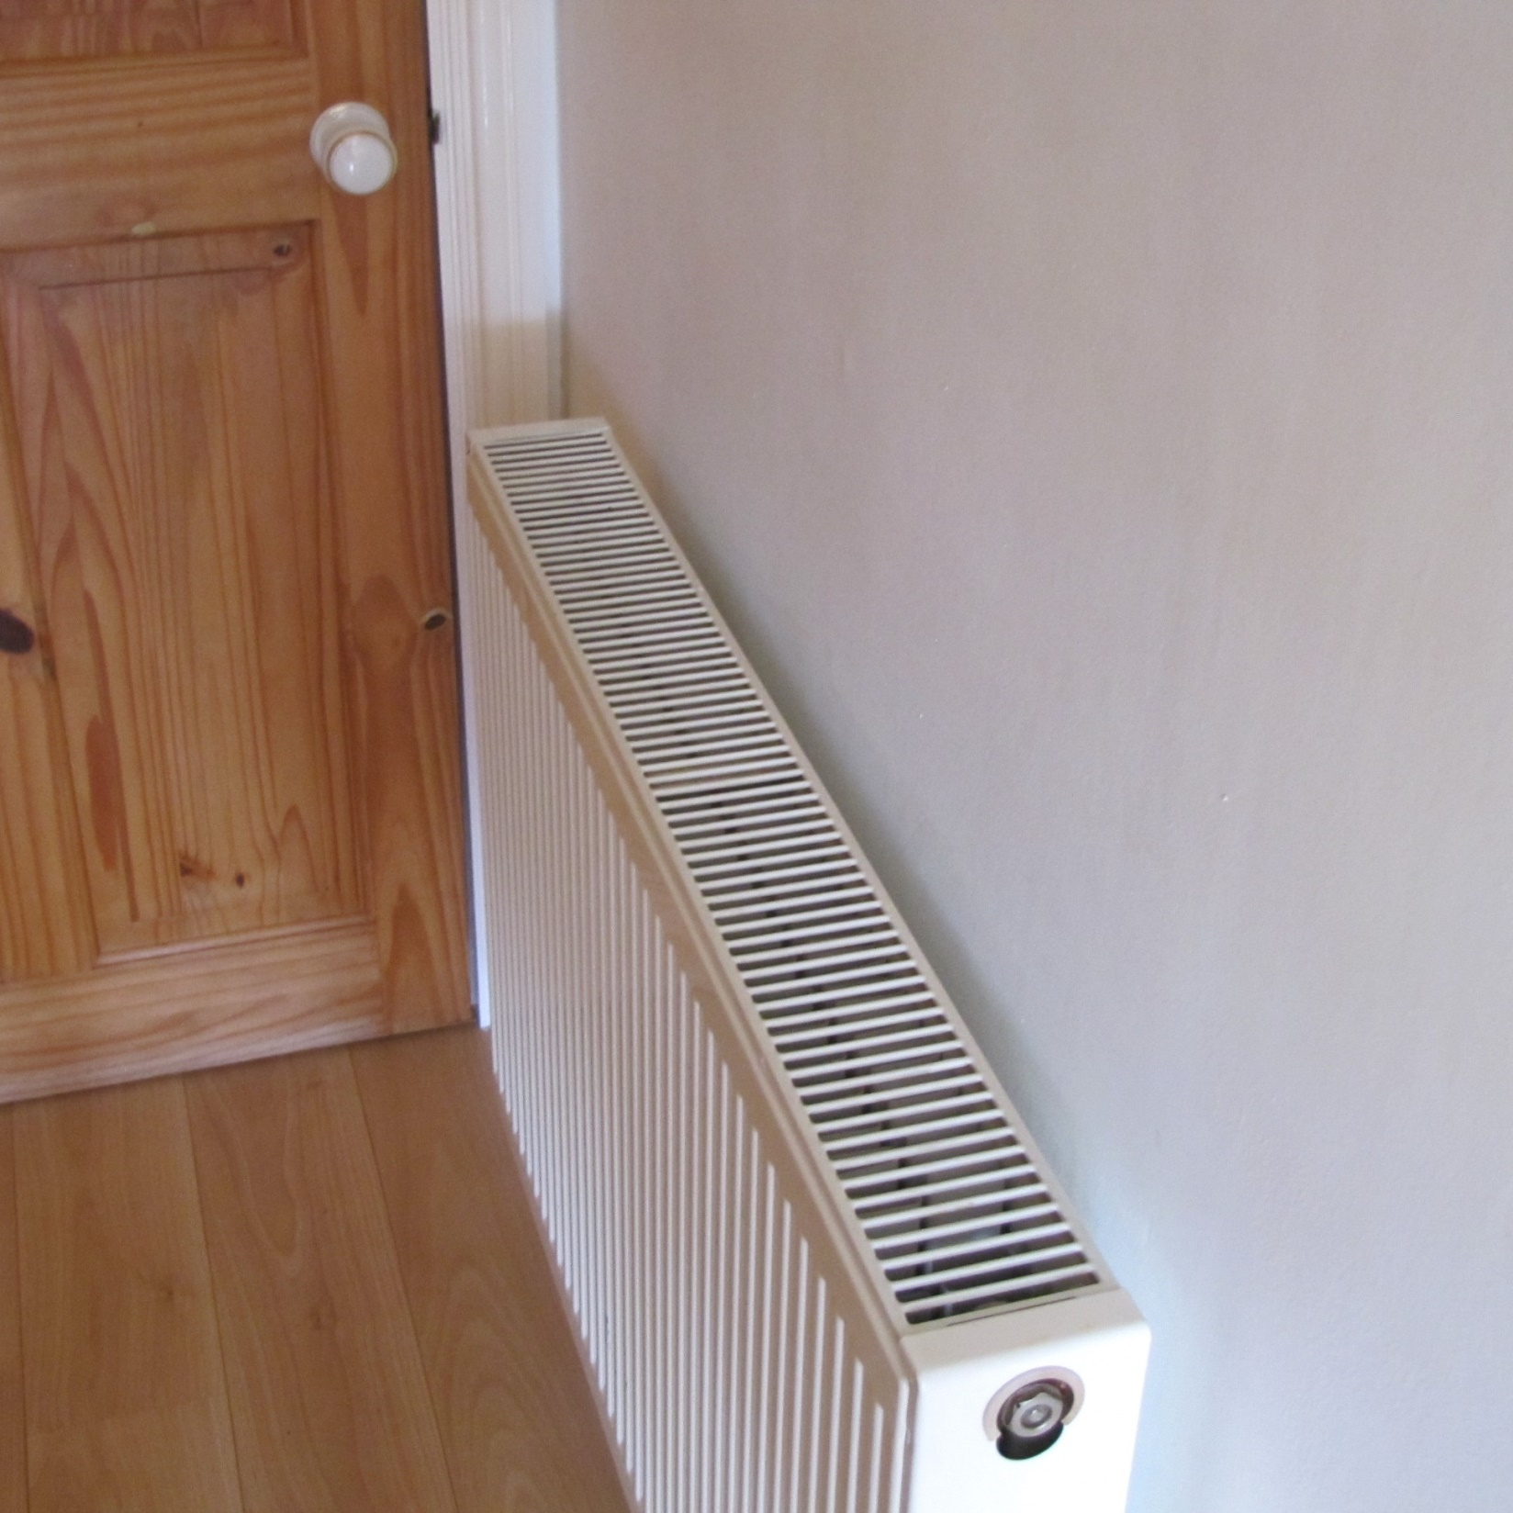
Granny had a think and went to look for Cumberland on the radiator. Cumberland was not there.

Slide 9
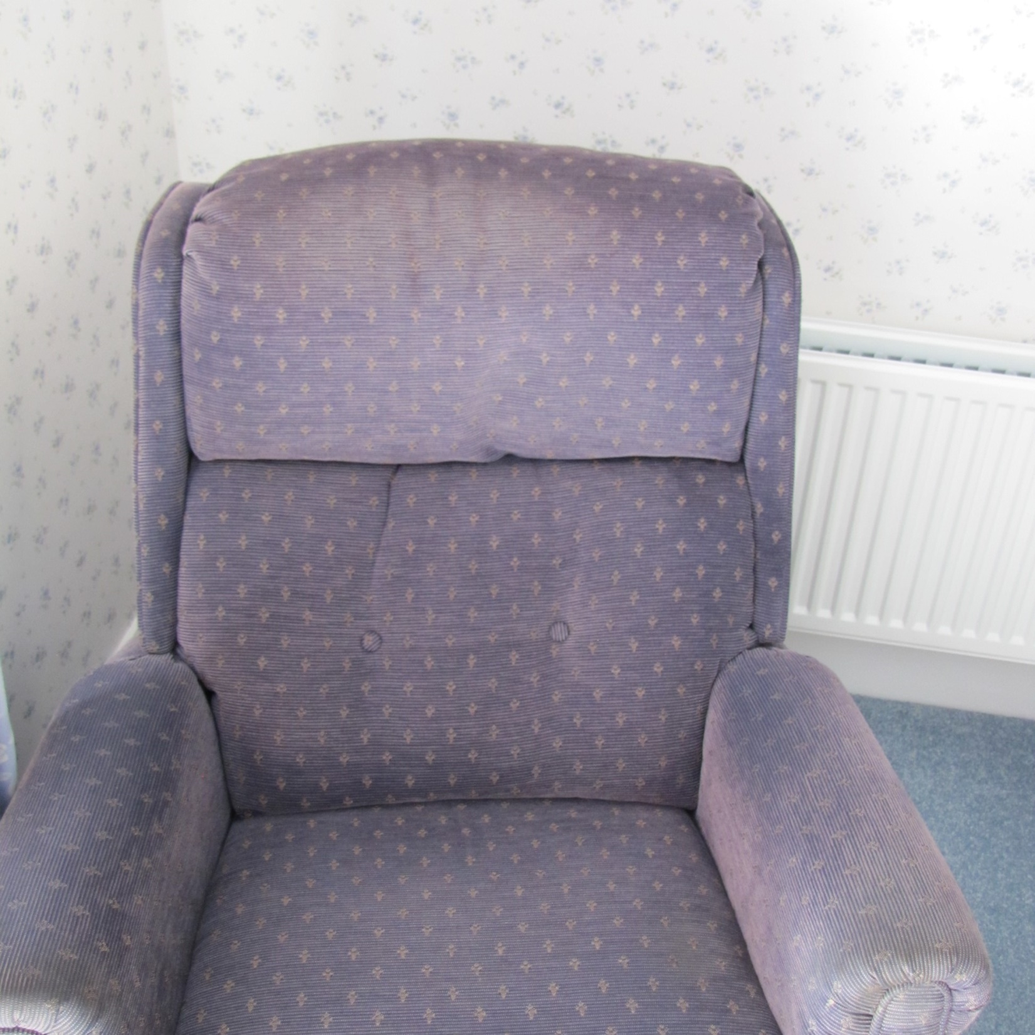
Granny looked for Cumberland on the big blue chair. Cumberland was not there.

Slide 10
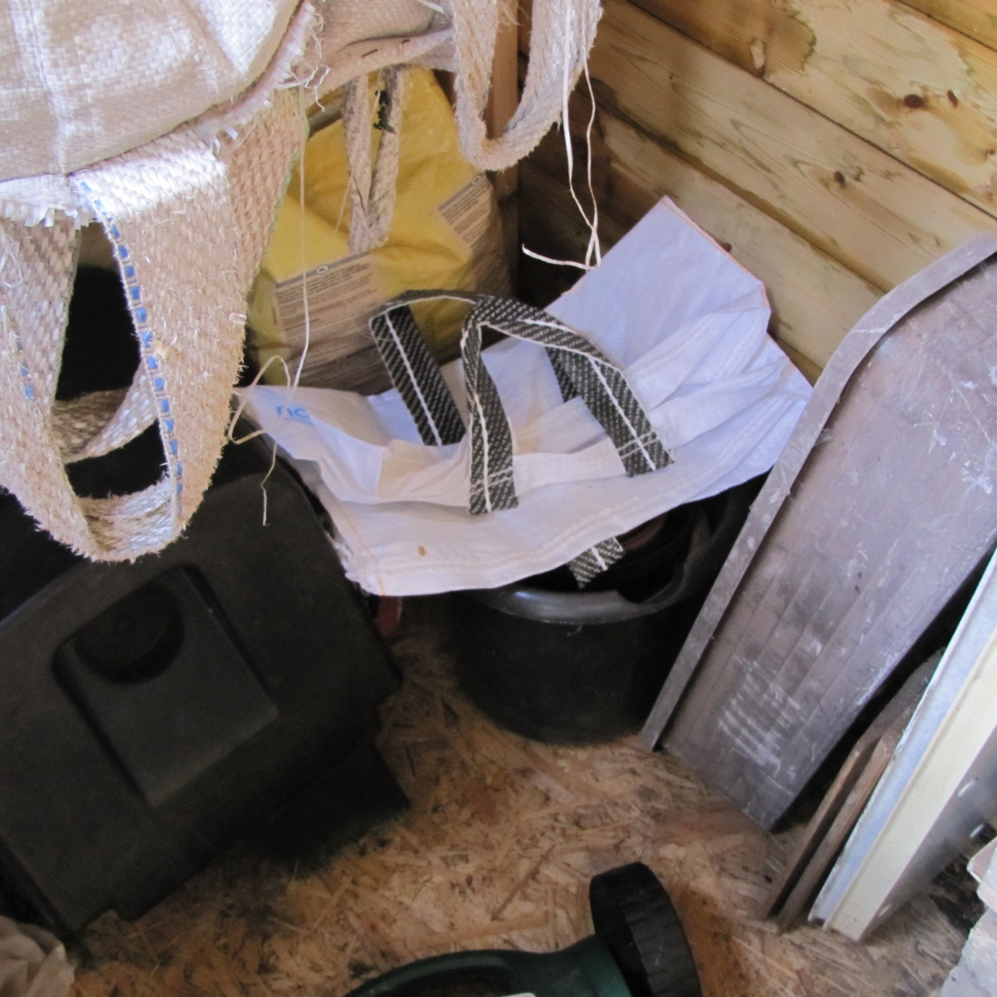
Grandad had a think and went to look for Cumberland in his shed. Cumberland was not there.

Slide 11
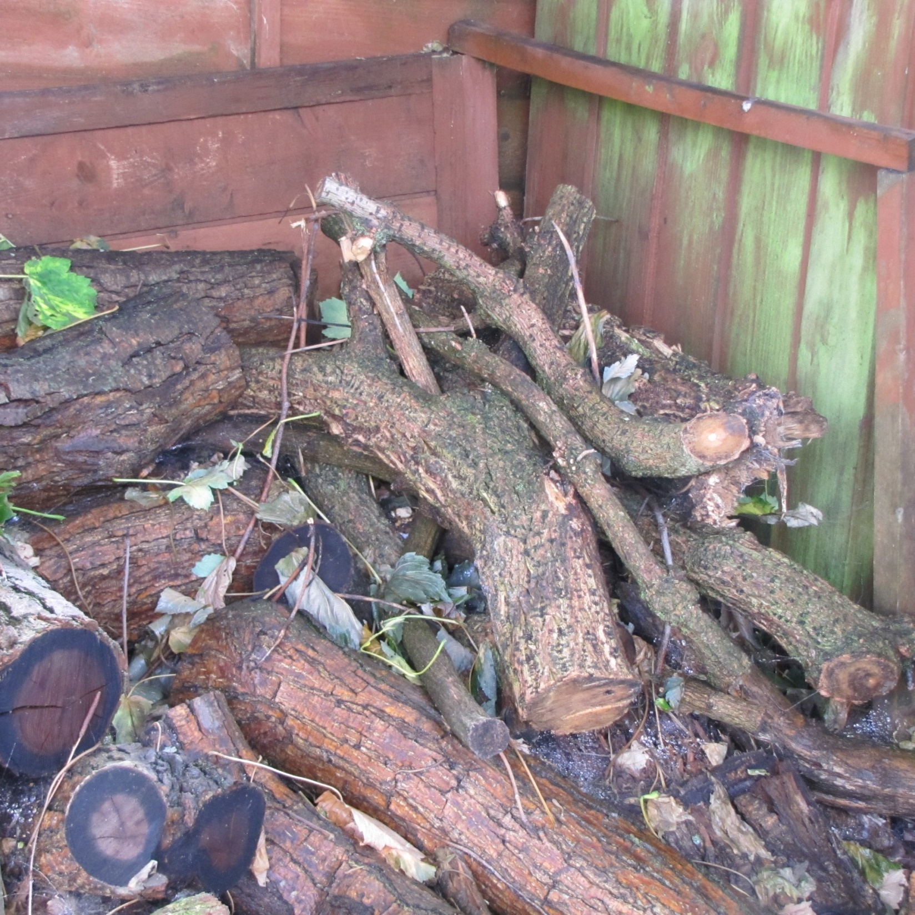
Grandad looked for Cumberland in his log pile. Cumberland was not there.

Slide 12
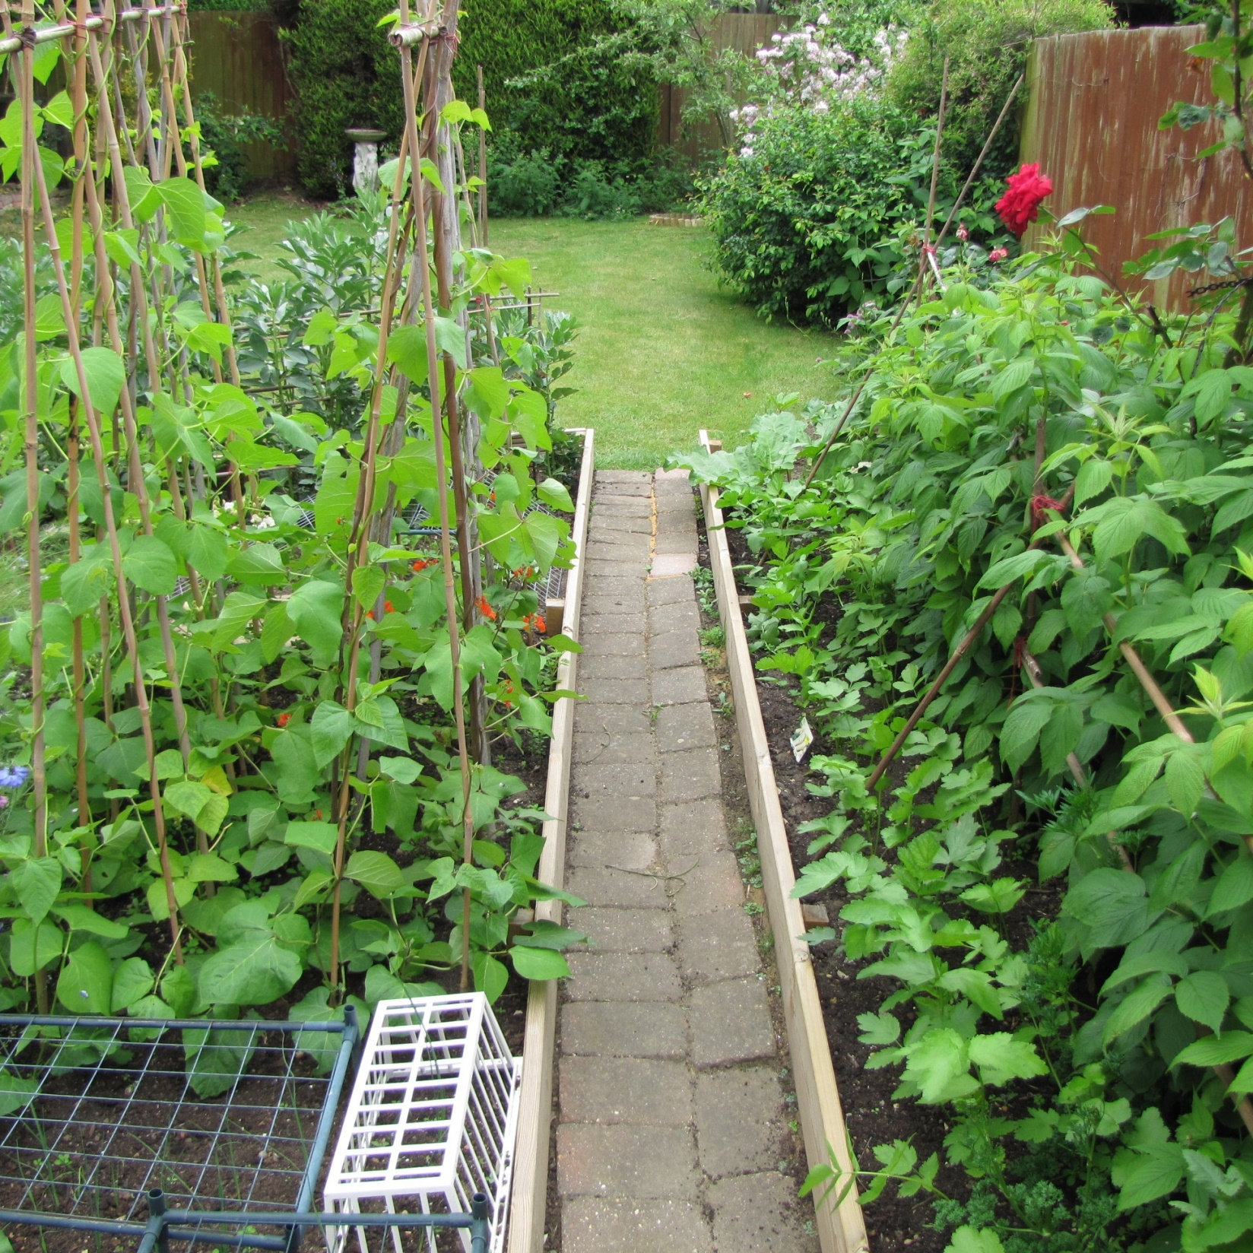
Fran had another think and went to look for Cumberland between the vegetables. Cumberland was not there.

Slide 13
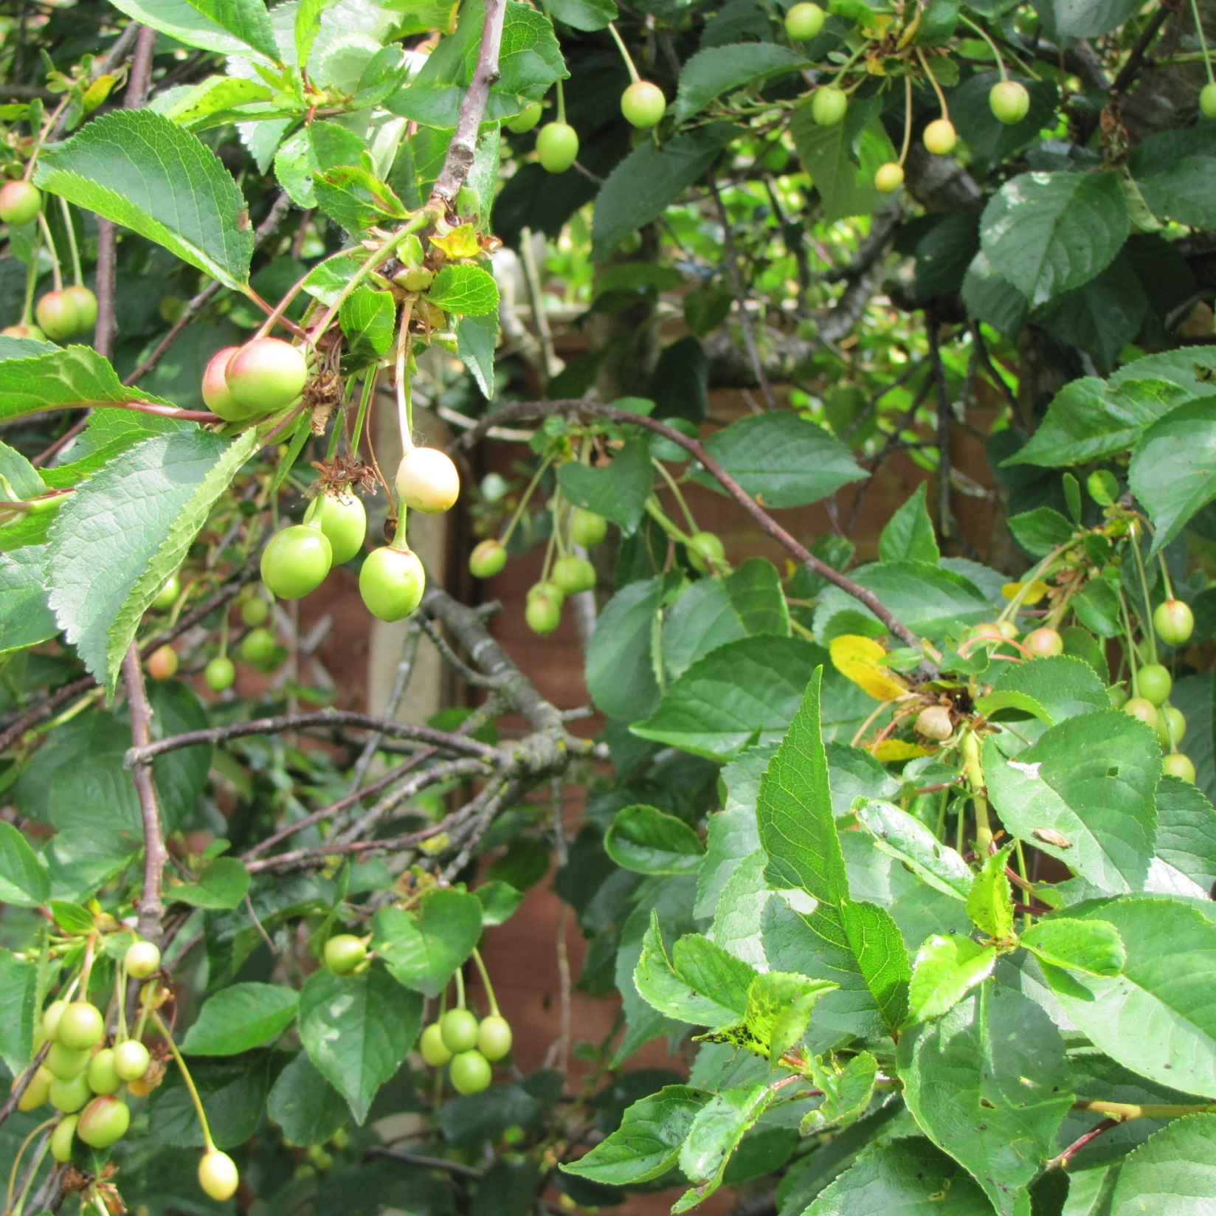
Fran looked for Cumberland in the Cherry tree. Cumberland was not there.

Slide 14
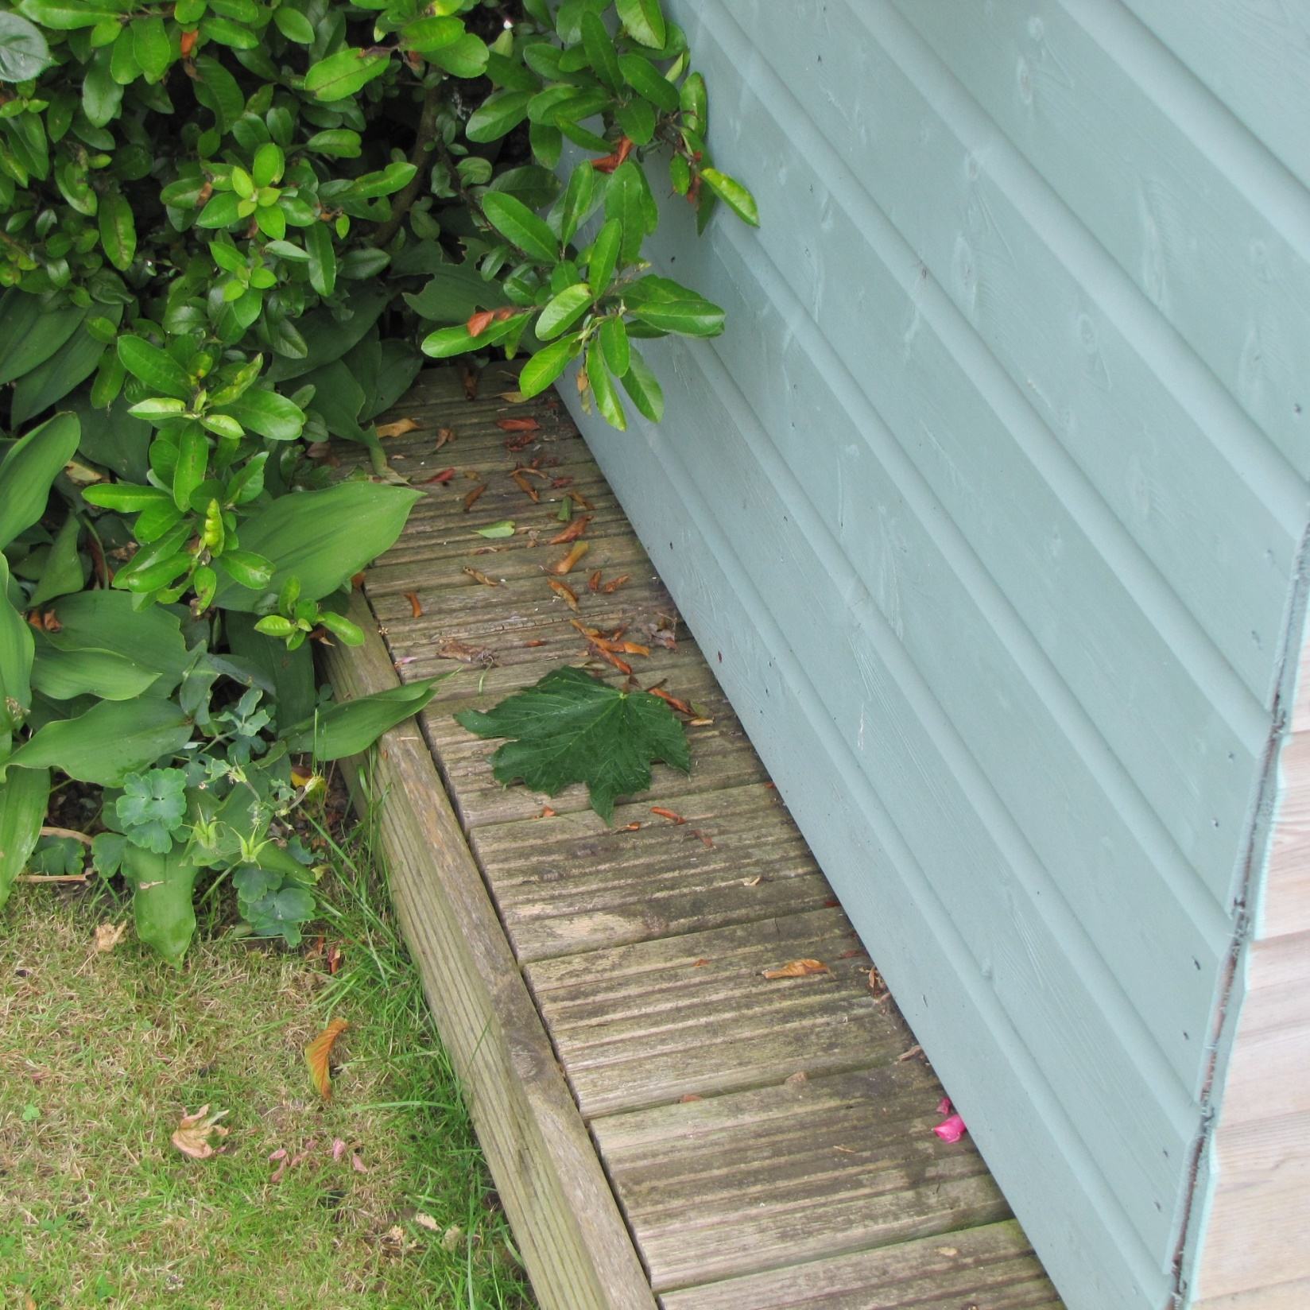
James had another think and went to look for Cumberland beside the shed. Cumberland was not there.

Slide 15
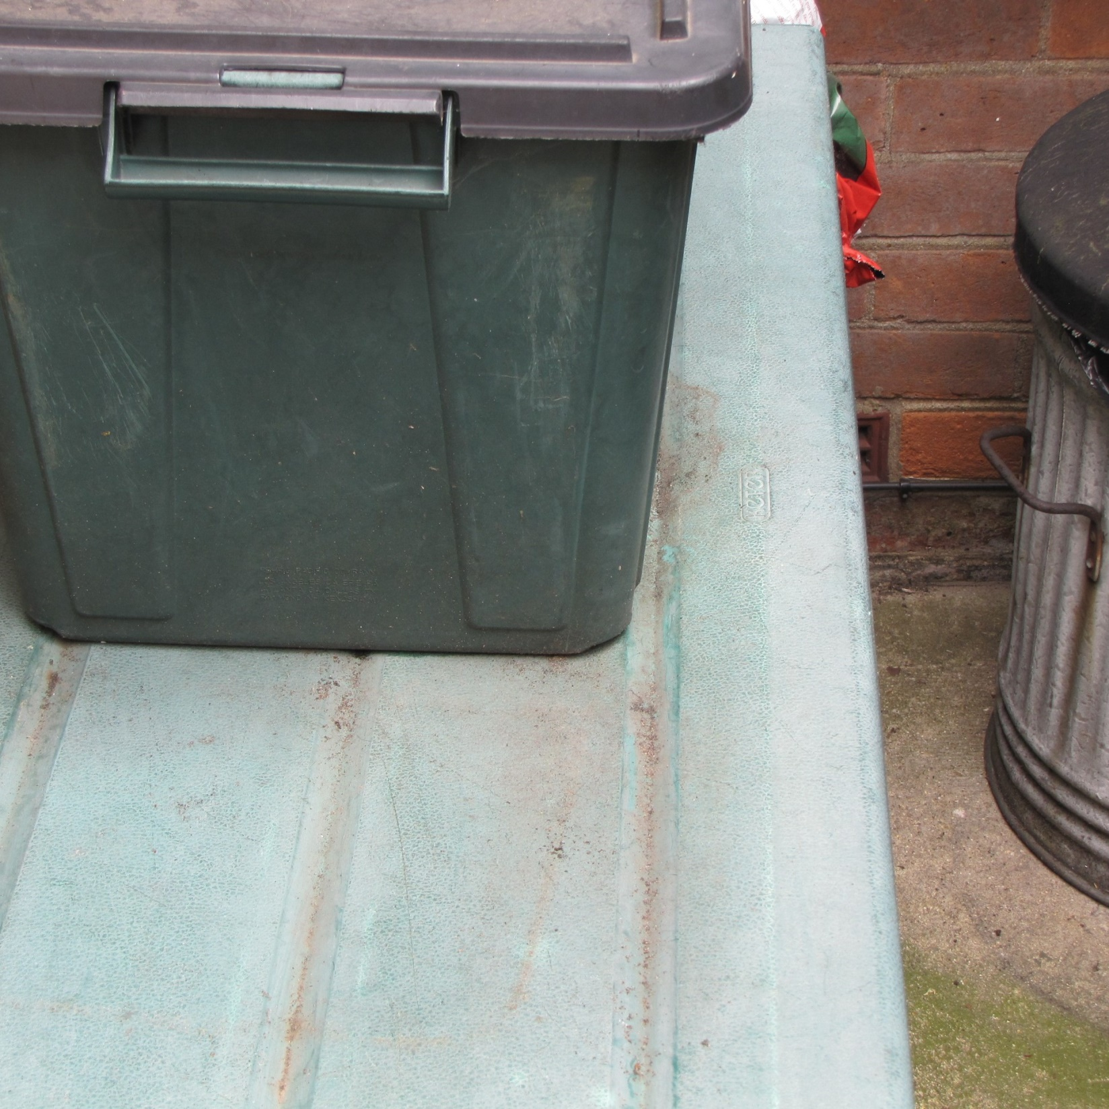
James looked for Cumberland on the log box. Cumberland was not there.

Slide 16
So where was Cumberland? Granny said that they should have a good long think.
It was getting dark and Cumberland was still lost.

Slide 17
All this time Cumberland knew where he was. As it was night time, he was in the dark.

Slide 18
Then Fran remembered helping Grandad pump up the tyres on Granny’s bicycle.

Slide 19
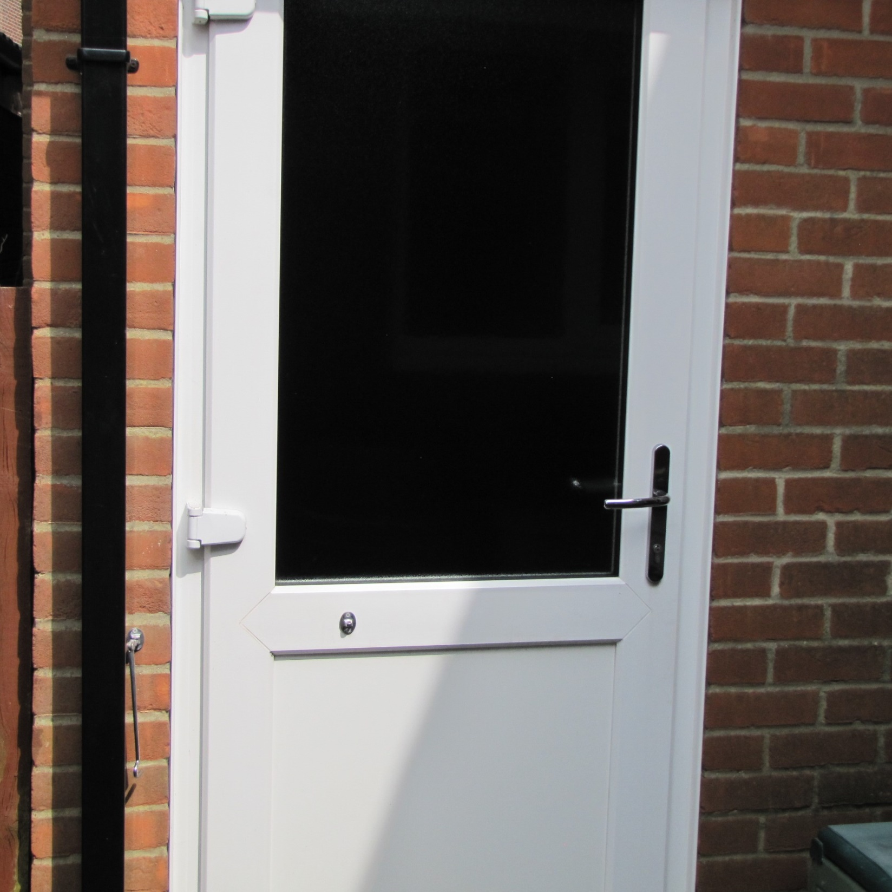
“I know where Cumberland is!” Fran shouted. She went out to the garage. Grandad opened the door and switched on the light.

Slide 20
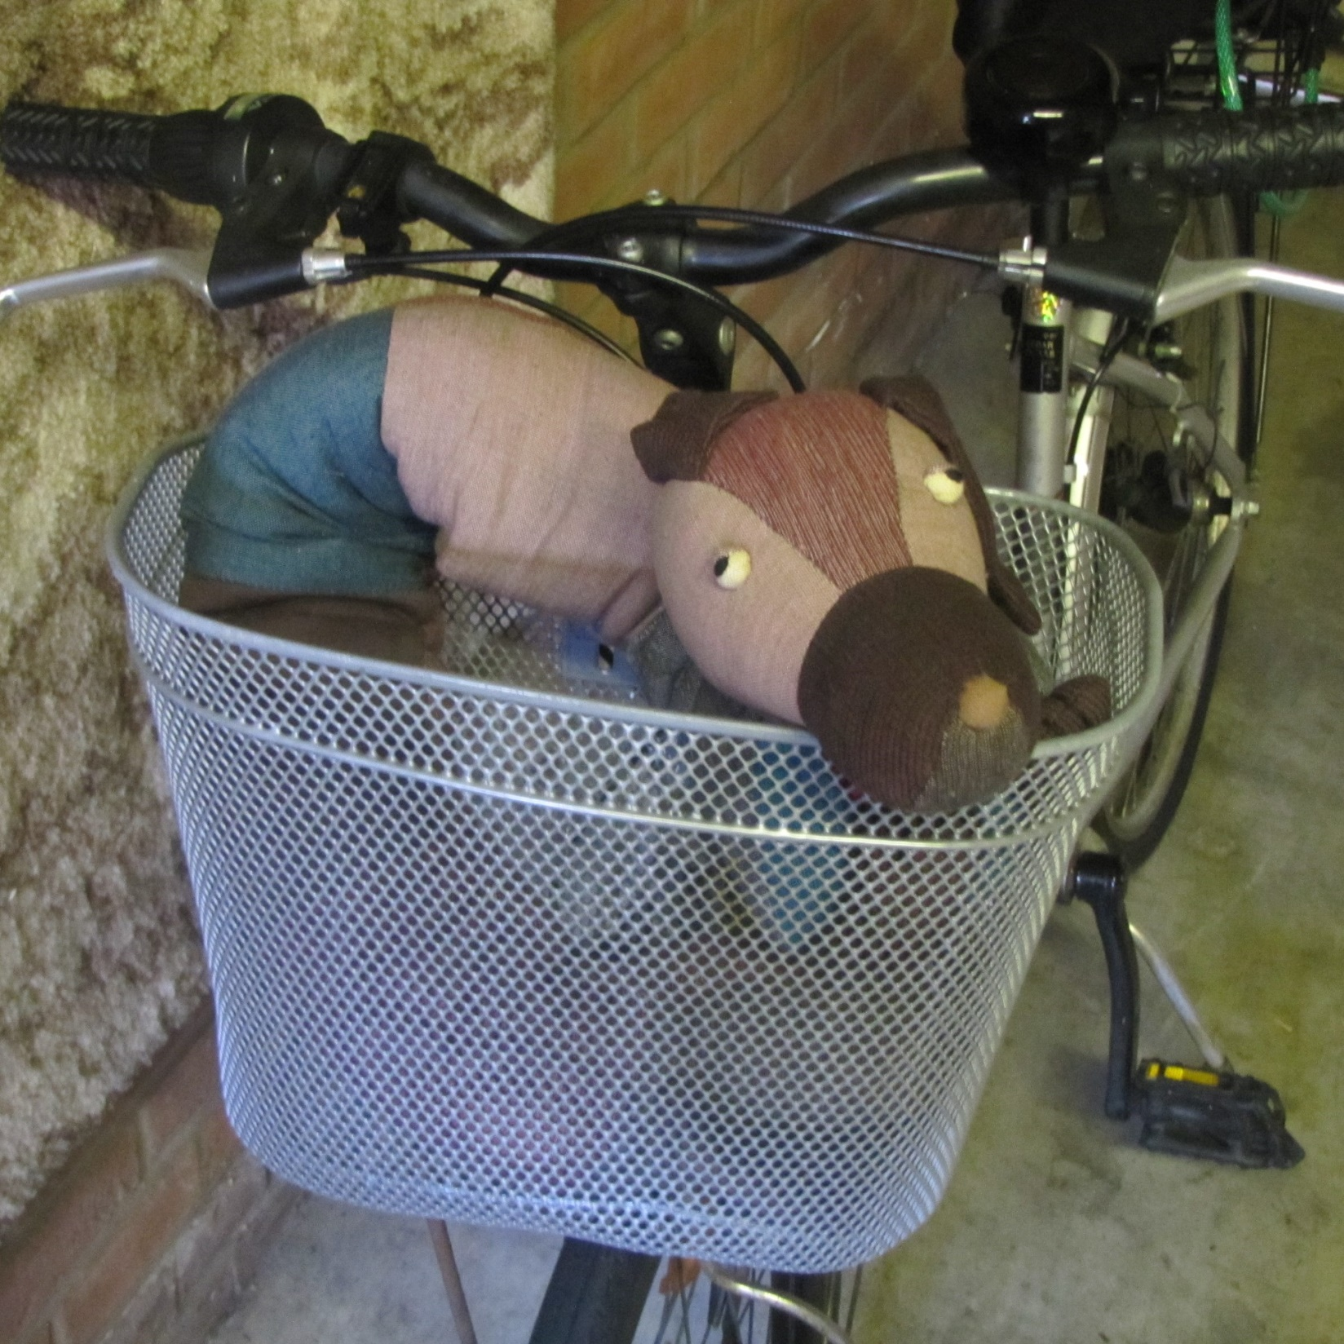
There was Cumberland squashed into the basket on Granny’s bicycle. Fran was very pleased to see him.

Slide 21
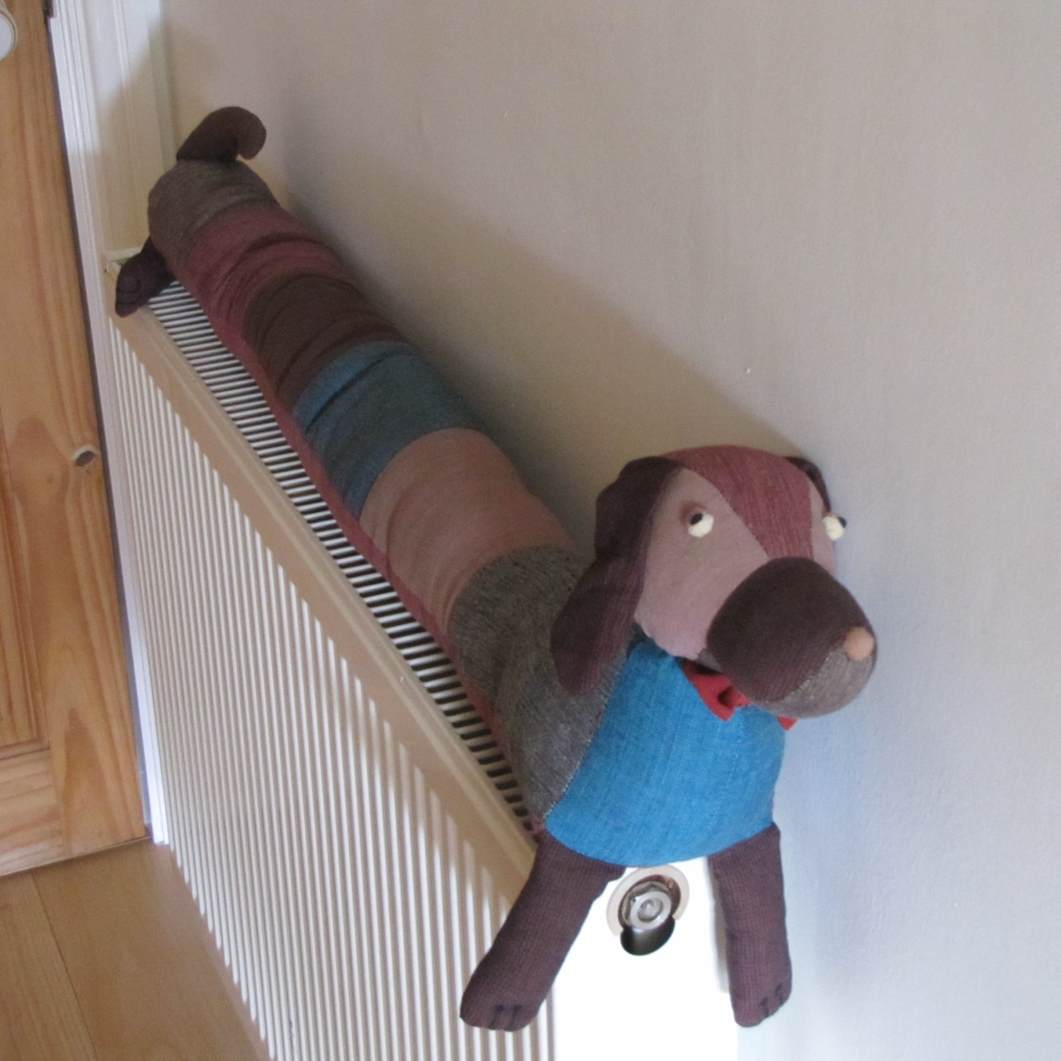
Fran put Cumberland on the radiator to warm up. Cumberland was pleased to stretch out after being curled up all day.

Slide 22
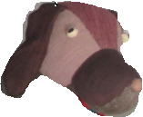
Notes for parents and teachers
Cumberland comes from a Fairtrade cooperative in Nepal and his journey to his new home was enabled by Traidcraft plc.
This book could be about getting lost or perhaps searching for something that has been
lost. It could be about families working together – everybody trying to help. Better still it
might be about whatever those who hear the story think it is about, but you will only
discover what children think it is about by talking with them.
This book is one of a series about Cumberland and his world that raise questions about,
love, joy, feeling alone, enjoying company, being sad and being happy.
You might follow this story with talking about not leaving things about, but it is probably
more fun to play hide and seek.

Slide 23
Published 2018 in association with Bear Lands Publishing, St. Mary’s Centre, Llys Onnen, Abergwyngregyn, Gwynedd, LL33 0LD, Wales.
Copyright © 2018 David W Lankshear (text and illustrations).
David W Lankshear has asserted his right under the Copyright, Design and Patents Act 1988 to be identified as the author of this Work.
All rights reserved. No part of this publication may be reproduced, stored in a retrieval system, or transmitted, in any form or by any means, electronic, electrostatic, magnetic tape, mechanical, photocopying, recording or otherwise, without full acknowledgement of Bear Lands Publishing and copyright holders.
First published 2018

