Slide 1
Cumberland in goal
By David W. Lankshear

Slide 2
James wanted to play football. Fran did not like playing football with James, because she always had to go in goal. Sometimes when she was in goal the ball hit her. It hurt!

Slide 3
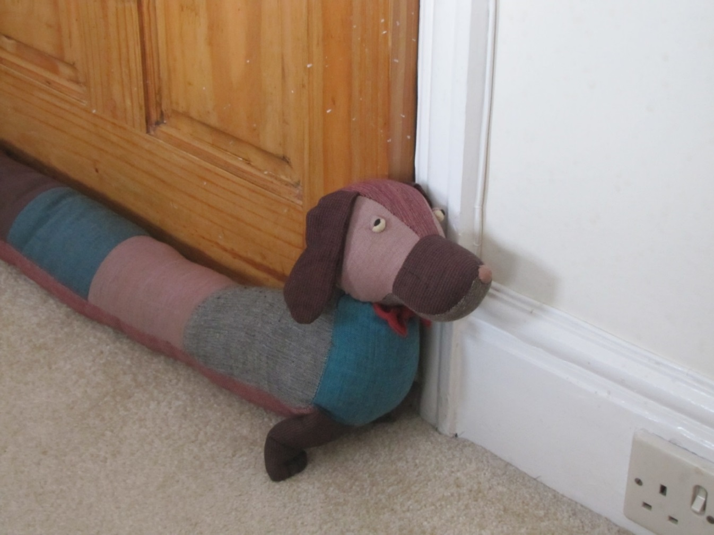
“All right,” said Fran, “I will play but only if we put Cumberland in gaol.” “How could we put Cumberland in Goal?” said James, “That is just silly.”

Slide 4
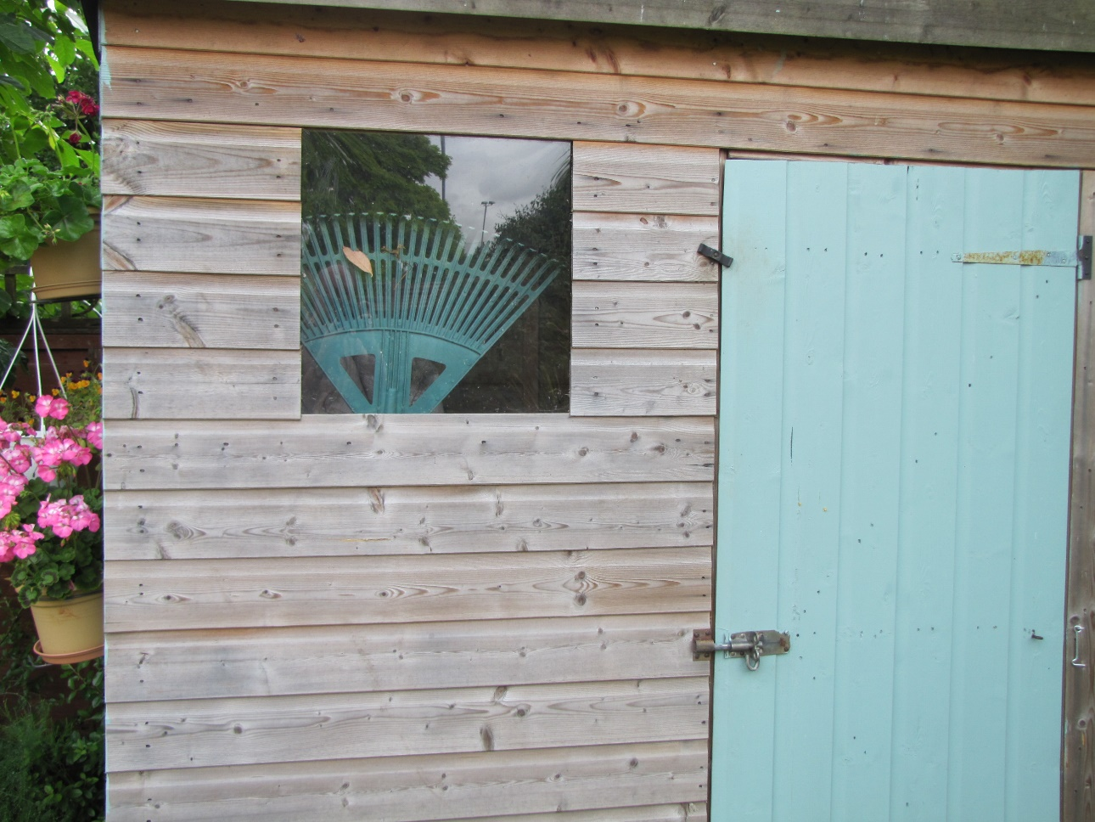
“Let’s ask Grandad and see what he thinks.” They found Grandad in his shed and explained the problem.

Slide 5
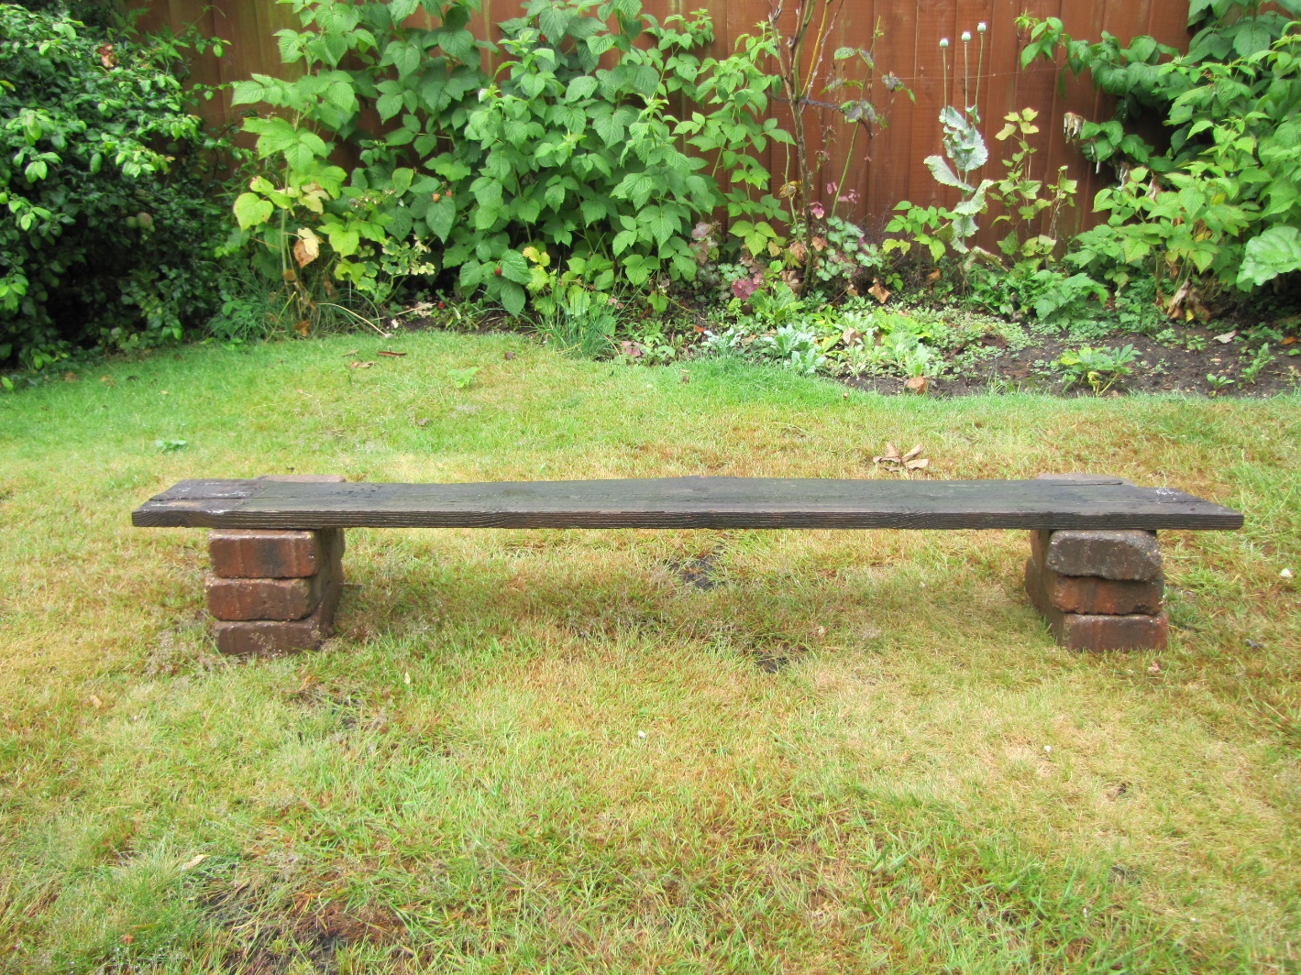
“Hmmph,” said Grandad, “Let me think.” Grandad got some bricks and a plank and made a goal. “There,” said Grandad, “even Cumberland could be a goal keeper in that goal.”

Slide 6
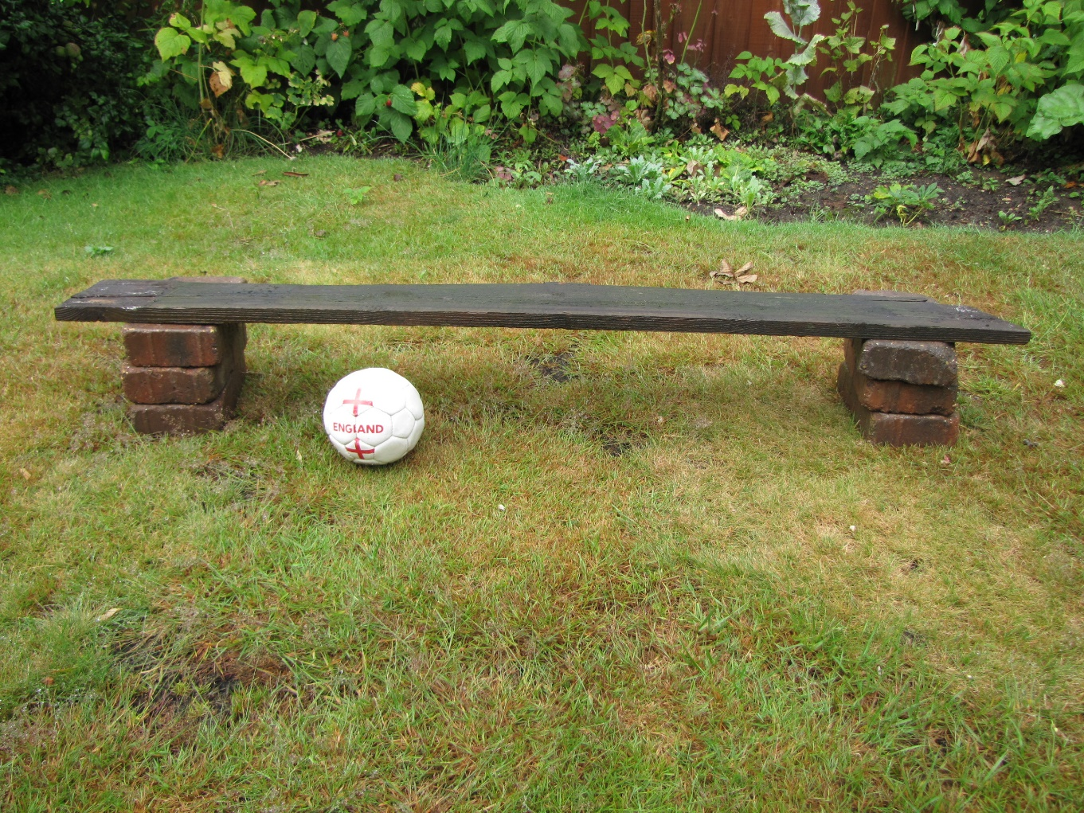
“Grandad,” said James, “That is silly. The ball is too big to go into the goal. Even if Cumberland wasn’t there you could never score a goal.”

Slide 7
“Well, then the game would always be a draw. No-one would loose and that would save all the arguments.” “No, we need a proper goal and a proper goal- keeper,” said James.
Score
0 – 0

Slide 8
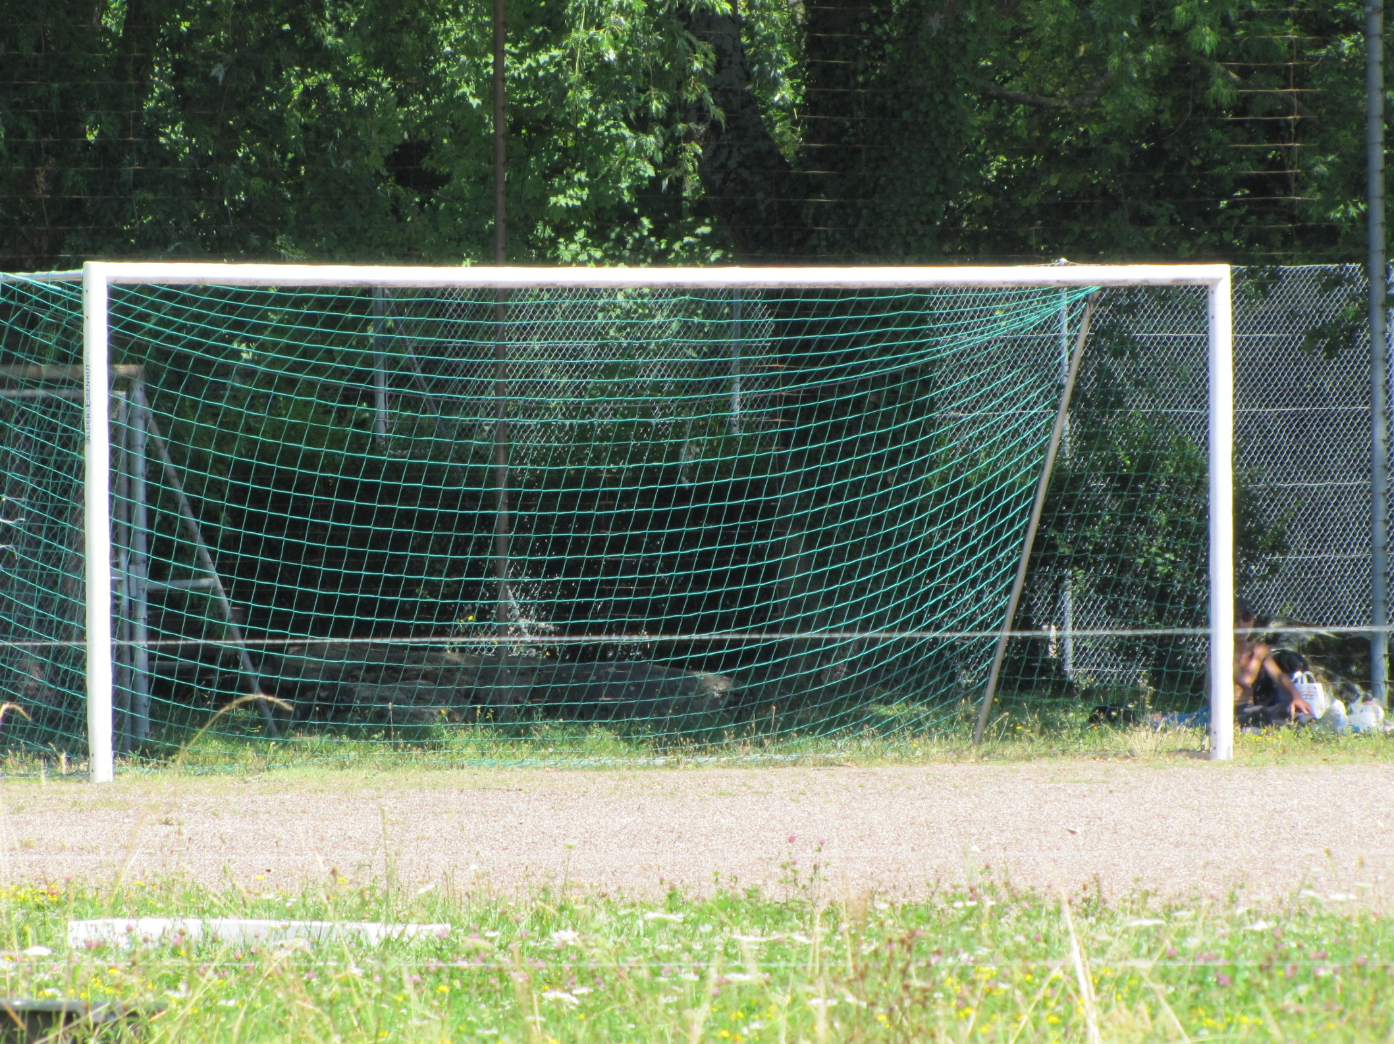
Grandad took the children to the park. He took Cumberland as well. The goals were very big. Cumberland looked lost in front of such a big goal.

Slide 9
The goal was too big. Scoring goals was too easy. It got boring. When the score was James 20 Fran 20, Grandad decided it was time to go back for lunch.
Score
20 – 20

Slide 10
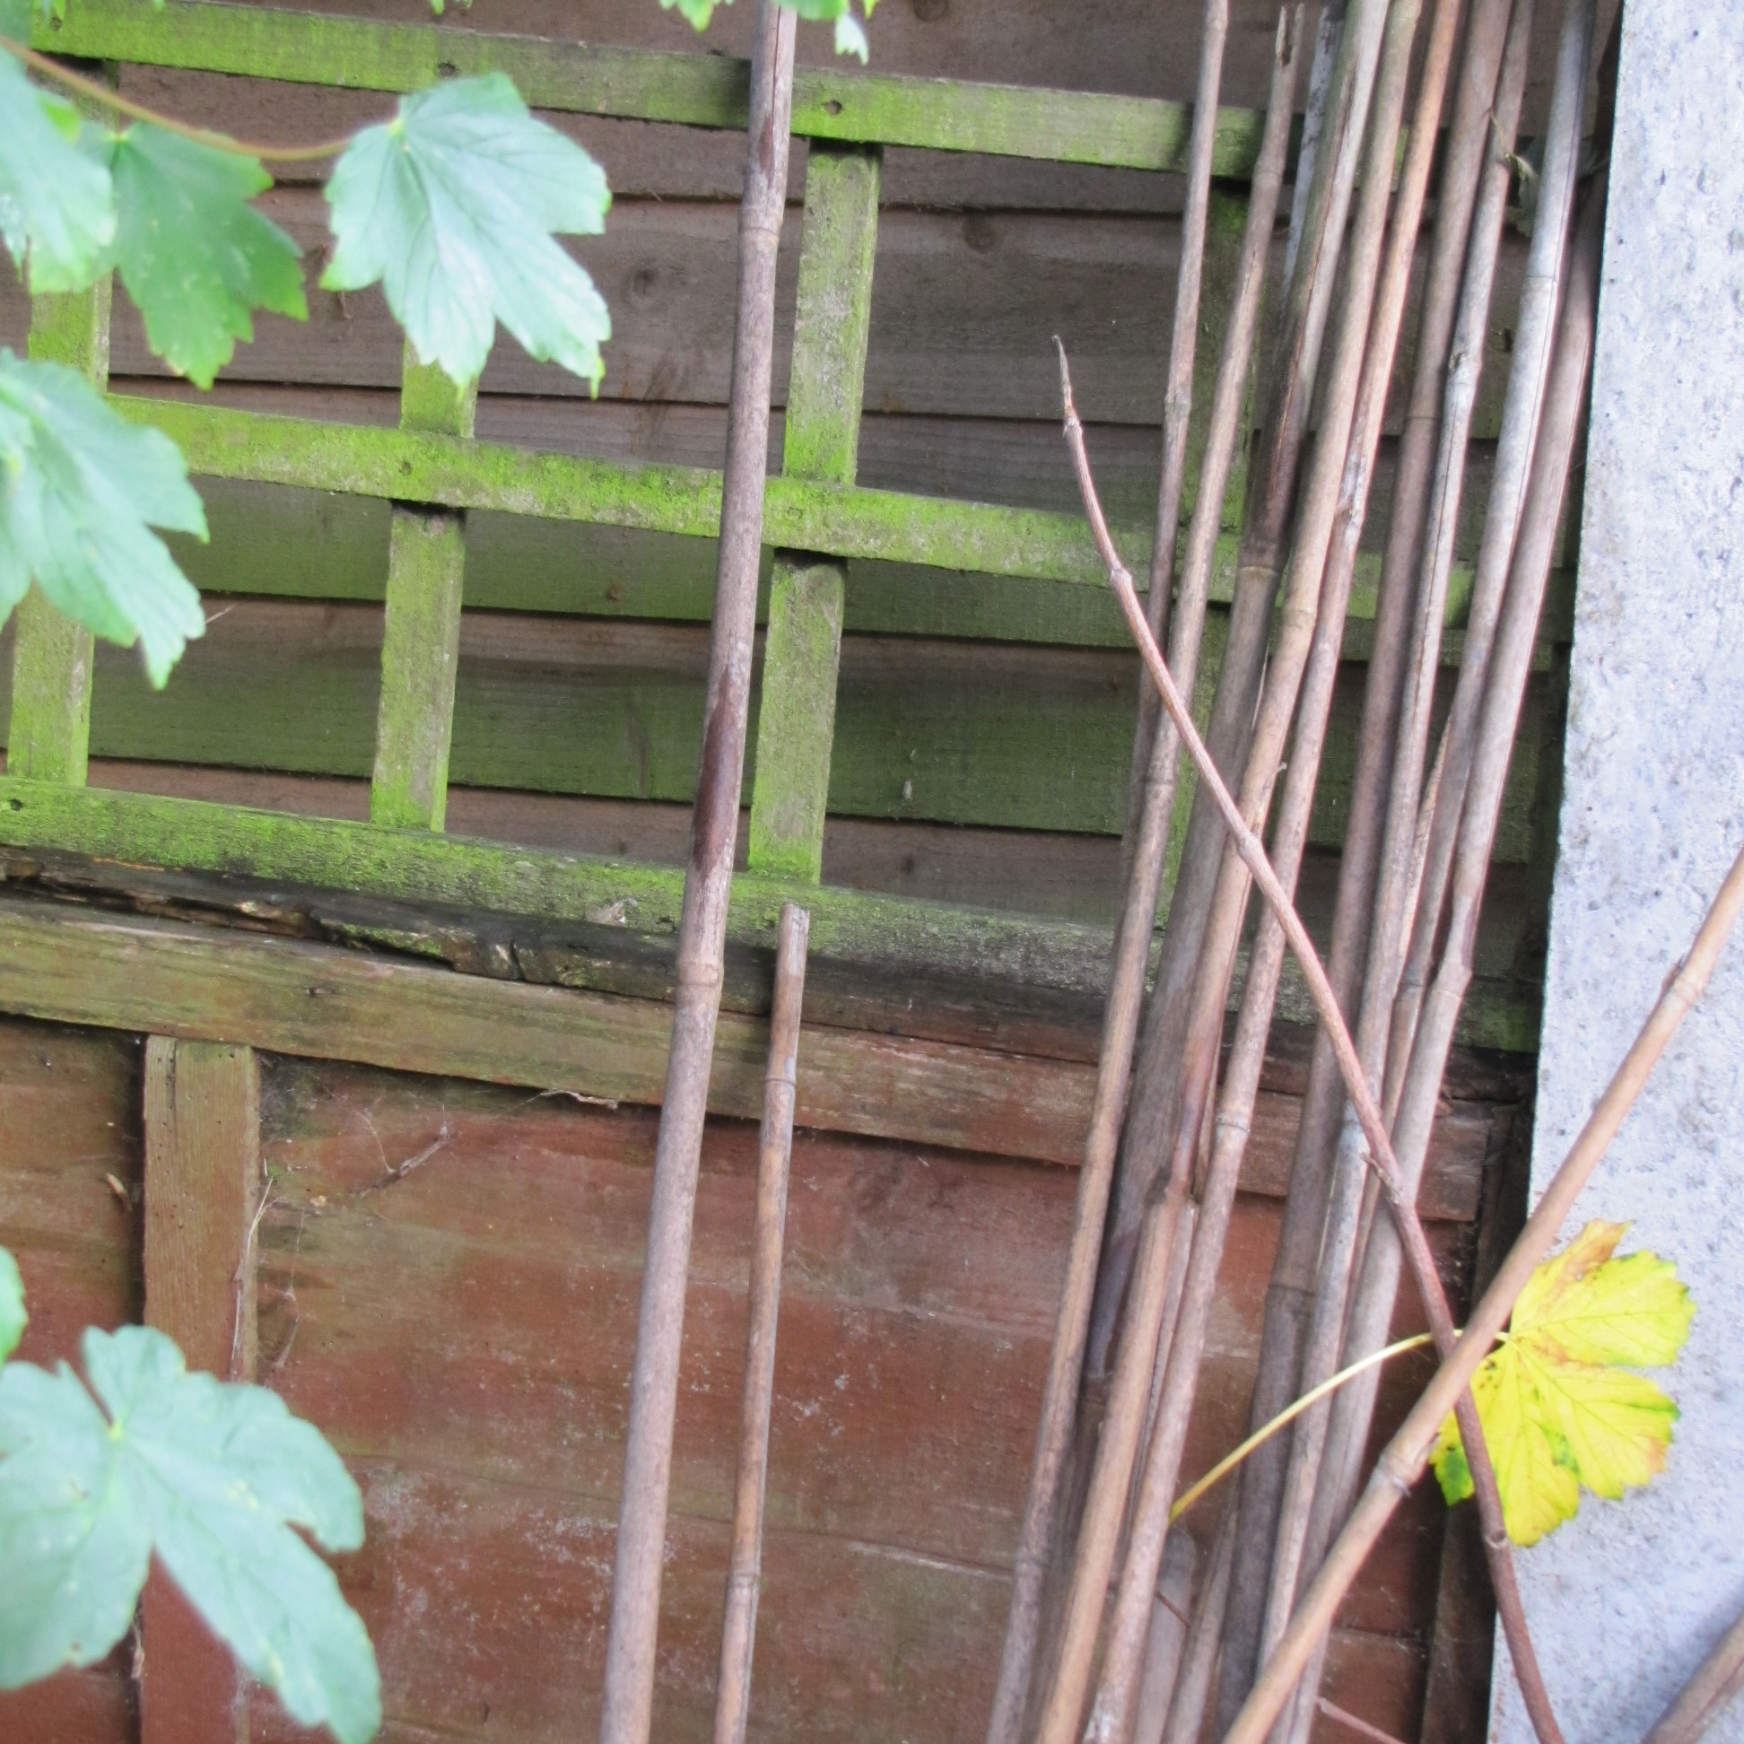
After lunch Grandad had a hunt in his shed and he found the frames that he used to grow peas in the summer. Then he took one of his bamboo poles and tied it to the frames.

Slide 11
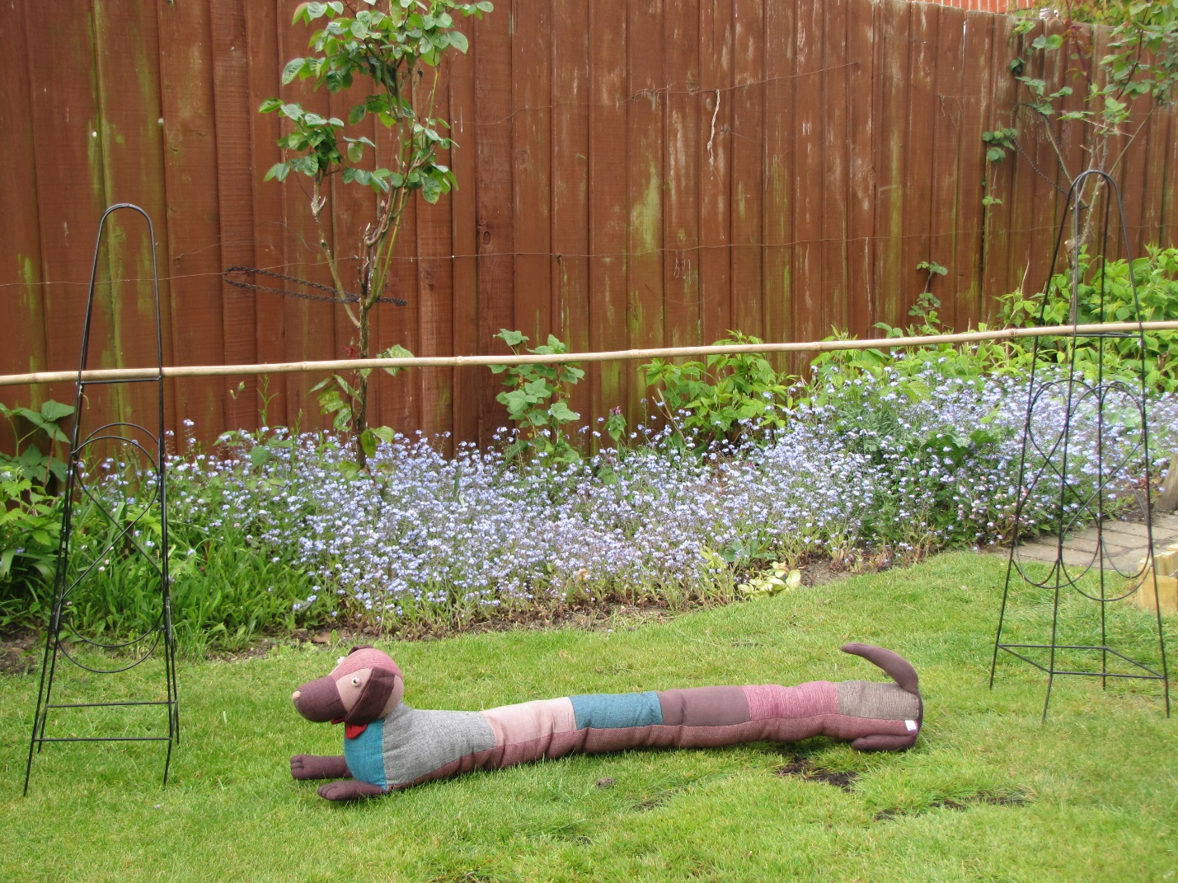
Grandad put the goal at the end of the garden with Cumberland in front of it. Cumberland wasn’t sure that he wanted to be in goal. The ball looked very big and wet. He thought it might be muddy.

Slide 12
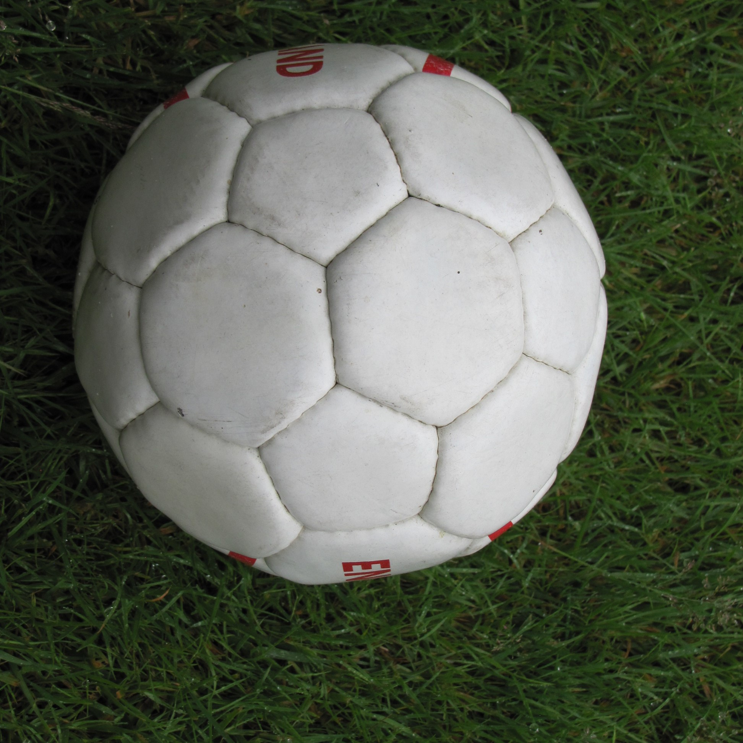
“Now, if the ball touches Cumberland, he has ‘saved’ it,” said Grandad, “If the ball knocks over the goal it is no goal.”

Slide 13
James, Fran and Grandad played football. It was hard to score a goal. James nearly scored but the ball hit Cumberland, so it was no goal. This happened quite a lot.

Slide 14
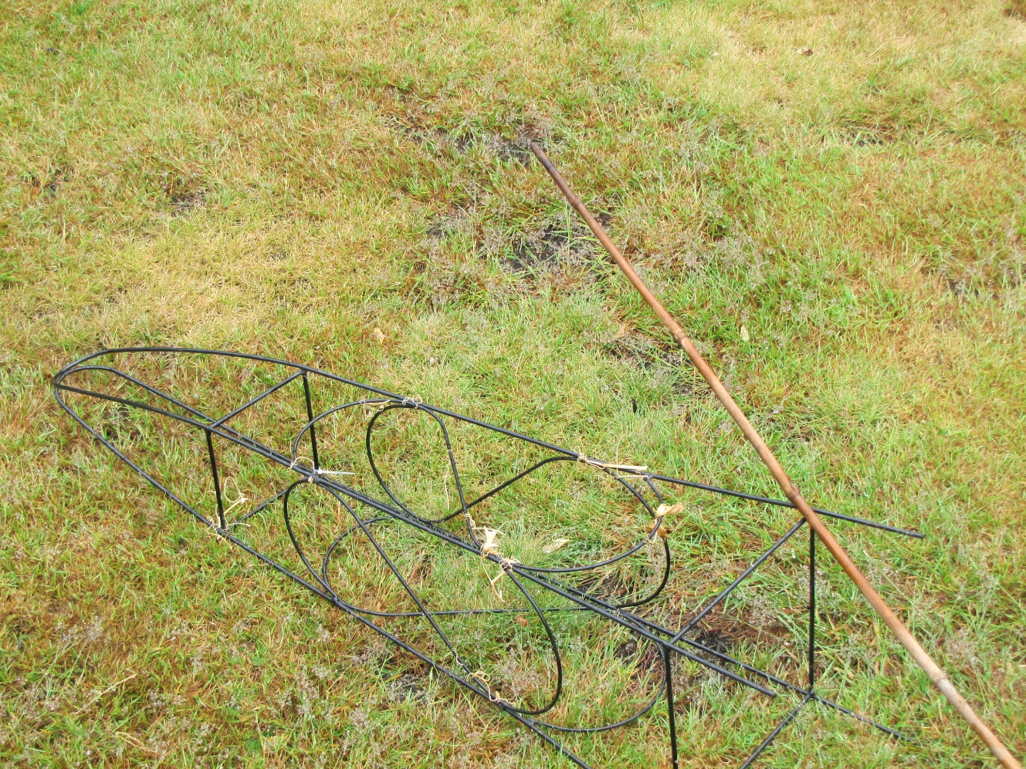
Grandad nearly scored but the goal fell over.

Slide 15
Fran kicked the ball up in the air. It went over Cumberland and into the goal. She had scored. She was winning.
GOAL!!!!

Slide 16
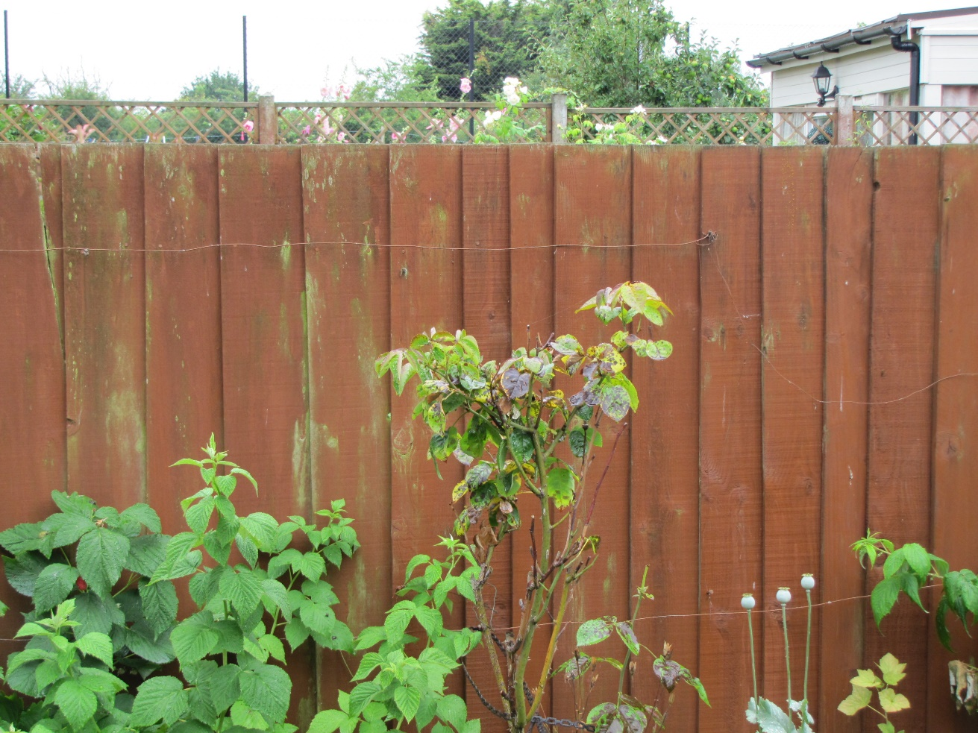
Granny was about to call them in for tea when Grandad kicked the ball too high. It went into the next-door garden. Granny said, “Oh, Grandad!” Grandad went to ask if he could have the ball back.

Slide 17
James said that this meant that they could not finish the game so it had to be a draw.
Score
Fran James Grandad
0 0

Slide 18
Fran thought that James was being annoying again. It had been a really good game so she did not complain. It would have been a shame to spoil a nice afternoon.
??!!!??
Unfair!
Boo!

Slide 19
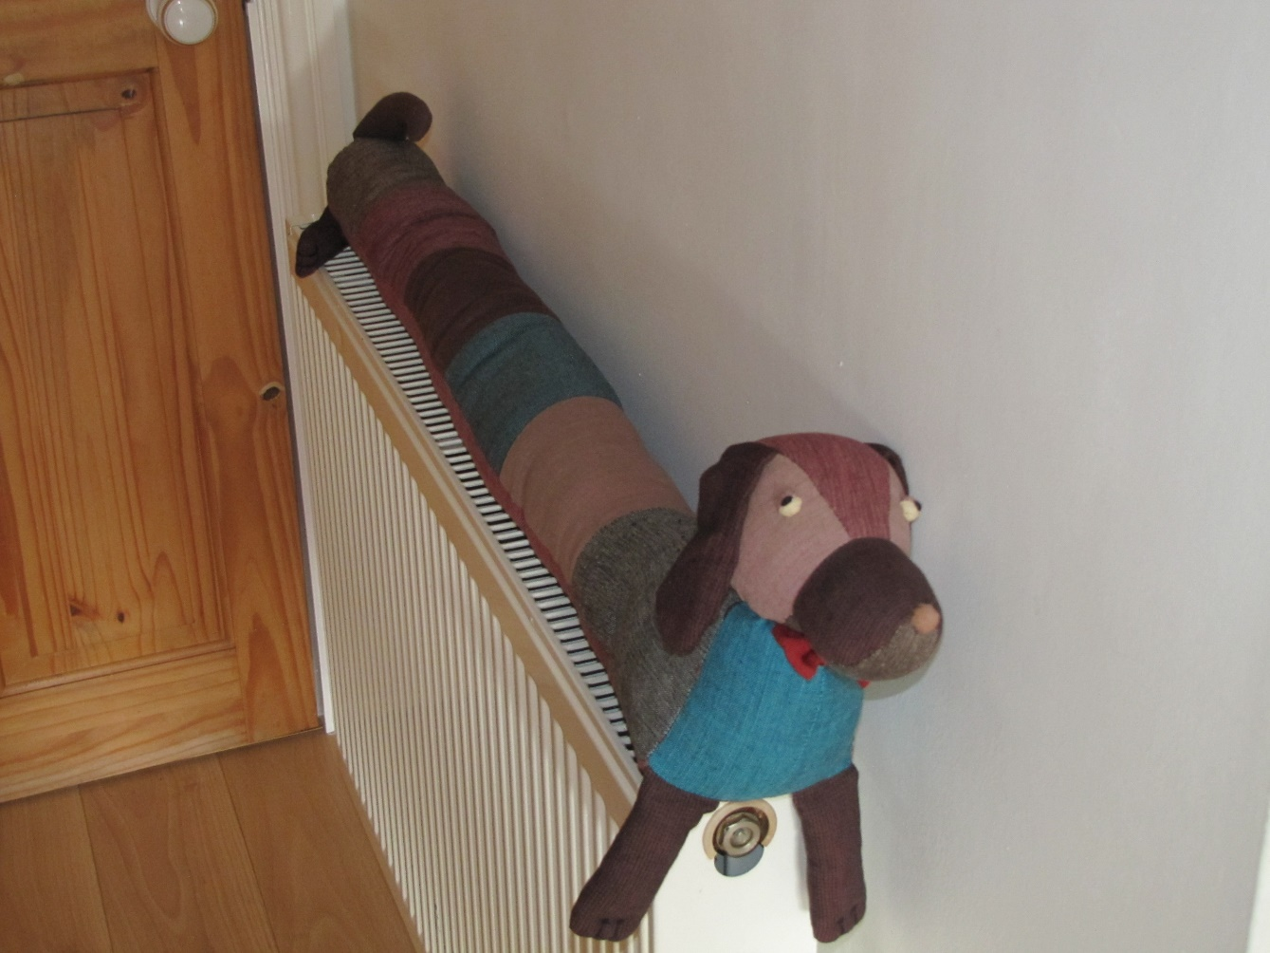
Granny said Cumberland had got damp spending all that time being in goal so she put him on the radiator.

Slide 20
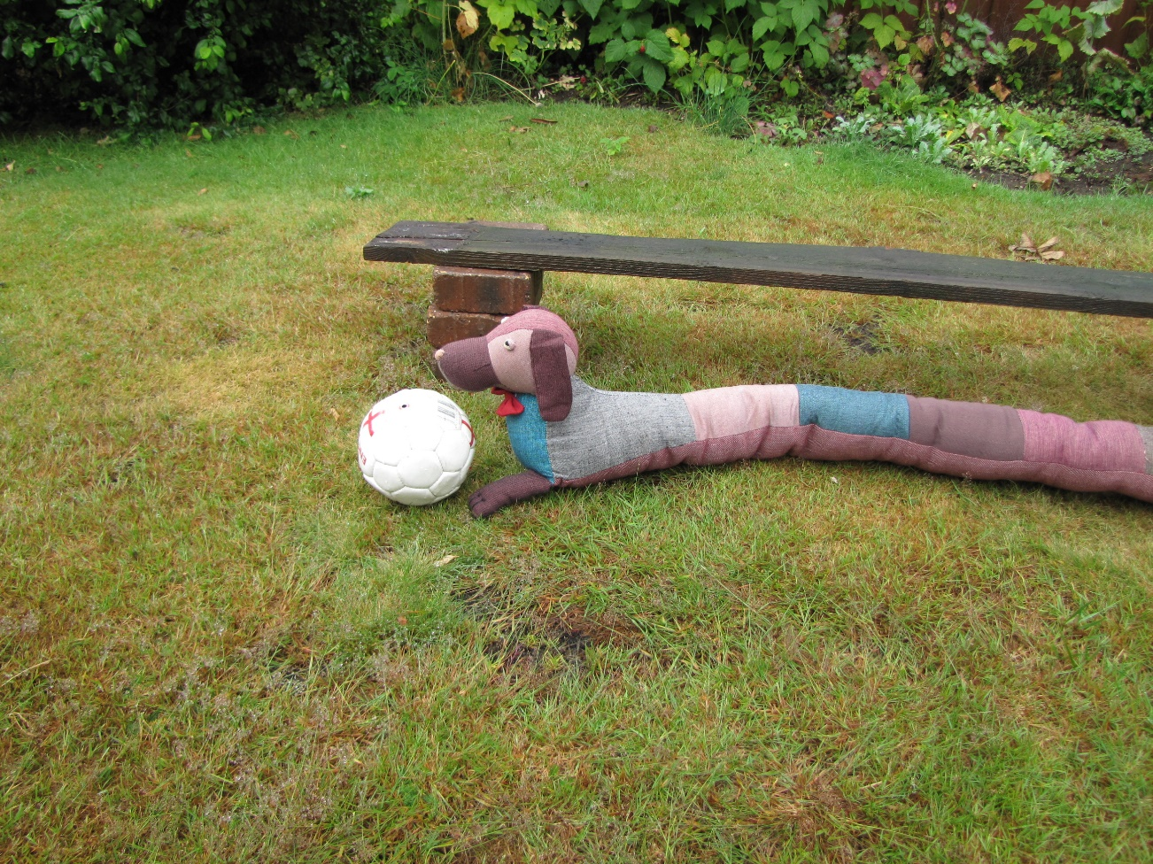
Everyone said that Cumberland was a good goal keeper. Cumberland wasn’t sure that he wanted to be a goal keeper, but was happy that people said that he had done well.

Slide 21
Cumberland was pleased that it had been a good day for his friend, Fran, but he was glad to be back by his door and away from the muddy football.

Slide 22
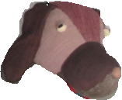
Notes for parents and teachers
Cumberland comes from a Fairtrade cooperative in Nepal and his journey to his
new home was enabled by Traidcraft plc
This book could be about fairness or about not spoiling a nice time by making a fuss. You
might want to talk about whether those hearing the story thought Fran was
right to let James say it was a draw. It might be about who should be the one to go in goal.
It could be about annoying older brothers or having a nice time with families. Better still it might be about whatever those who hear the story think it is about, but you will only
discover what children think it is about by talking with them.
This book is one of a series about Cumberland and his world that raise questions about,
love, joy, feeling alone, enjoying company, being sad and being happy.

Slide 23
Published 2018 in association with Bear Lands Publishing, St. Mary’s Centre, Llys Onnen, Abergwyngregyn, Gwynedd, LL33 0LD, Wales.
Copyright © 2018 David W Lankshear (text and illustrations).
David W Lankshear has asserted his right under the Copyright, Design and Patents Act 1988 to be identified as the author of this Work.
All rights reserved. No part of this publication may be reproduced, stored in a retrieval system, or transmitted, in any form or by any means, electronic, electrostatic, magnetic tape, mechanical, photocopying, recording or otherwise, without full acknowledgement of Bear Lands Publishing and copyright holders.
First published 2018

