Slide 1
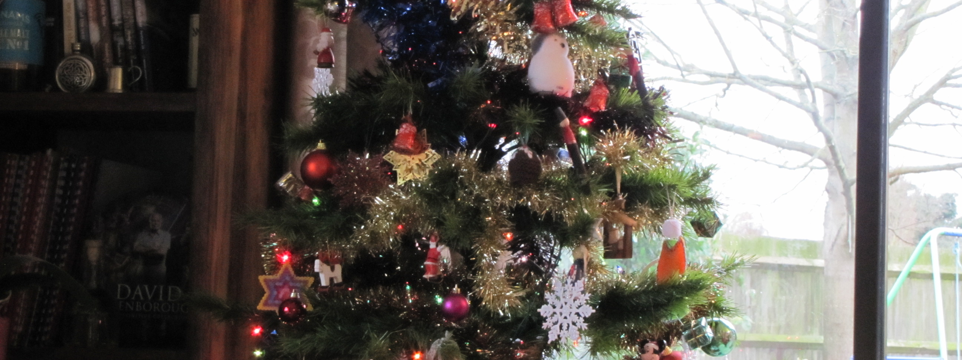
Cumberland at Christmas
By David W. Lankshear

Slide 2
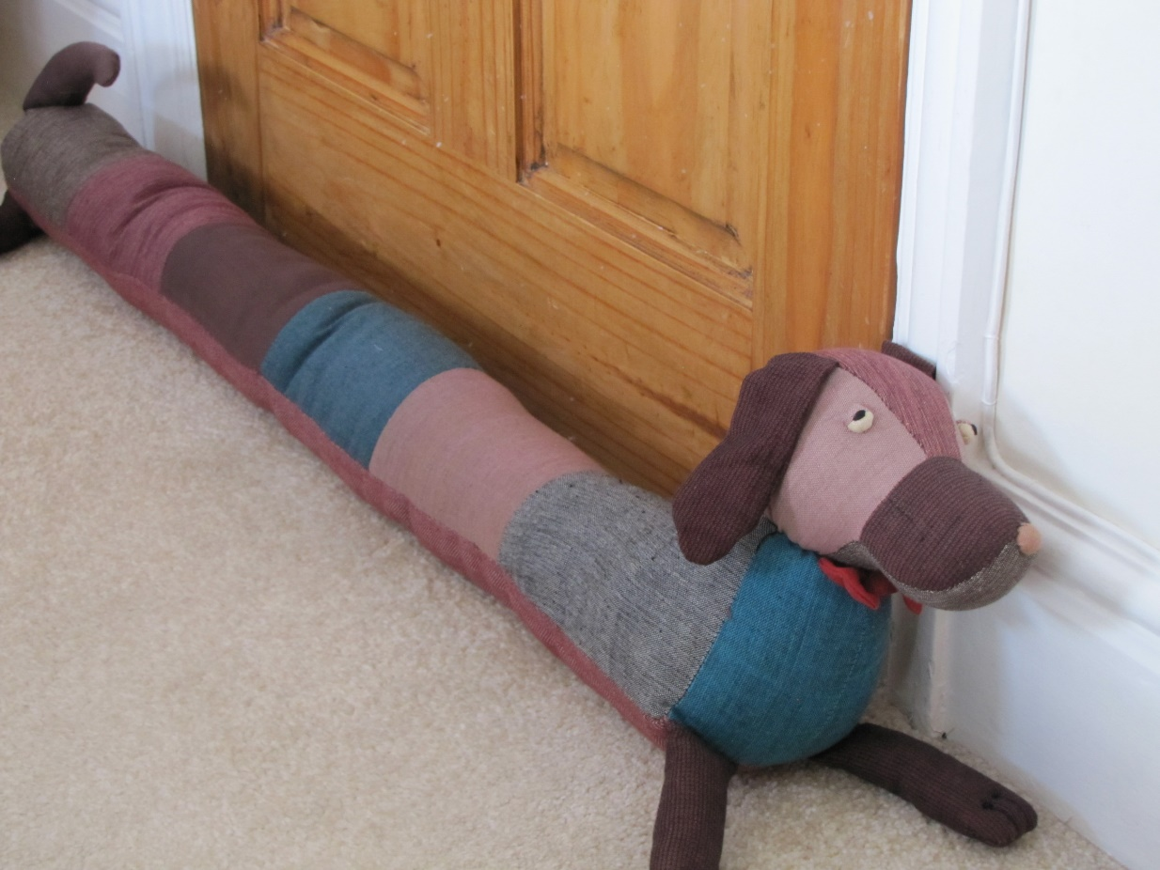
Granny said, “Perhaps we should take Cumberland with us when we go to see James and Fran at Christmas.” Cumberland was not sure that he wanted to visit Fran’s house, but he liked being with Fran.

Slide 3
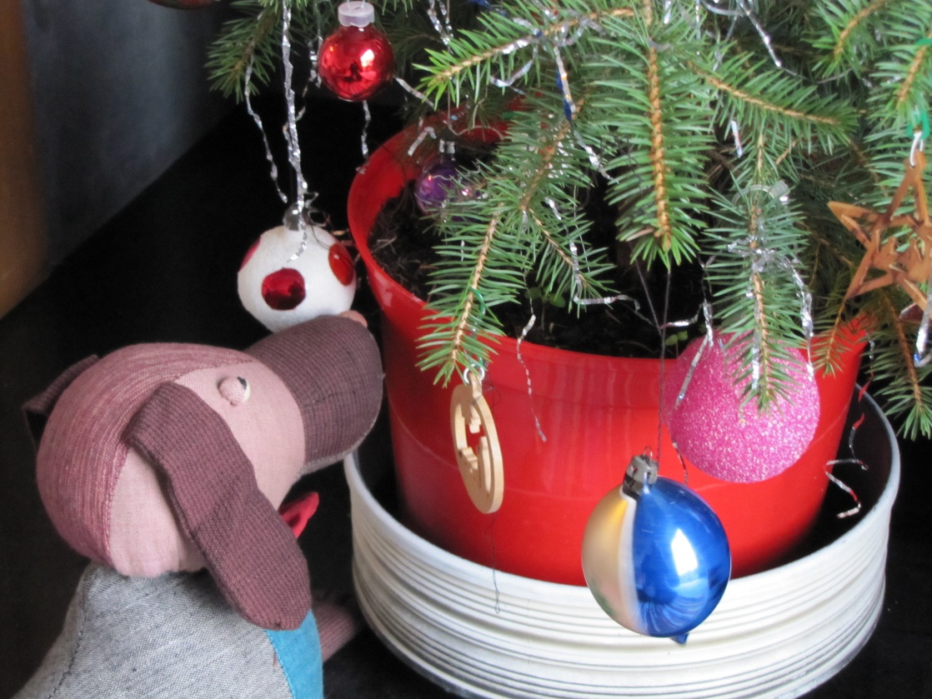
Cumberland was not sure what Christmas was all about. He wondered if it was something to do with the little tree with decorations that was in the front room.

Slide 4
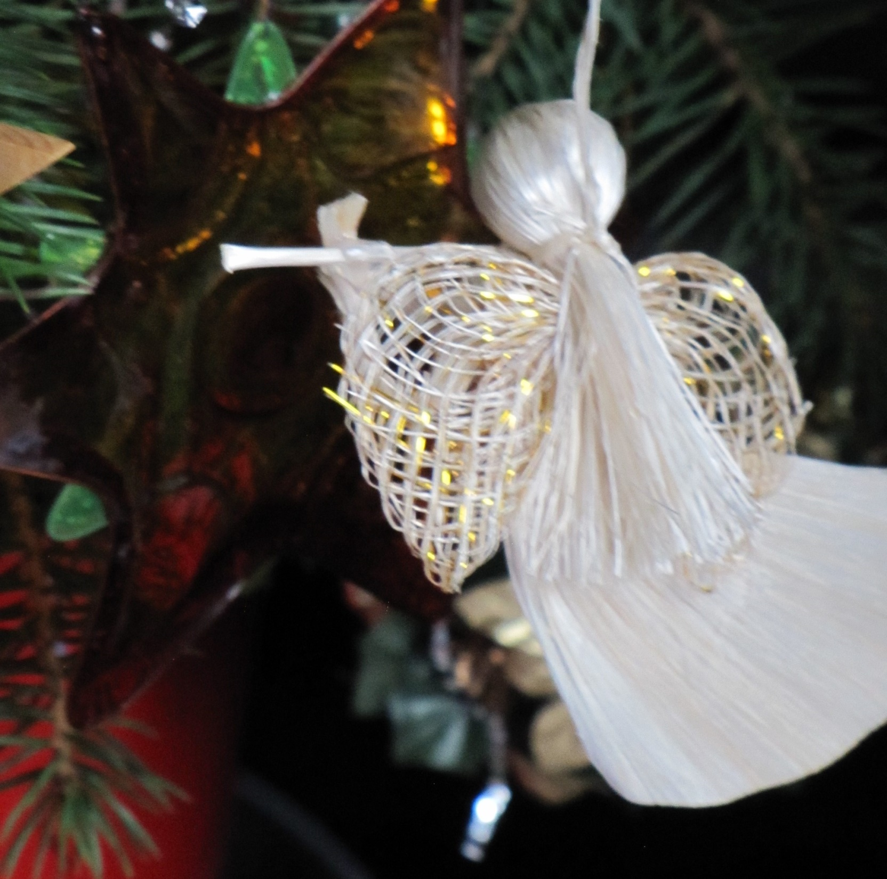
Some of the decorations were in special shapes. This one looked like a person, but Cumberland had never seen a person with wings before.

Slide 5
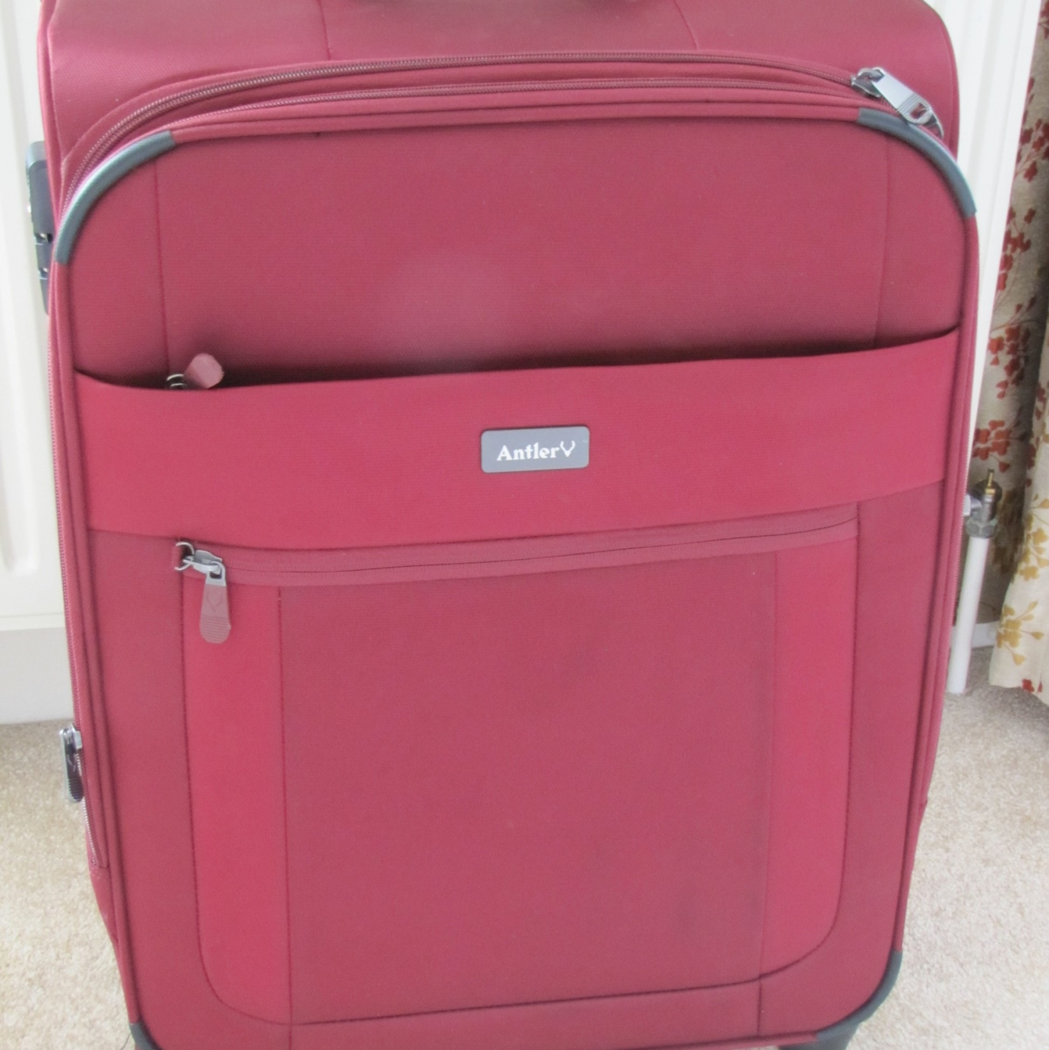
Suitcases were packed. Then everyone, including Cumberland, got into Grandad’s car. They drove a long way until they got to the house where Fran and James lived.

Slide 6
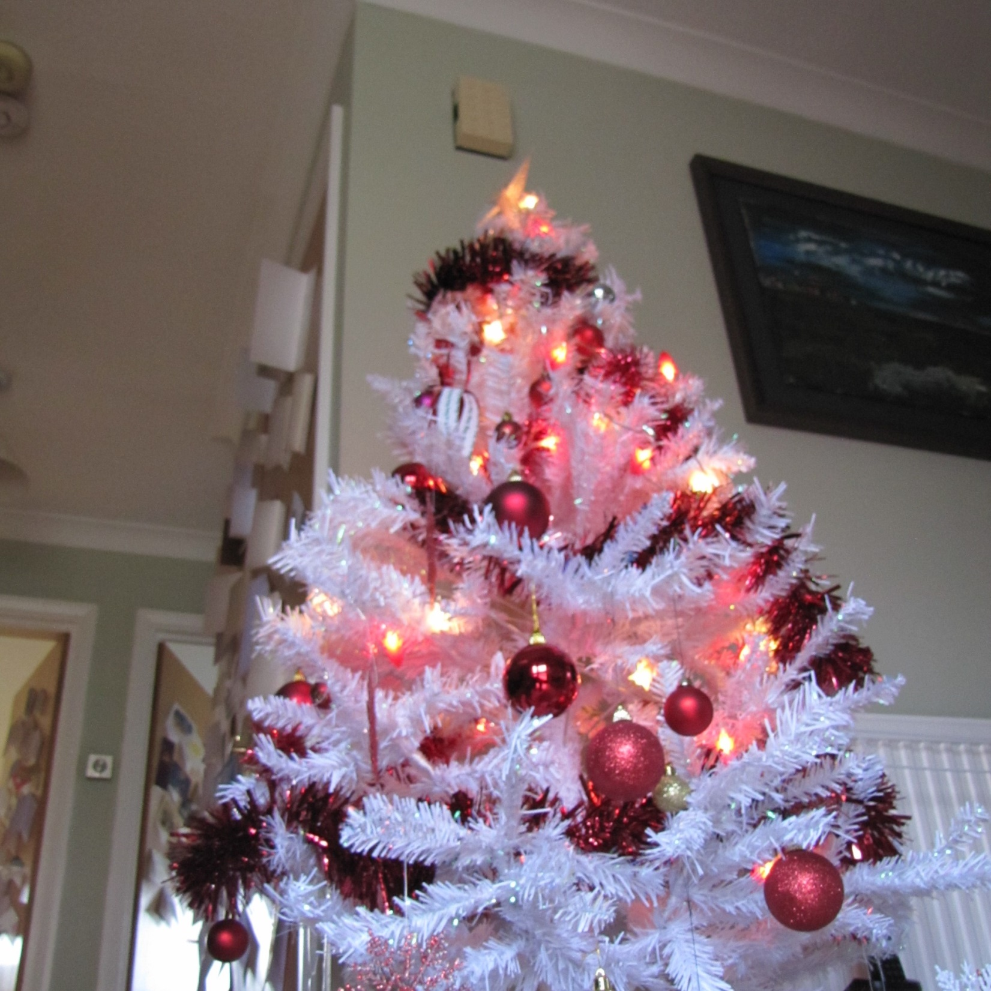
The first thing that Cumberland saw when they got to Fran’s house was another tree. This one was white with red decorations. It seemed strange to Cumberland, but everything seemed strange here.

Slide 7
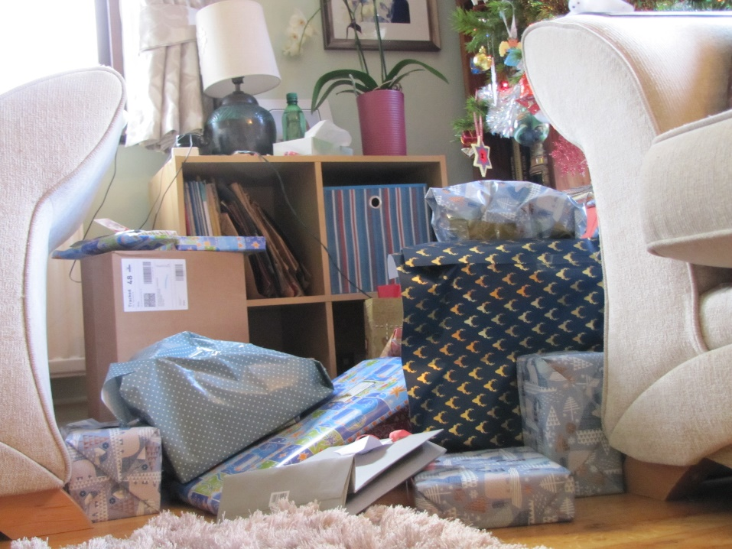
When they got into the sitting room there were parcels stacked beneath another tree. This one looked like the tree at Cumberland’s home , but it was much bigger. What was going on?

Slide 8
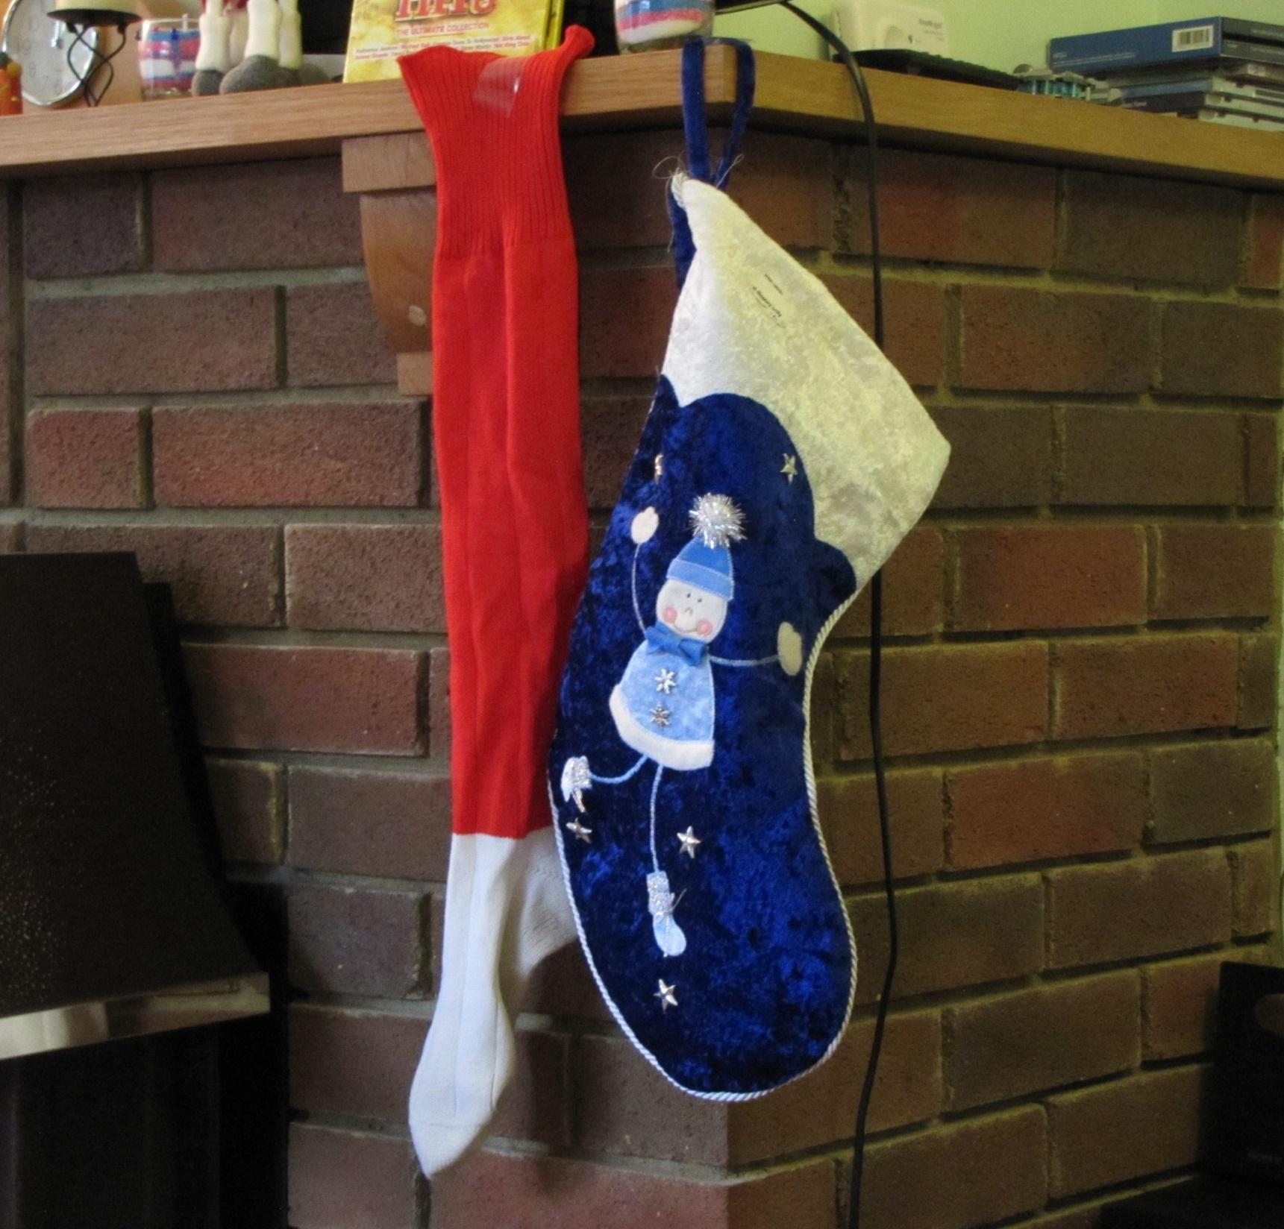
There were socks and sacks hung up on the mantlepiece. Granny said these red socks used to belong to Grandad when he played rugby. What was going on?

Slide 9
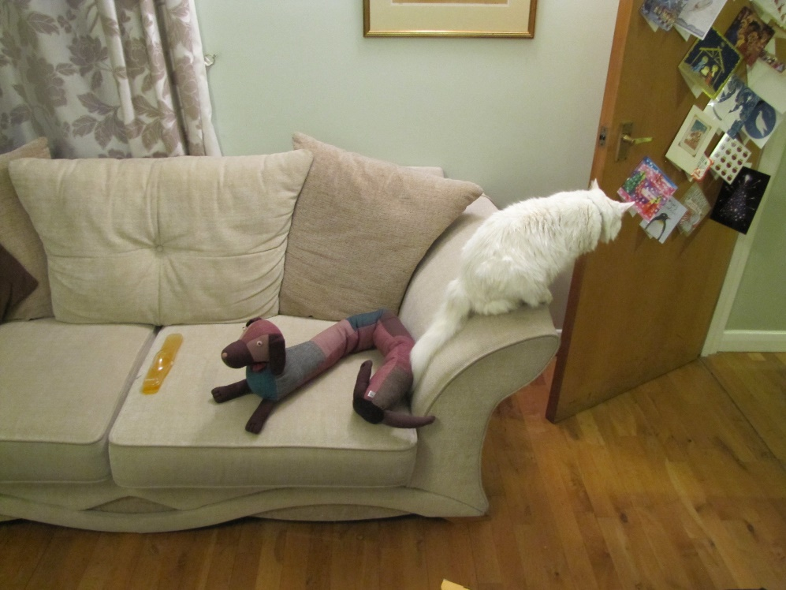
A cat called ‘Ben’ lived at Fran’s house. He did not want to be friends with Cumberland. He would not talk to him. Cumberland felt quite lonely.

Slide 10
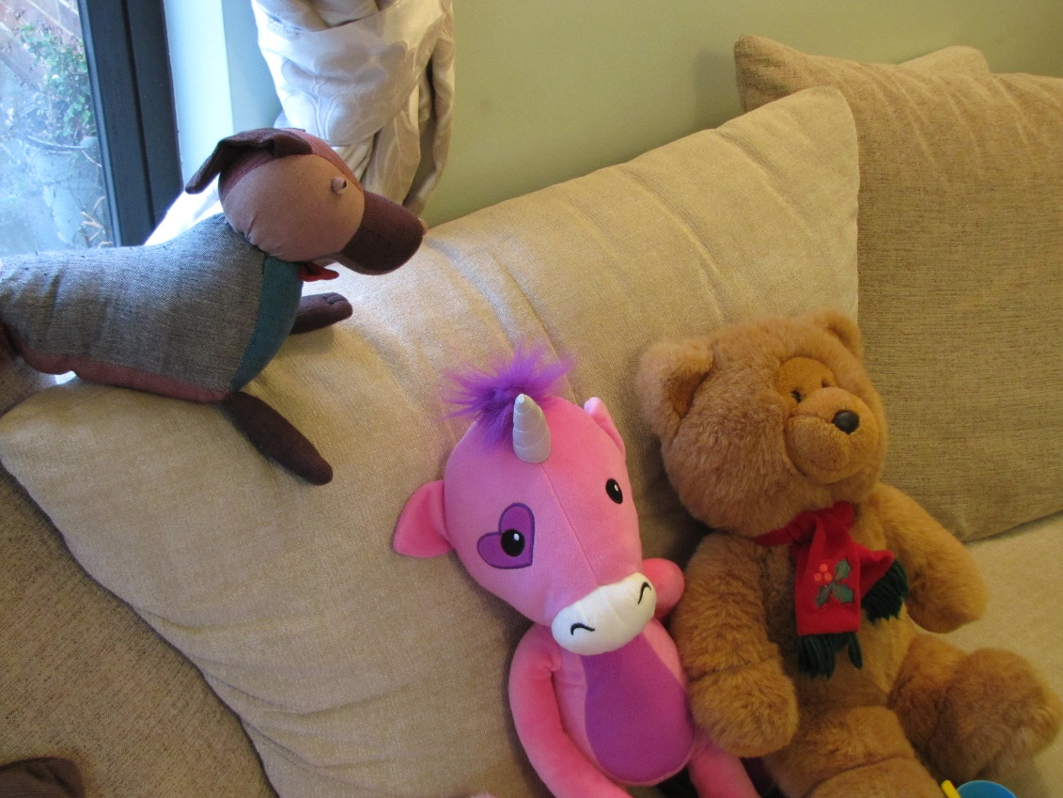
Cumberland met some more of Fran’s friends. They were not very friendly either. The Bear and the Unicorn just sat together on the sofa and talked to each other.

Slide 11
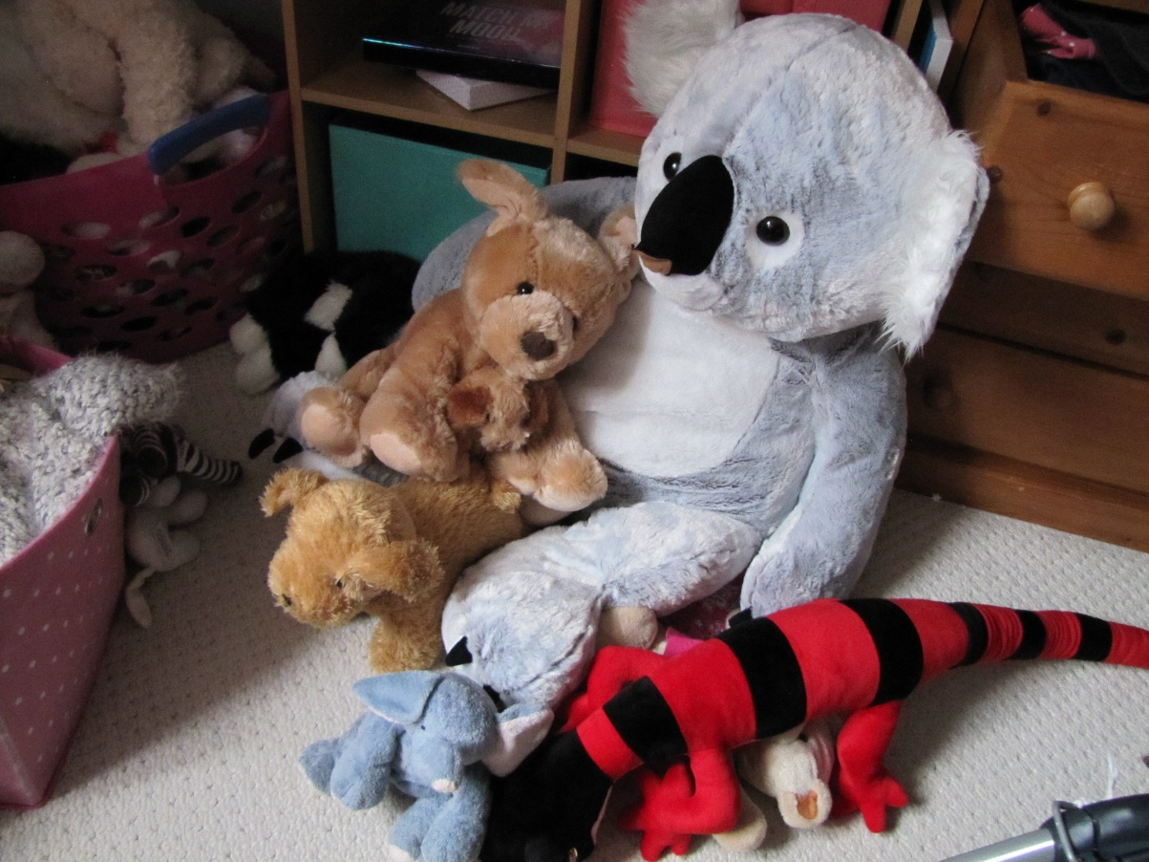
The big Koala, the little bear and the little dog were having a cuddle together. None of them wanted to talk to Cumberland either.

Slide 12
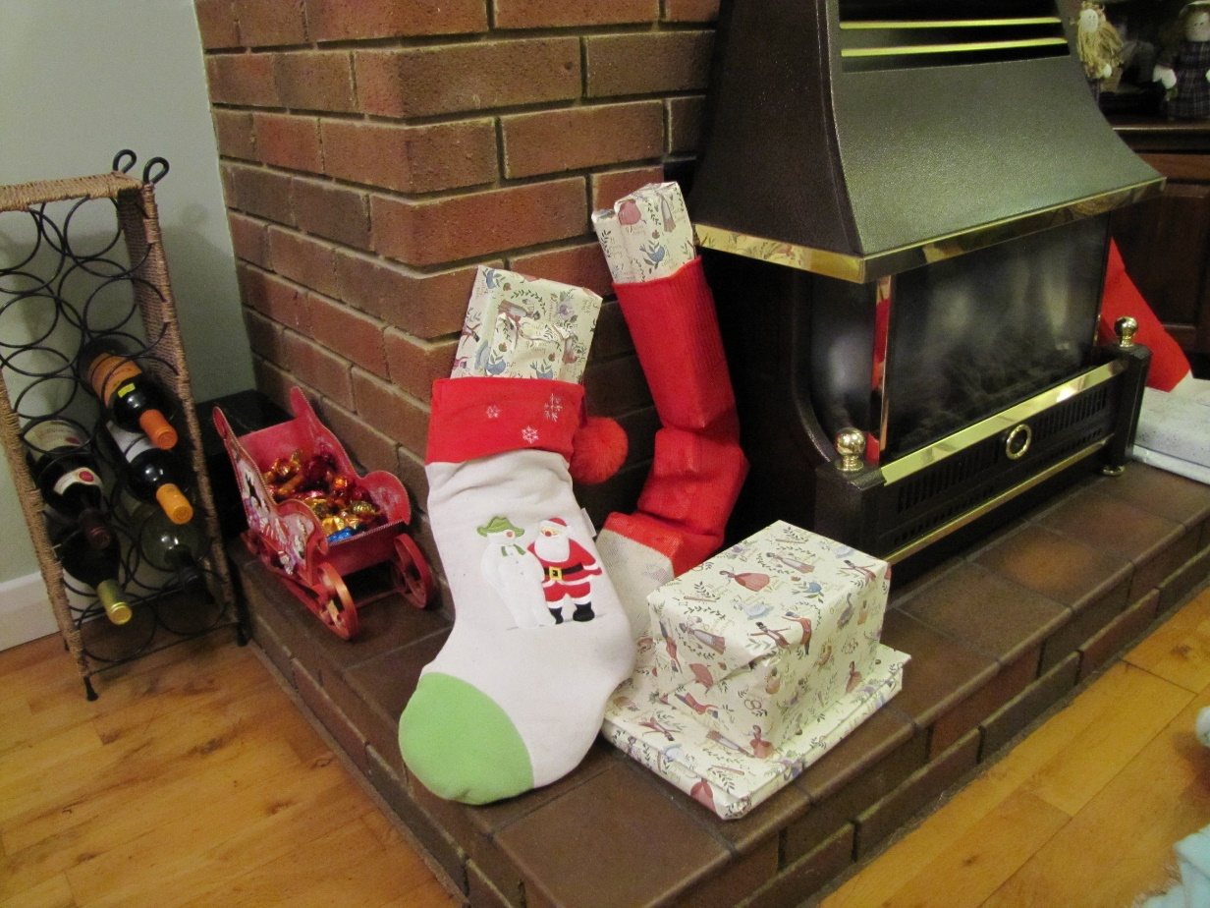
Next morning everyone got up very early and discovered that the socks and sacks were full of parcels.

Slide 13
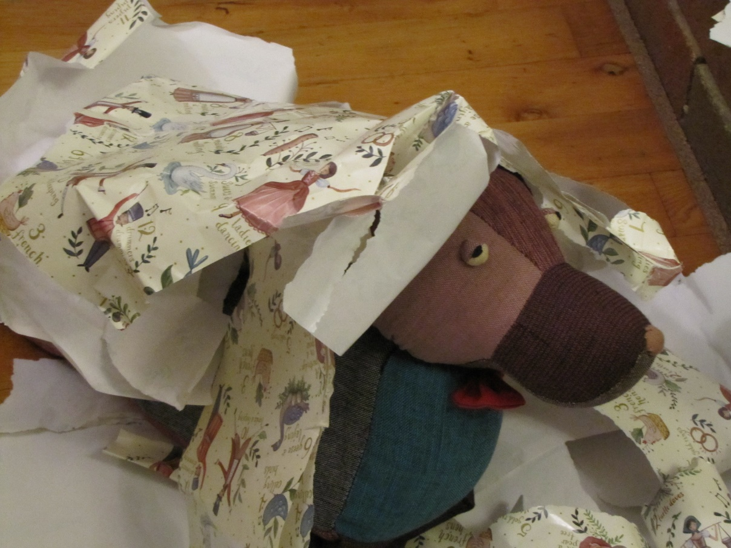
James and Fran opened their parcels very quickly. Paper went everywhere. Some fell on Cumberland.

Slide 14
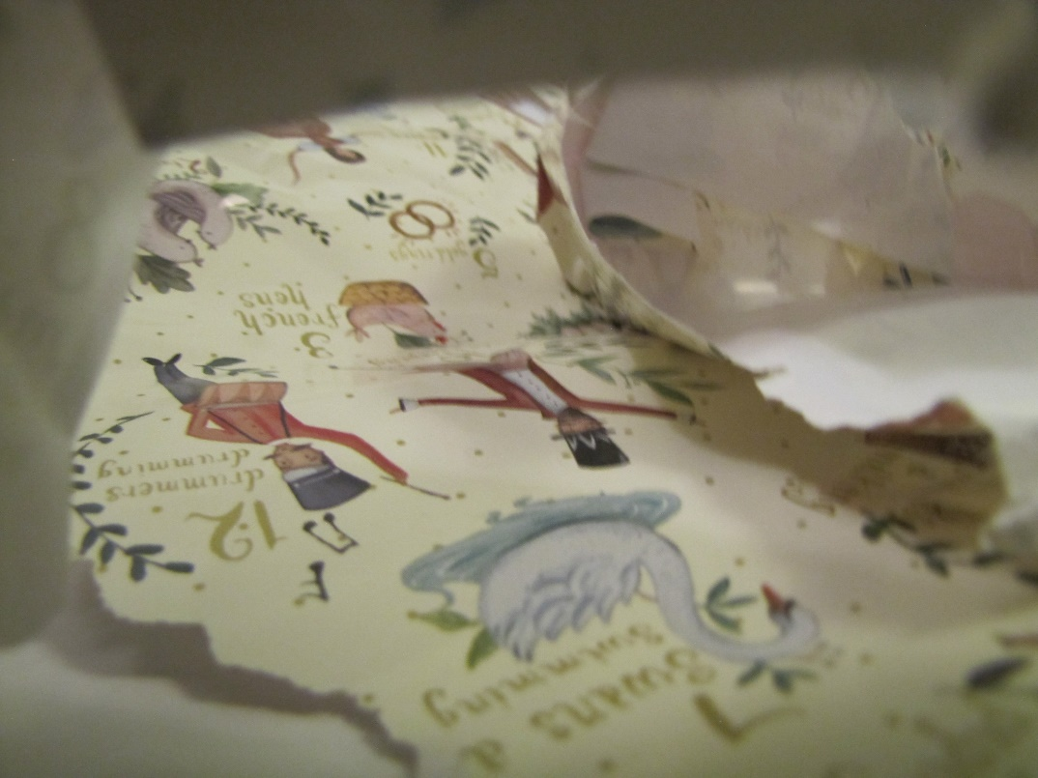
For a while all he could see was bits of paper!

Slide 15
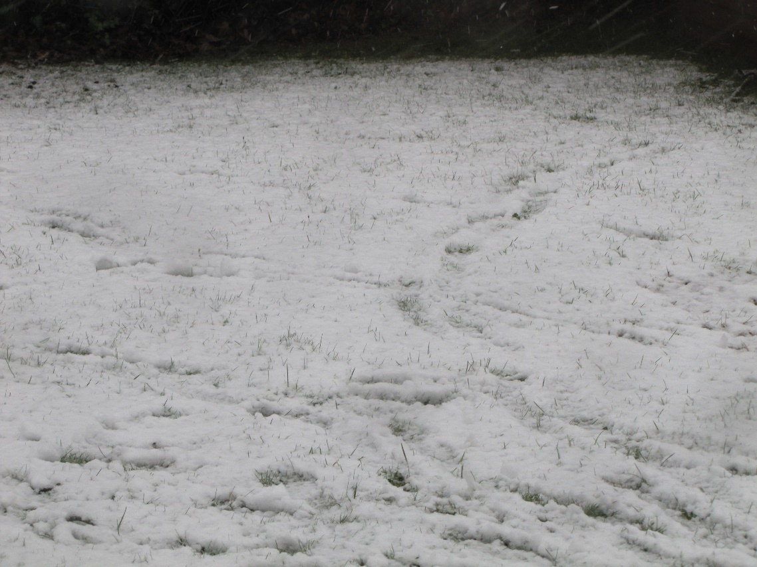
Then it started to snow. After breakfast James and Fran went out and had fun in the snow. They seemed very excited.

Slide 16
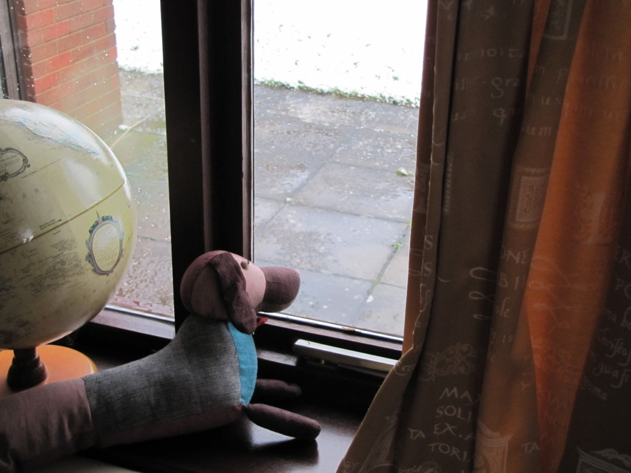
Cumberland decided he preferred to be inside. If Fran had taken him outside, she might have left him there and the snow looked quite cold and wet. He did not want to be left in the snow.

Slide 17
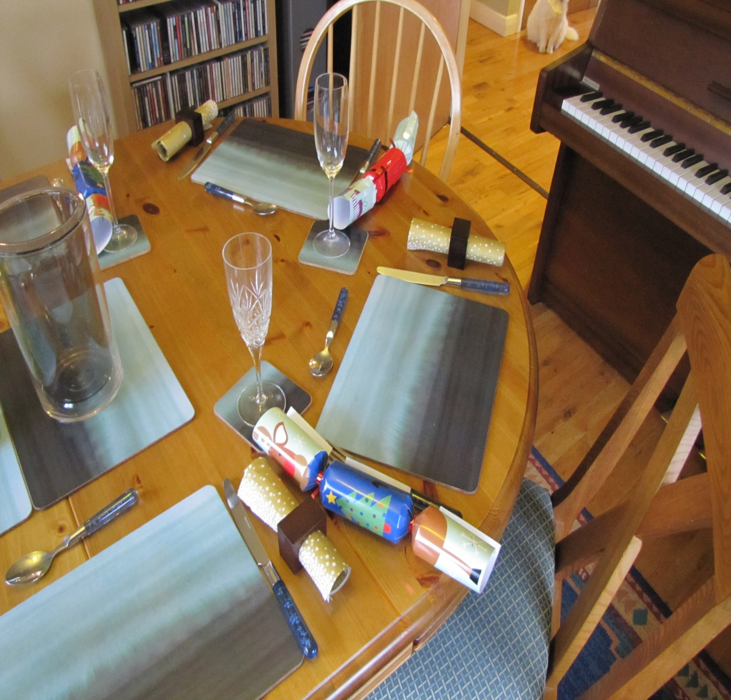
When Fran and James came in from the snow, everyone had a big lunch. It took a long time. Cumberland sat and watched them all eat.

Slide 18
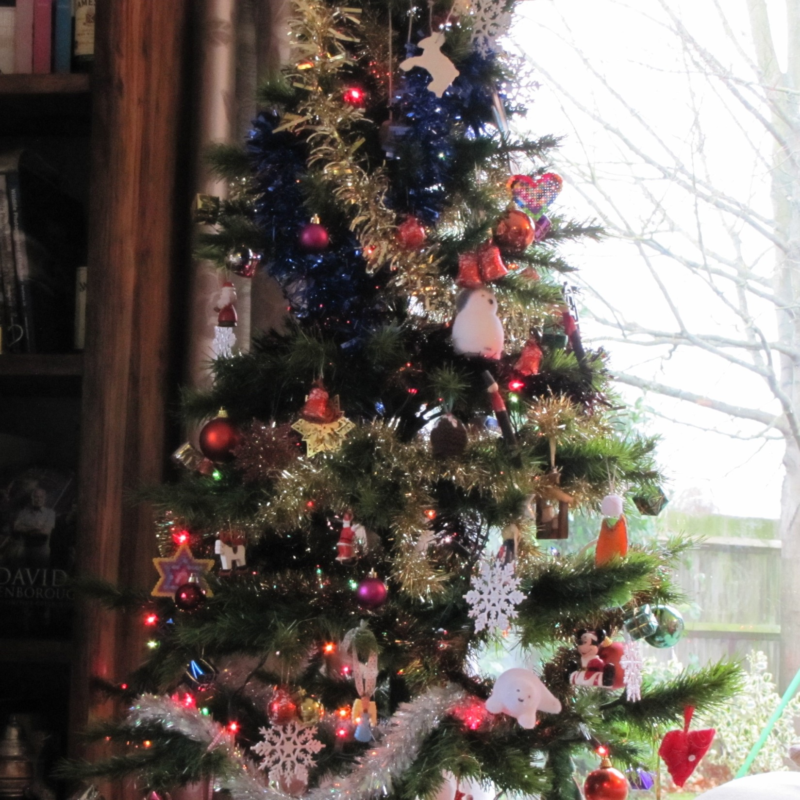
After lunch there were the presents under the tree to open. None of them were for Cumberland.

Slide 19
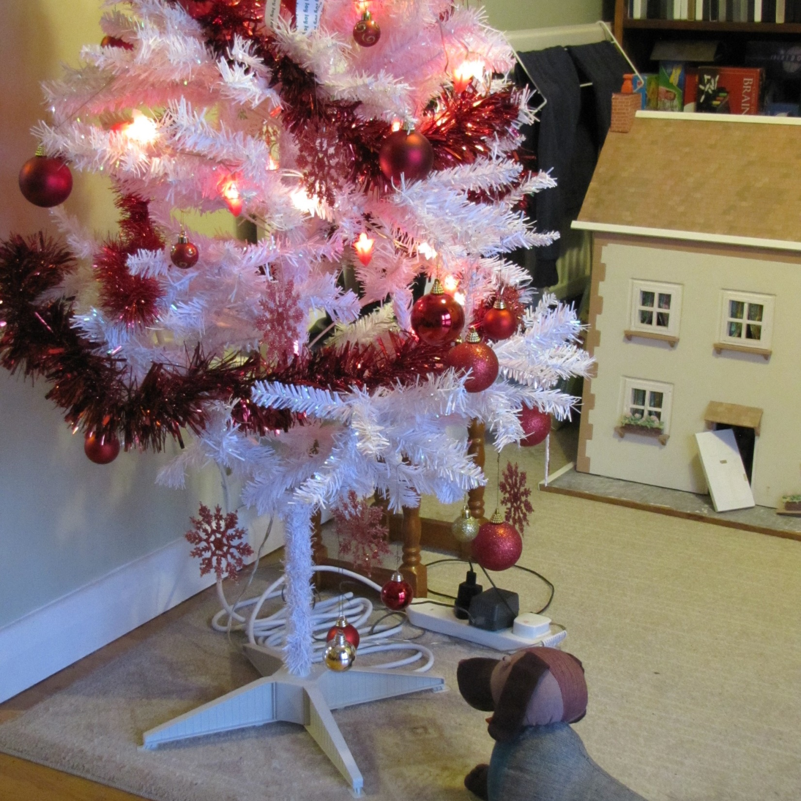
Soon it was time for Granny and Grandad to go home. Cumberland had a last look at the white tree in the hall. Then it was back in Grandad’s car.

Slide 20
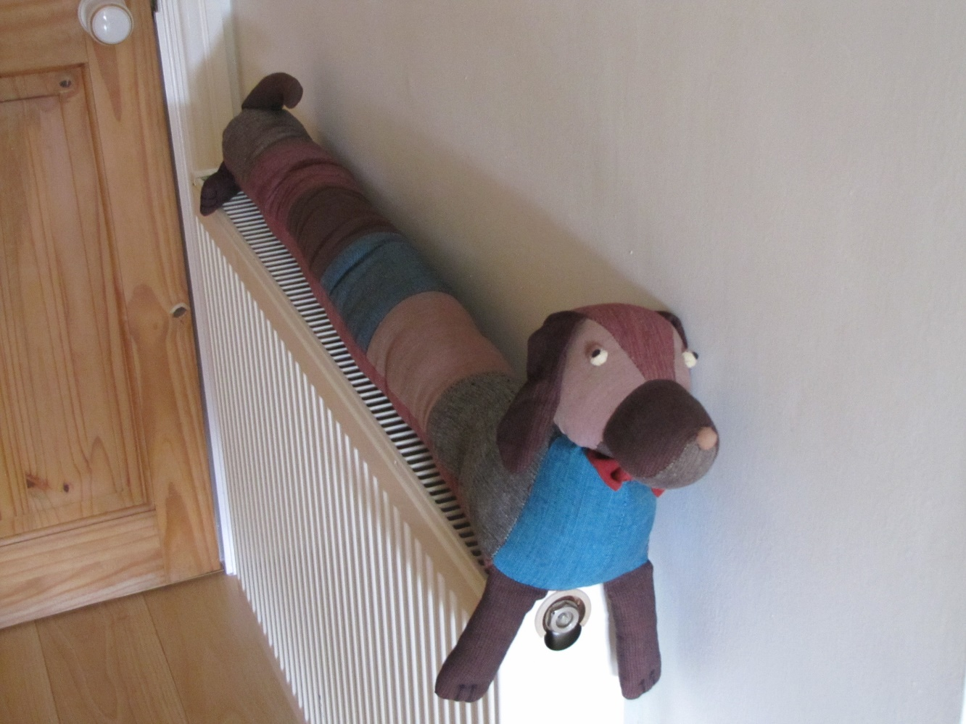
Cumberland was glad to be home. He was very glad that Granny had put him on his radiator so that he cold warm up, because he had been quite cold in the car.

Slide 21
It had been interesting visiting Fran but he had felt lonely. Cumberland decided that he preferred it when Fran visited him at his house.

Slide 22
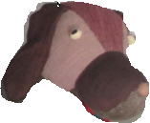
Notes for parents and teachers
Cumberland comes from a Fairtrade cooperative in Nepal and his journey to his new home was enabled by Traidcraft plc.
This book could be about feeling left out. It could present opportunities to talk about
Christmas and the family traditions that form part of the festival.
It could be about the differences between meeting people in your own home or going to
visit them in theirs. Better still it might be about whatever those who hear the story think it is about, but you will only discover what children think it is about by talking with them.
This book is one of a series about Cumberland and his world that raise questions about,
love, joy, feeling alone, enjoying company, being sad and being happy.

Slide 23
Published 2018 in association with Bear Lands Publishing, St. Mary’s Centre, Llys Onnen, Abergwyngregyn, Gwynedd, LL33 0LD, Wales.
Copyright © 2018 David W Lankshear (text and illustrations).
David W Lankshear has asserted his right under the Copyright, Design and Patents Act 1988 to be identified as the author of this Work.
All rights reserved. No part of this publication may be reproduced, stored in a retrieval system, or transmitted, in any form or by any means, electronic, electrostatic, magnetic tape, mechanical, photocopying, recording or otherwise, without full acknowledgement of Bear Lands Publishing and copyright holders.
First published 2018

