Slide 1
Cumberland and the unhappy day
By David W. Lankshear

Slide 2
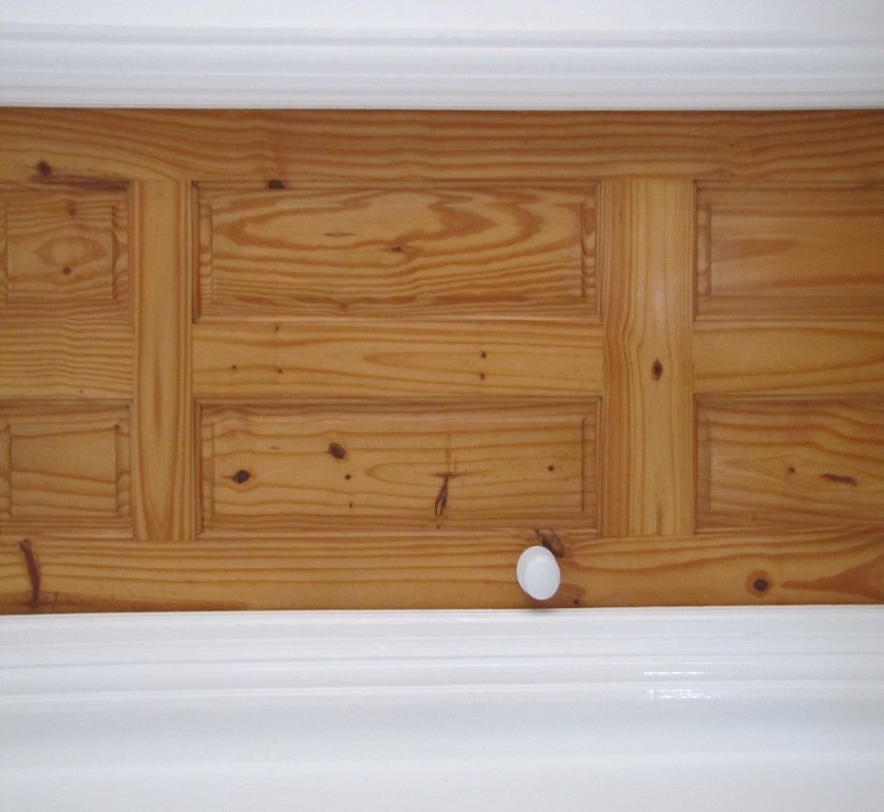
No horrid brothers allowed – James this means you!
James was being horrid not just annoying, but really horrid. Fran went into the bedroom where she slept in Granny and Grandad’s house. She shut the door and put a notice on it.

Slide 3
James was being so horrid he thought about putting Cumberland in the washing machine and sending him for a spin.

Slide 4
But instead of that he picked up Cumberland and threaded him through the bannisters. Cumberland felt uncomfortable and he looked silly.

Slide 5
Granny said, “James that is being silly. Put Cumberland back where he belongs. Call Fran down for a drink.” James put Cumberland back and whispered the message so Fran would not hear.

Slide 6
Later Fran came down stairs and picked up Cumberland to give him a hug. James grabbed Cumberland’s tail. Soon there was a tug of war with Cumberland as the rope.

Slide 7
Cumberland’s body became very tight. Suddenly there was a ripping sound. “What was that?” called Granny. Fran and James put Cumberland down.

Slide 8
Some of Cumberland’s stuffing had come out. Granny came into the room. She was very cross.

Slide 9
Granny pushed the stuffing back and wrapped a bandage round Cumberland to keep him safe. She sent James and Fran to their rooms.

Slide 10
James was still angry. James saw Grandad in the garden fetching logs from his log pile. James banged on the window and shouted to get Grandad’s attention.

Slide 11
Grandad heard the noise from the garden. He stopped what he was doing and put the chainsaw down carefully.

Slide 12
Grandad came upstairs and had a long talk with James. James told Grandad why he was so unhappy and cross. Grandad said he would make sure that things were put right.

Slide 13
James went to Granny and said he was sorry. Granny had sewn Cumberland back together while James had been talking to Grandad.

Slide 14
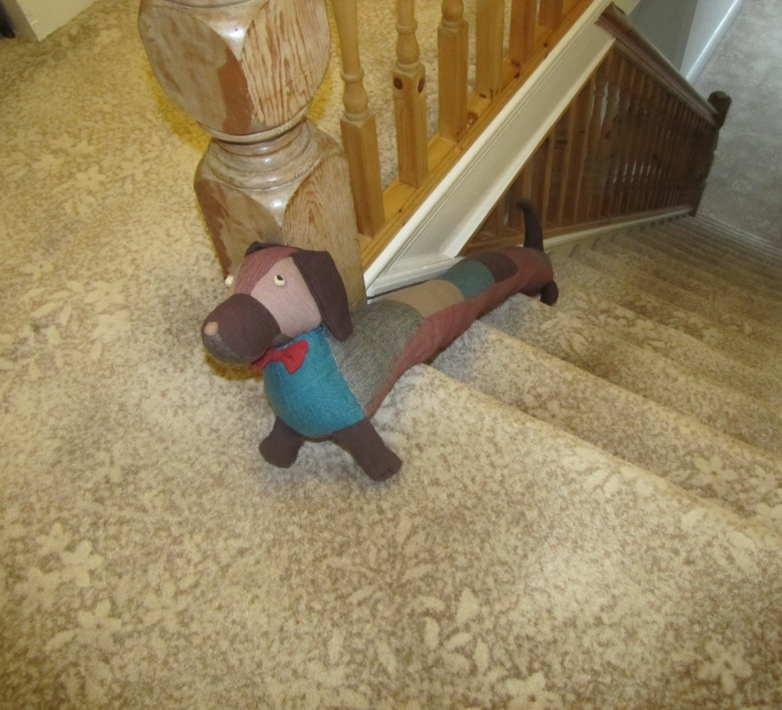
James took Cumberland upstairs to Fran and explained what had happened. He said he was sorry that he had got her into trouble.

Slide 15
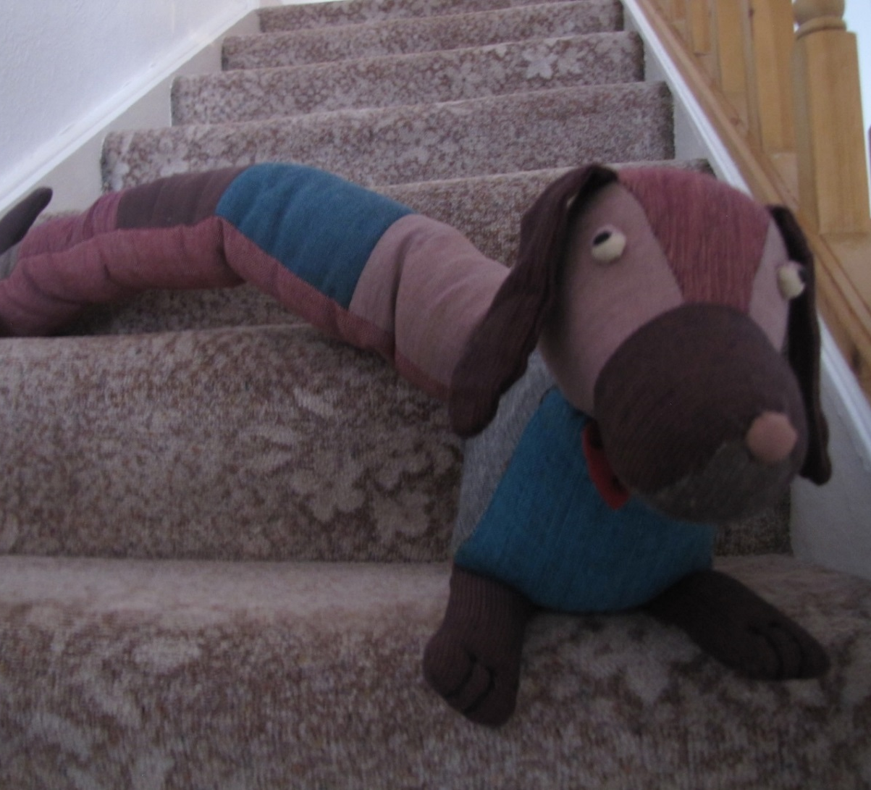
They all went back downstairs and helped Granny get lunch ready. Grandad tidied his chain saw away.

Slide 16
In the afternoon, they had a game of Monopoly. Granny’s set is very old. It is nearly as old as Granny.

Slide 17
Cumberland did not understand the game. The rules seemed complicated, but he could see that Fran and James were happy. He was pleased about that.

Slide 18
James finished with a large pile of money, so he won. Fran thought that this was annoying, but was pleased that James was happy again.

Slide 19
After tea Fran was in a chair with Cumberland. “I am sorry we hurt you today,” said Fran, “You were very brave when Granny was stitching you back together.”

Slide 20
Fran said to Cumberland, “Are you really better now?” Granny said, “I am sure he is, but you must both be gentle with him in future.”

Slide 21
Cumberland was pleased to be back in his usual place. It had not been nice to be pulled apart by James and Fran because they were cross with each other.

Slide 22
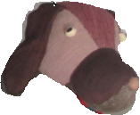
Notes for parents and teachers
Cumberland comes from a Fairtrade cooperative in Nepal and his journey to his new home was enabled by Traidcraft plc.
This book might be about being unhappy and angry, it might be about
hurting your friends. It might be about putting things right and the giving and
receiving of love. Better still it might be about whatever those who hear the story
think it is about, but you will only discover what children think it is about by talking with
them.
This book is one of a series about Cumberland and his world that raise questions about, love, joy,
feeling alone, enjoying company being sad and being happy.

Slide 23
Published 2018 in association with Bear Lands Publishing, St. Mary’s Centre, Llys Onnen, Abergwyngregyn, Gwynedd, LL33 0LD, Wales.
Copyright © David W Lankshear (text and illustrations).
David W Lankshear has asserted his right under the Copyright, Design and Patents Act 1988 to be identified as the author of this Work.
All rights reserved. No part of this publication may be reproduced, stored in a retrieval system, or transmitted, in any form or by any means, electronic, electrostatic, magnetic tape, mechanical, photocopying, recording or otherwise, without full acknowledgement of Bear Lands Publishing and copyright holders.
First published 2018

