Slide 1
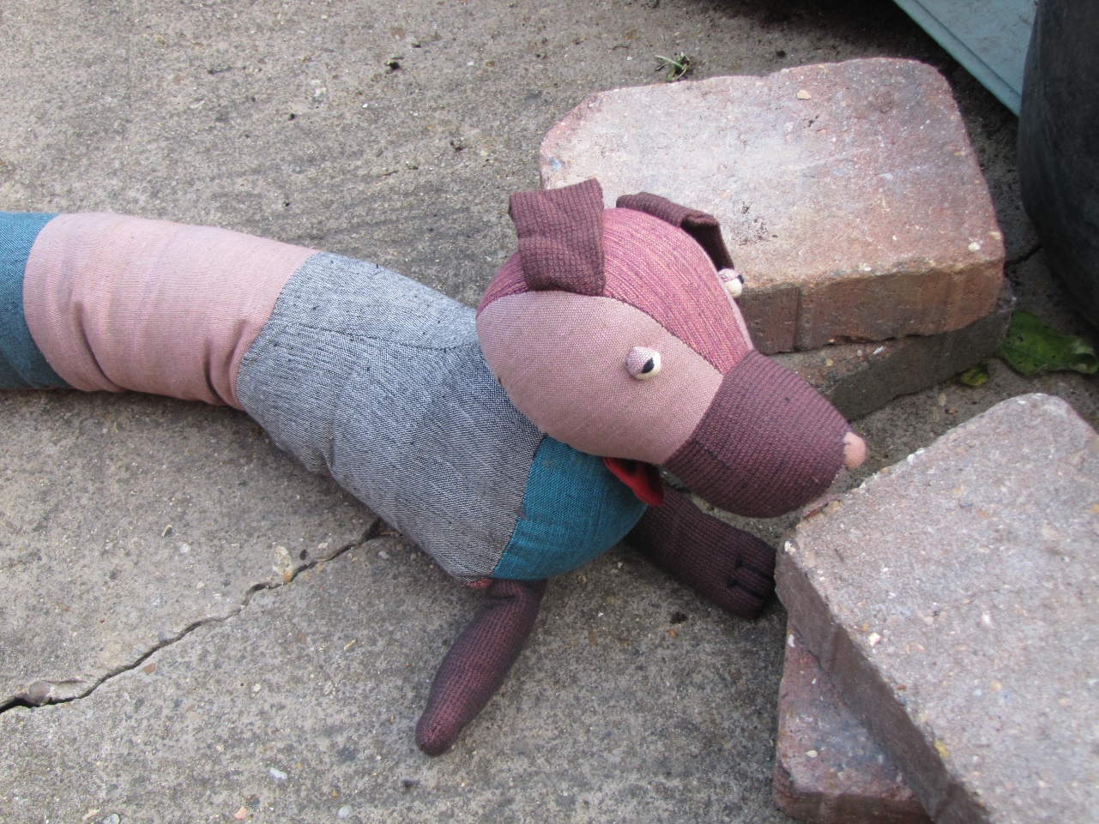
Cumberland and the journey of a brick
By David W. Lankshear

Slide 2
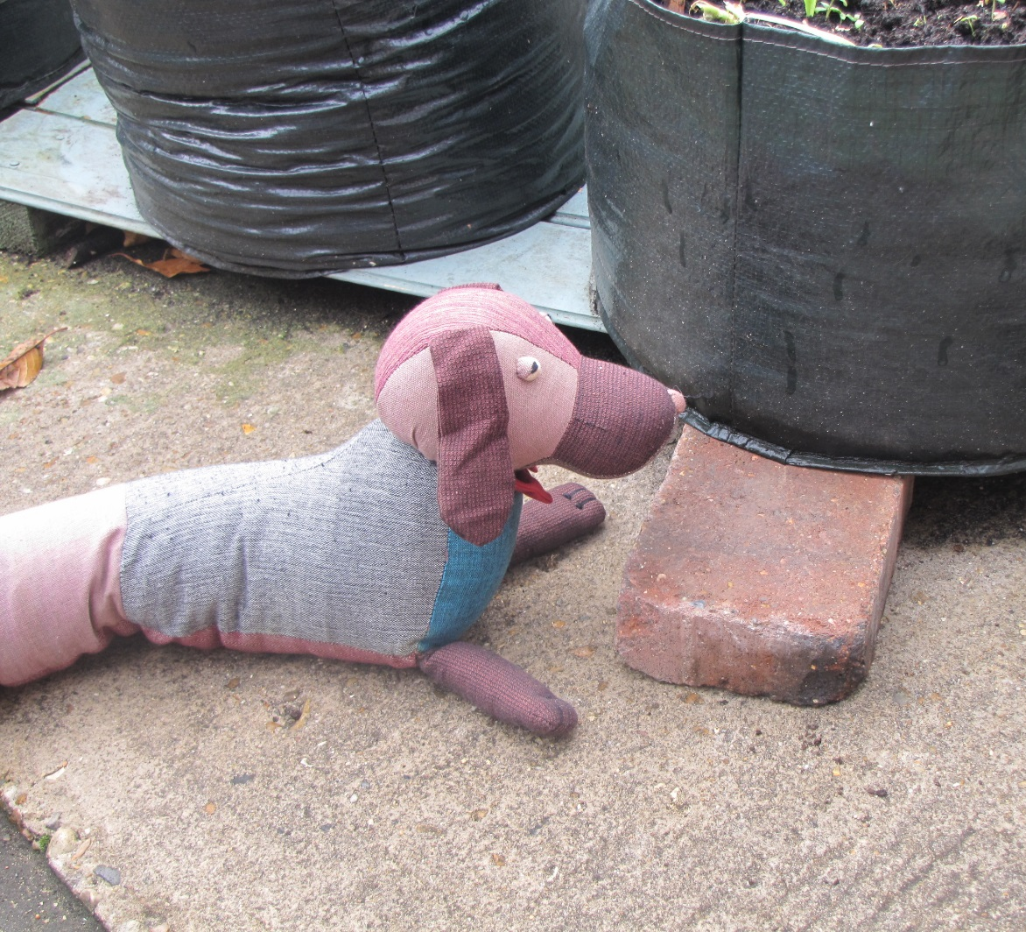
Cumberland was outside waiting for Fran to remember where she had left him. He was on the ground beside a brick.

Slide 3
“How did you get here?” asked the brick. “Fran dropped me here,” said Cumberland, “How did you get here?”

Slide 4
“Grandad put me here to support this pot for his lettuces. It is too big for the wooden supports on their own, so grandad gave the job to me.”

Slide 5
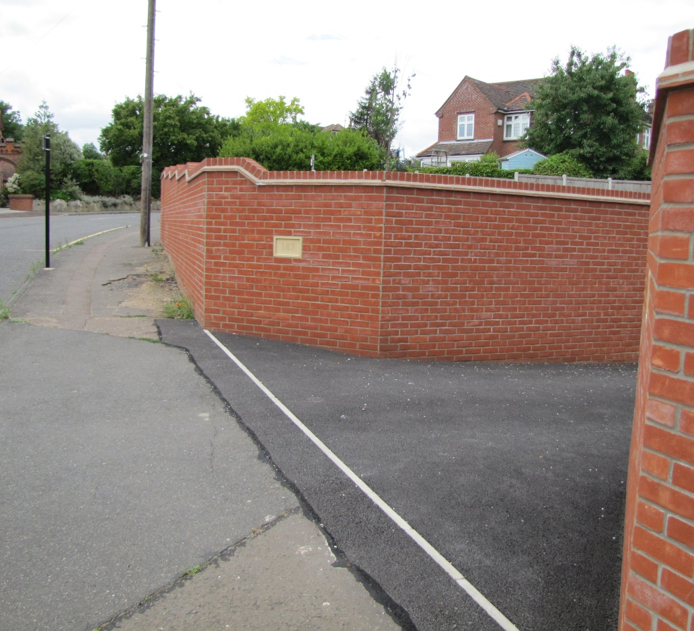
“I came to this house on a lorry,” said the brick, “At our first stop we heard some of the bricks in the wall saying, ‘we don’t want those ones near the cab, they are the wrong colour.”

Slide 6
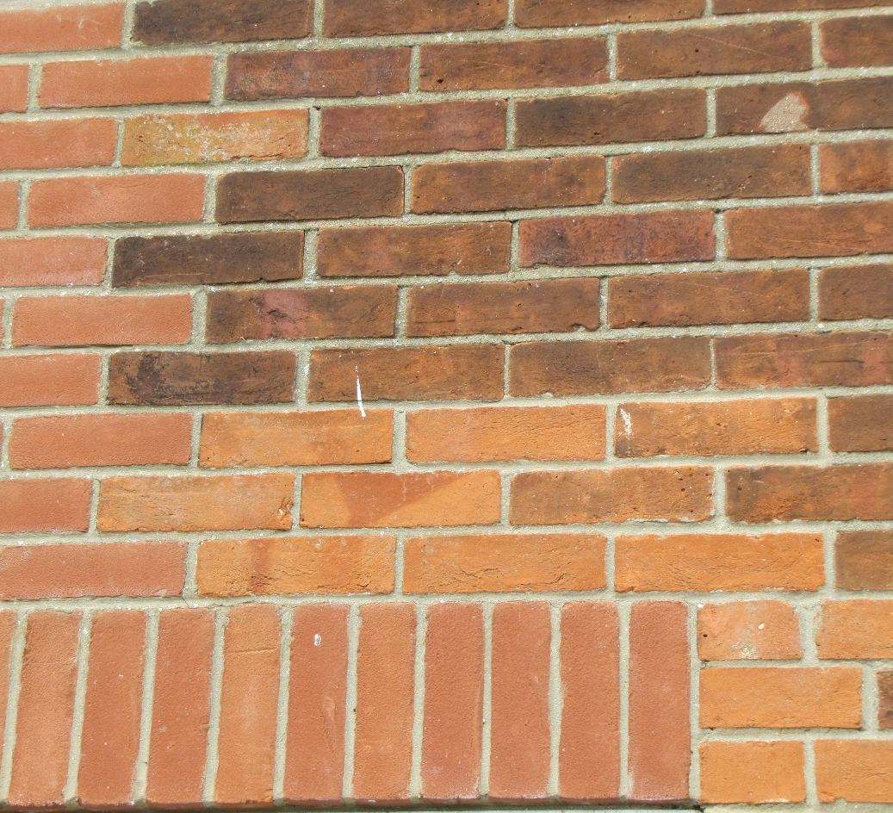
“If you put bricks of different colours in the same wall sometimes it can look really odd, but it can also look really good if they make a pattern.”

Slide 7
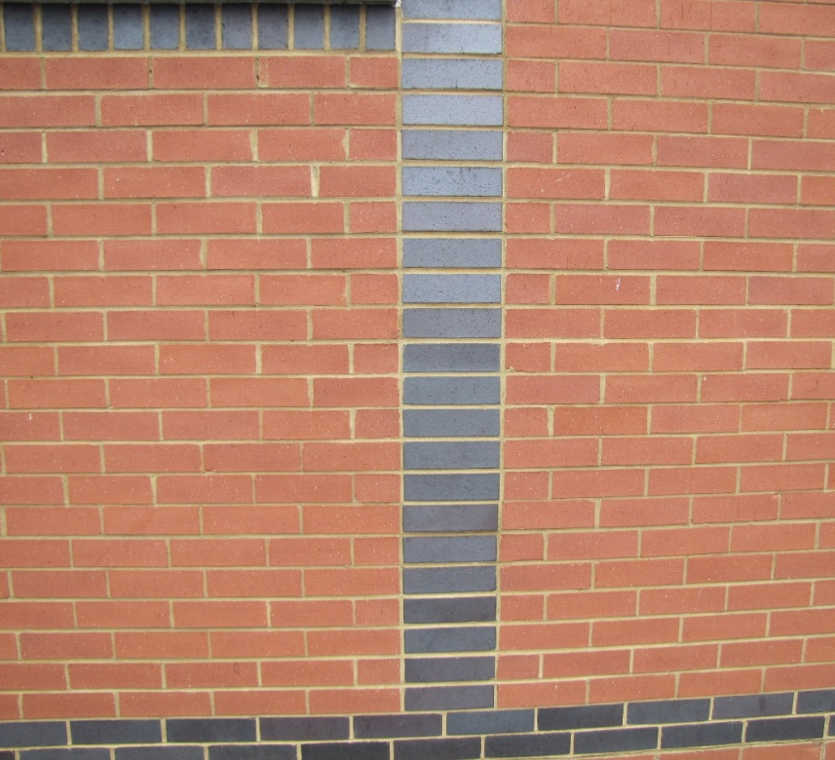
“At the second stop, the bricks in this wall said, we only want shiny black bricks to form the patterns that make the wall look interesting.”

Slide 8
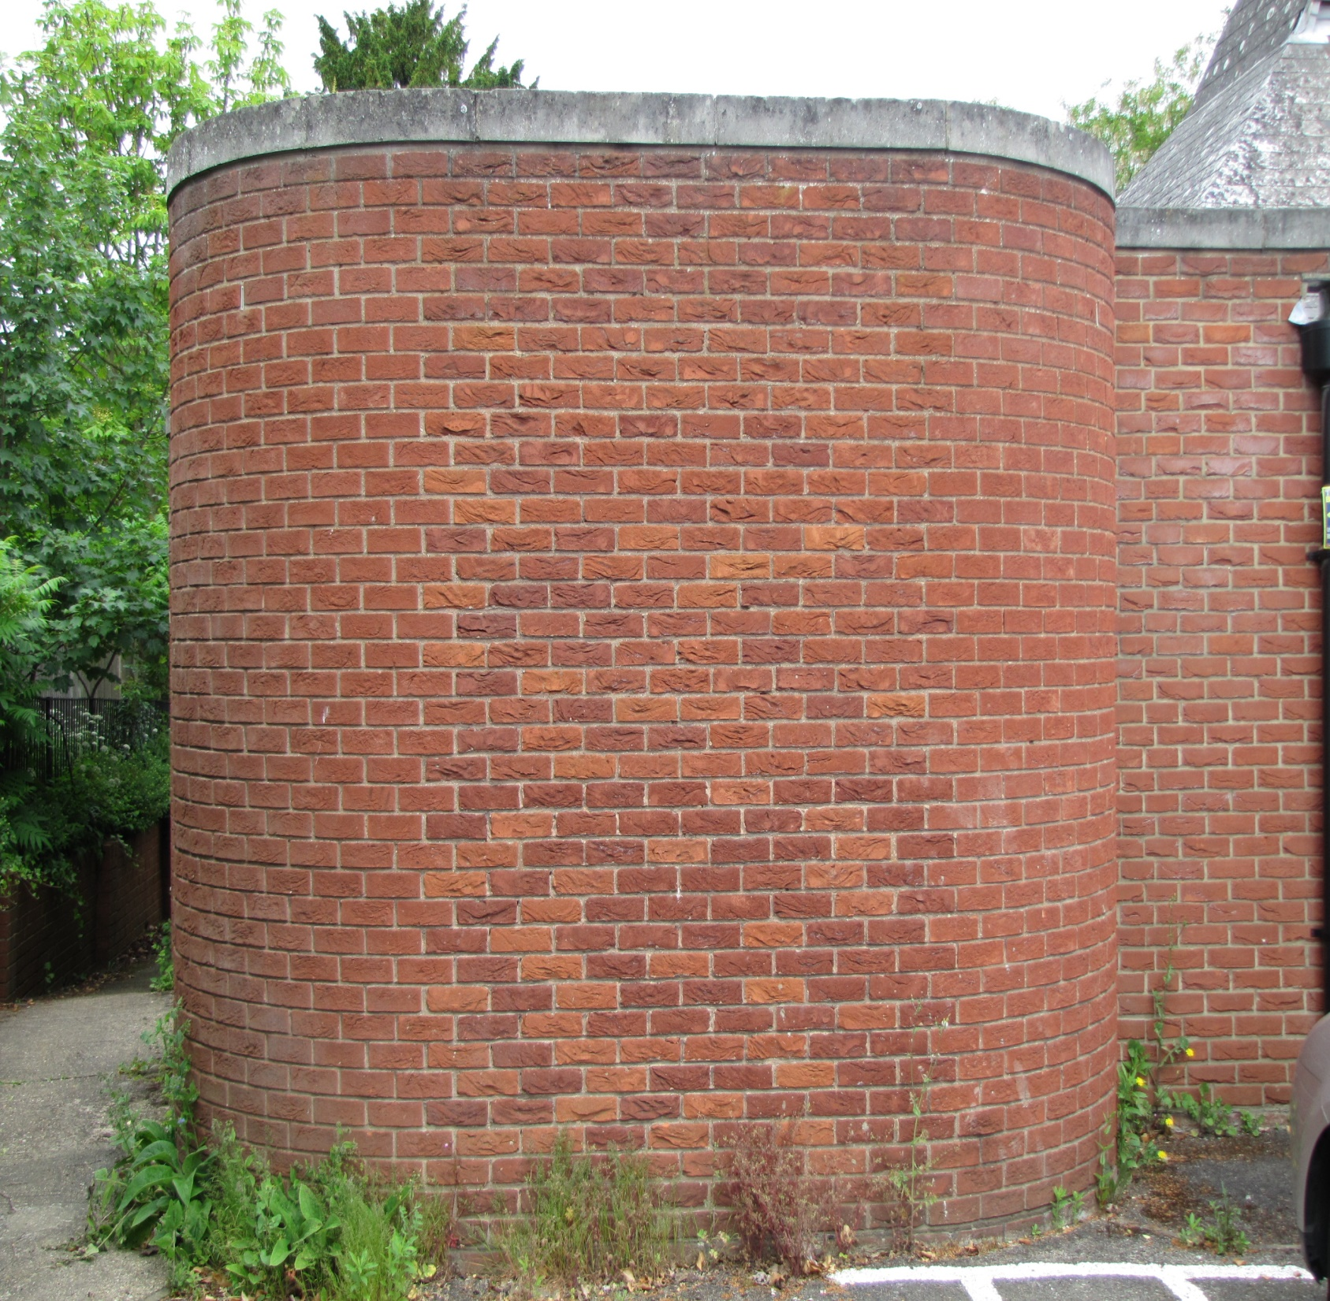
“At the third stop we heard the bricks say, we only want curved bricks in this wall. It was a bit sad not to be wanted at these places.”

Slide 9
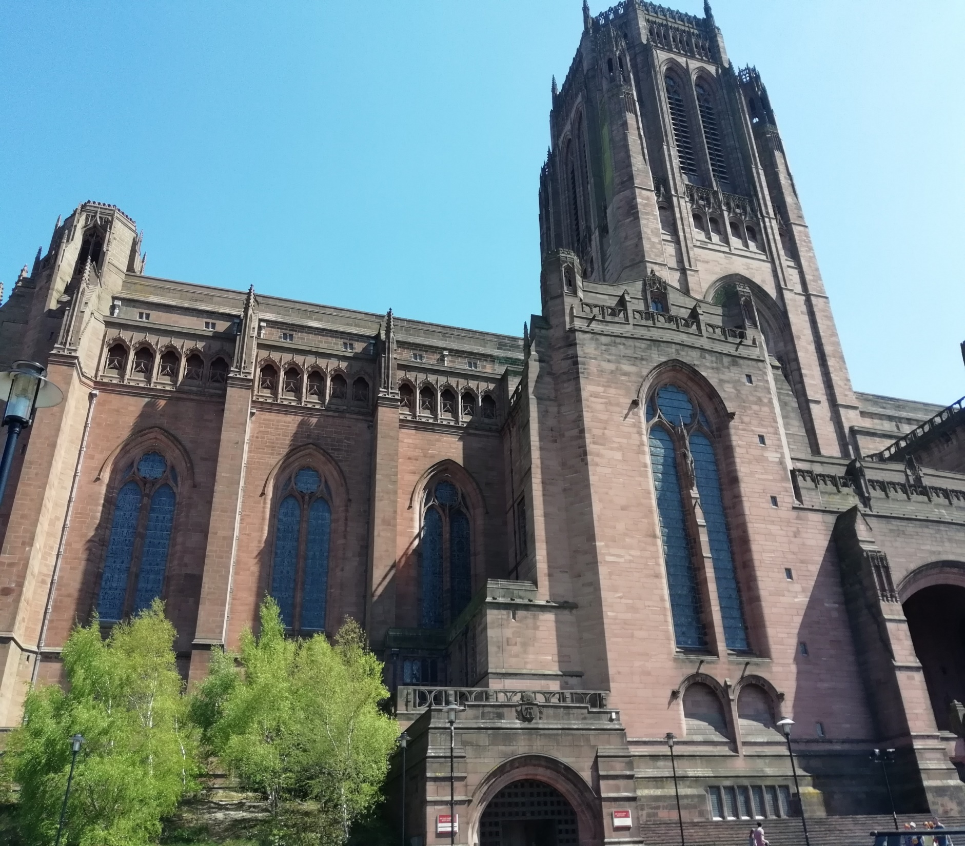
“Bricks like to do useful things. They can go towards making very large churches.”

Slide 10
“Or they can do what I do and help with different jobs that Grandad needs me to do.”

Slide 11
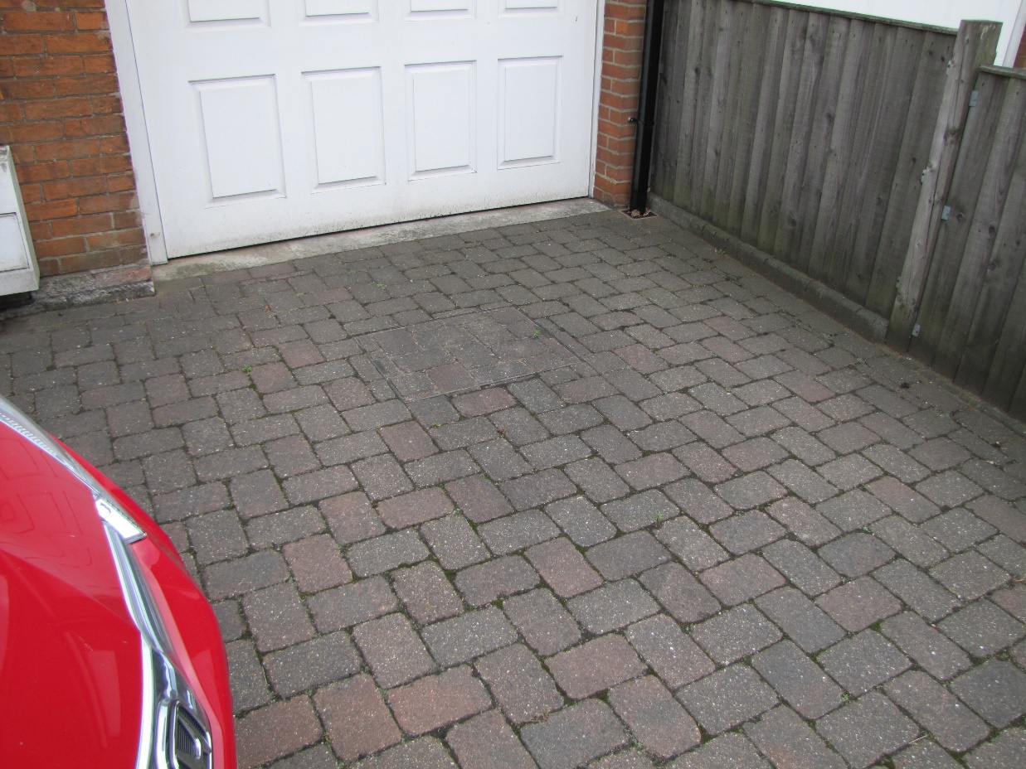
“When we arrived at Grandad’s house most of us were used to make a smooth hard surface for Grandad to park his car. That is useful, but it can be a bit boring.”

Slide 12
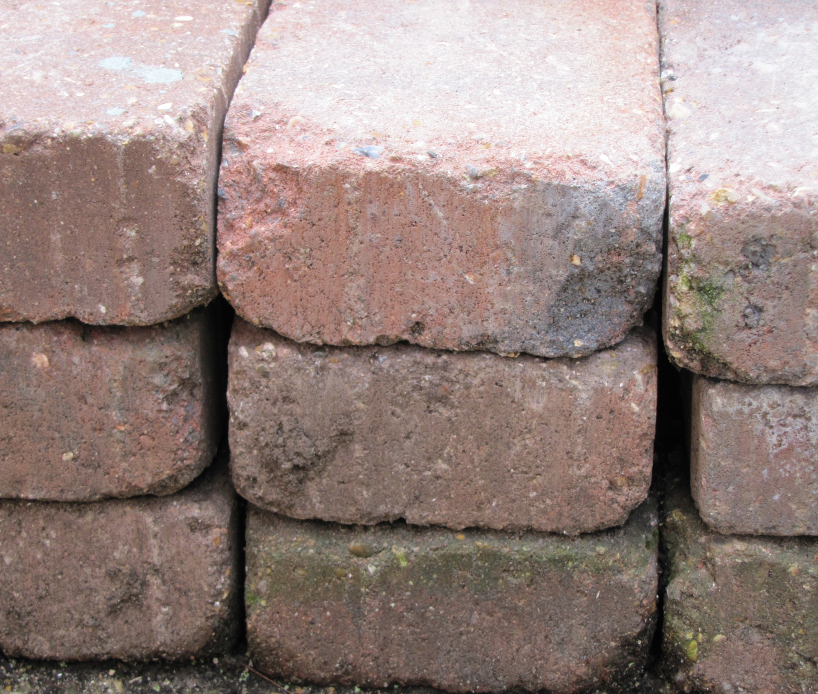
“Some of us were just left in a pile, like we had been in the yard before we were put on the lorry. We wondered what would happen next.”

Slide 13
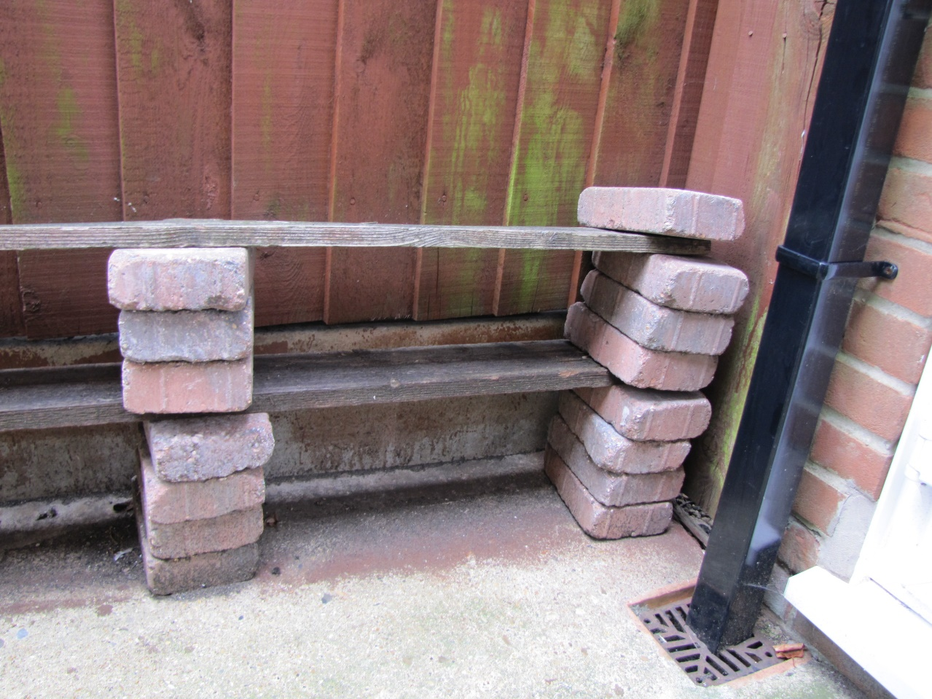
“When Grandad saw us in this pile he said ‘Good. I need some bricks to hold up my shelves.’”

Slide 14
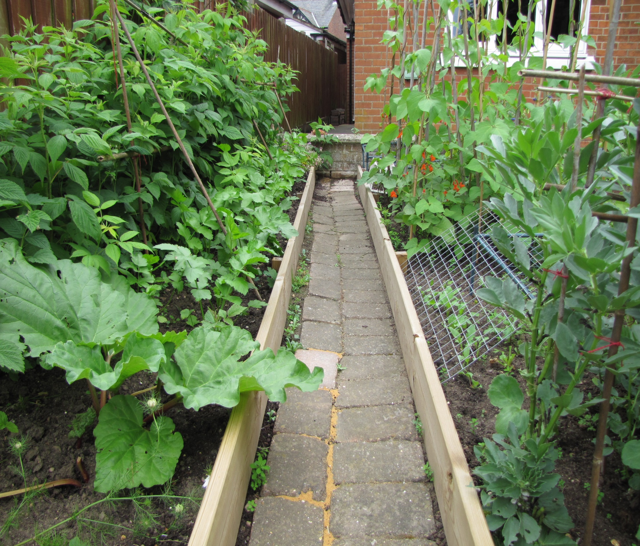
“Then he used some of us to make a path through his vegetable patch. There were still a few of us left and we wondered what would happen to us.”

Slide 15
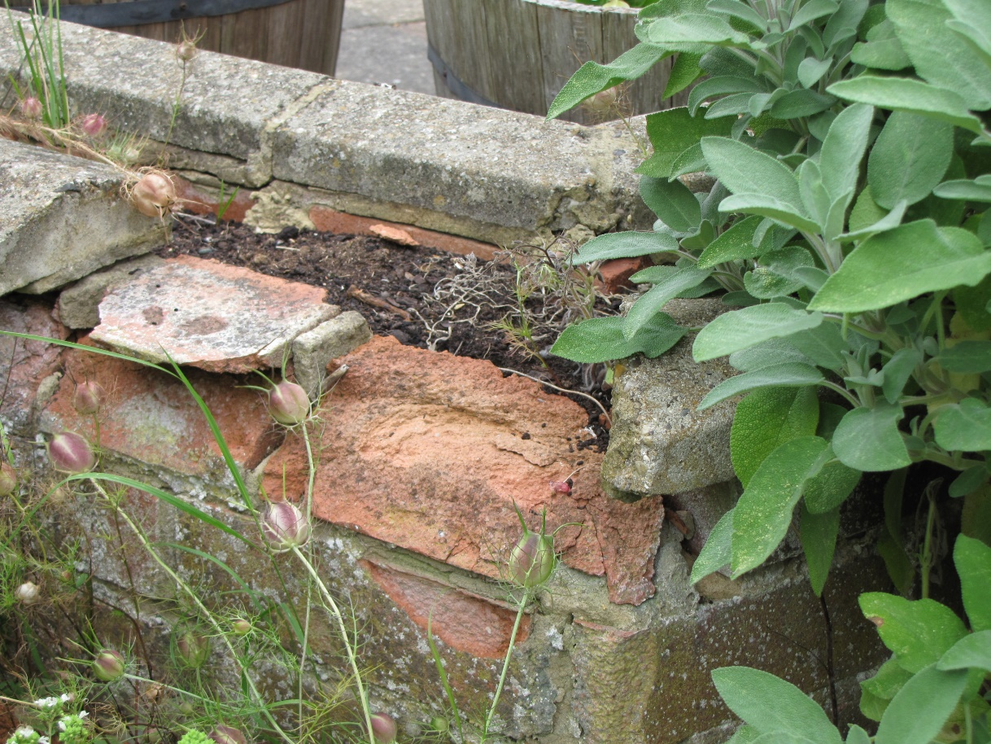
“Perhaps we would just be left out in the garden to crumble away without being much use to anyone.”

Slide 16
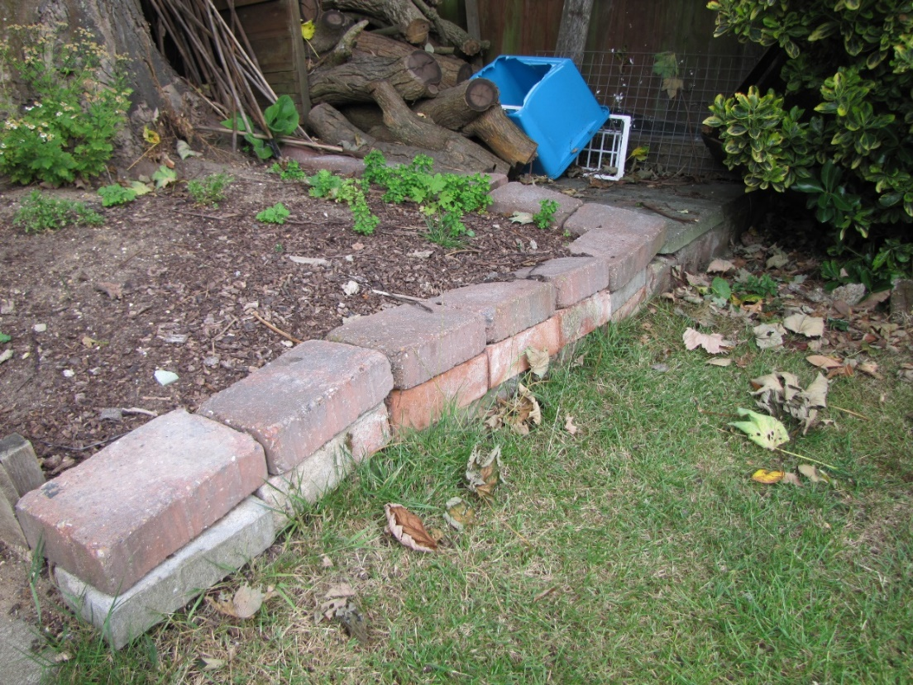
“Some of us got used to make a border around the place where the roots of the big tree in the garden make it really difficult for anything to grow.”

Slide 17
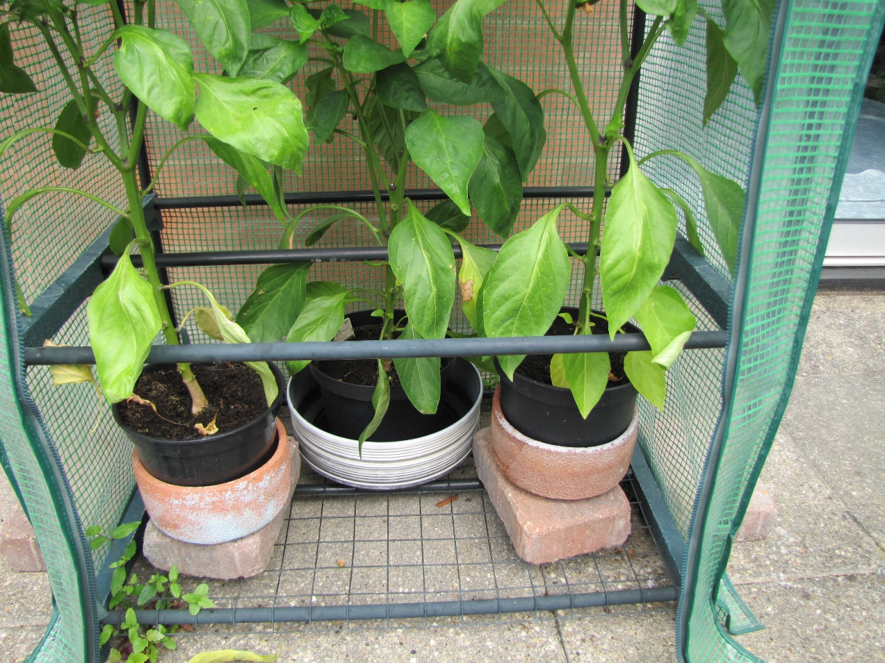
“There were just a few of us left. Grandad uses us for the special jobs. I am holding up the lettuces now, but next week I could be supporting the pepper plants in the greenhouse.”

Slide 18
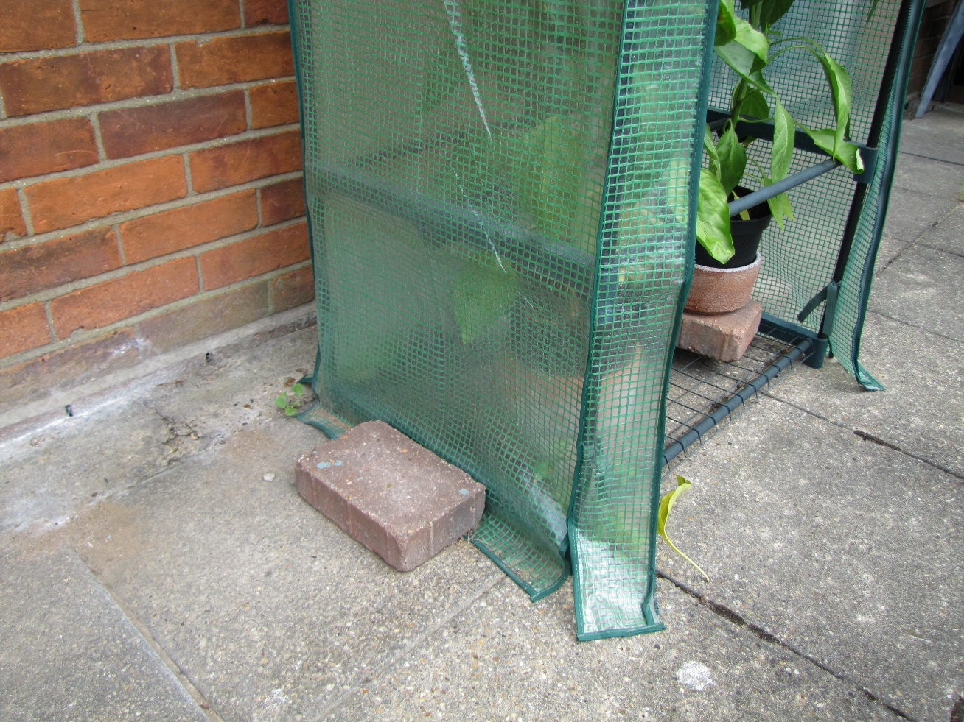
“Or holding the greenhouse down so that it doesn’t blow away in a storm. That is an important job!”

Slide 19
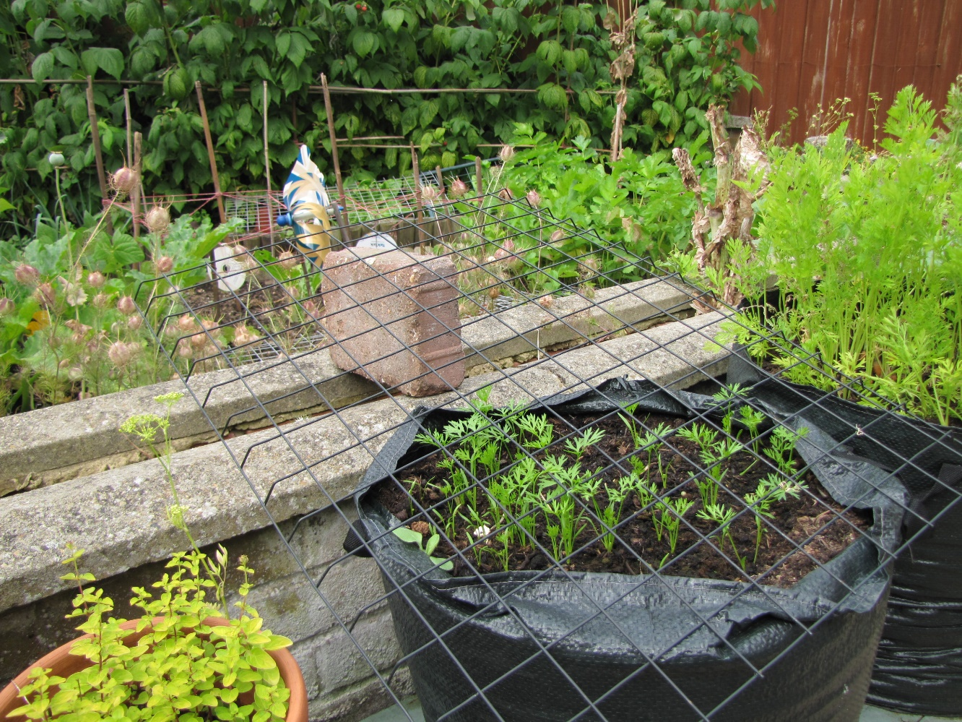
“Or holding up the wire netting that stops the birds eating the seedlings before they grow into carrots. That is another important job.”

Slide 20
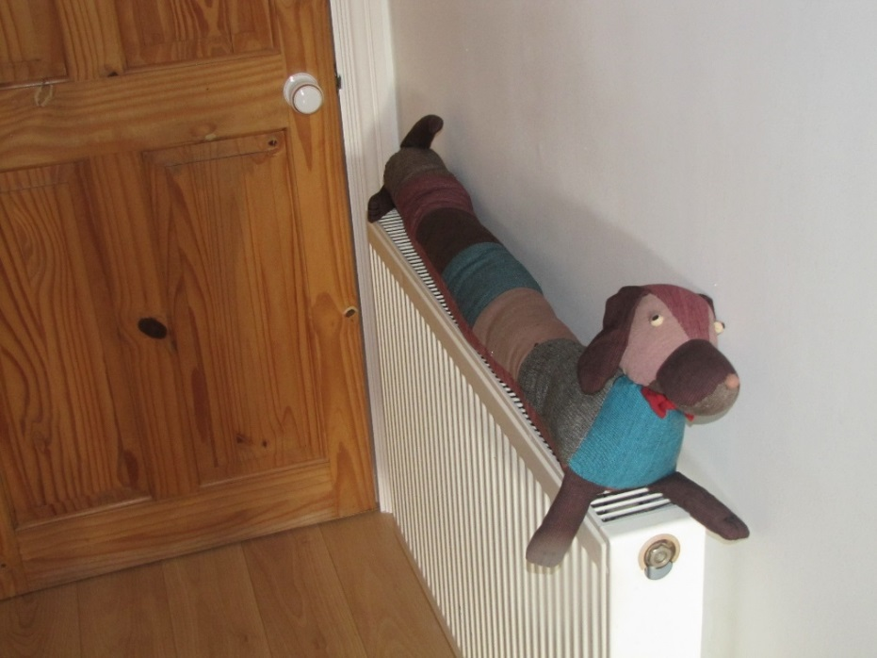
Cumberland thought that bricks were very useful, but he was glad when Fran came and took him inside. He was damp so she put him on the radiator to dry off.

Slide 21
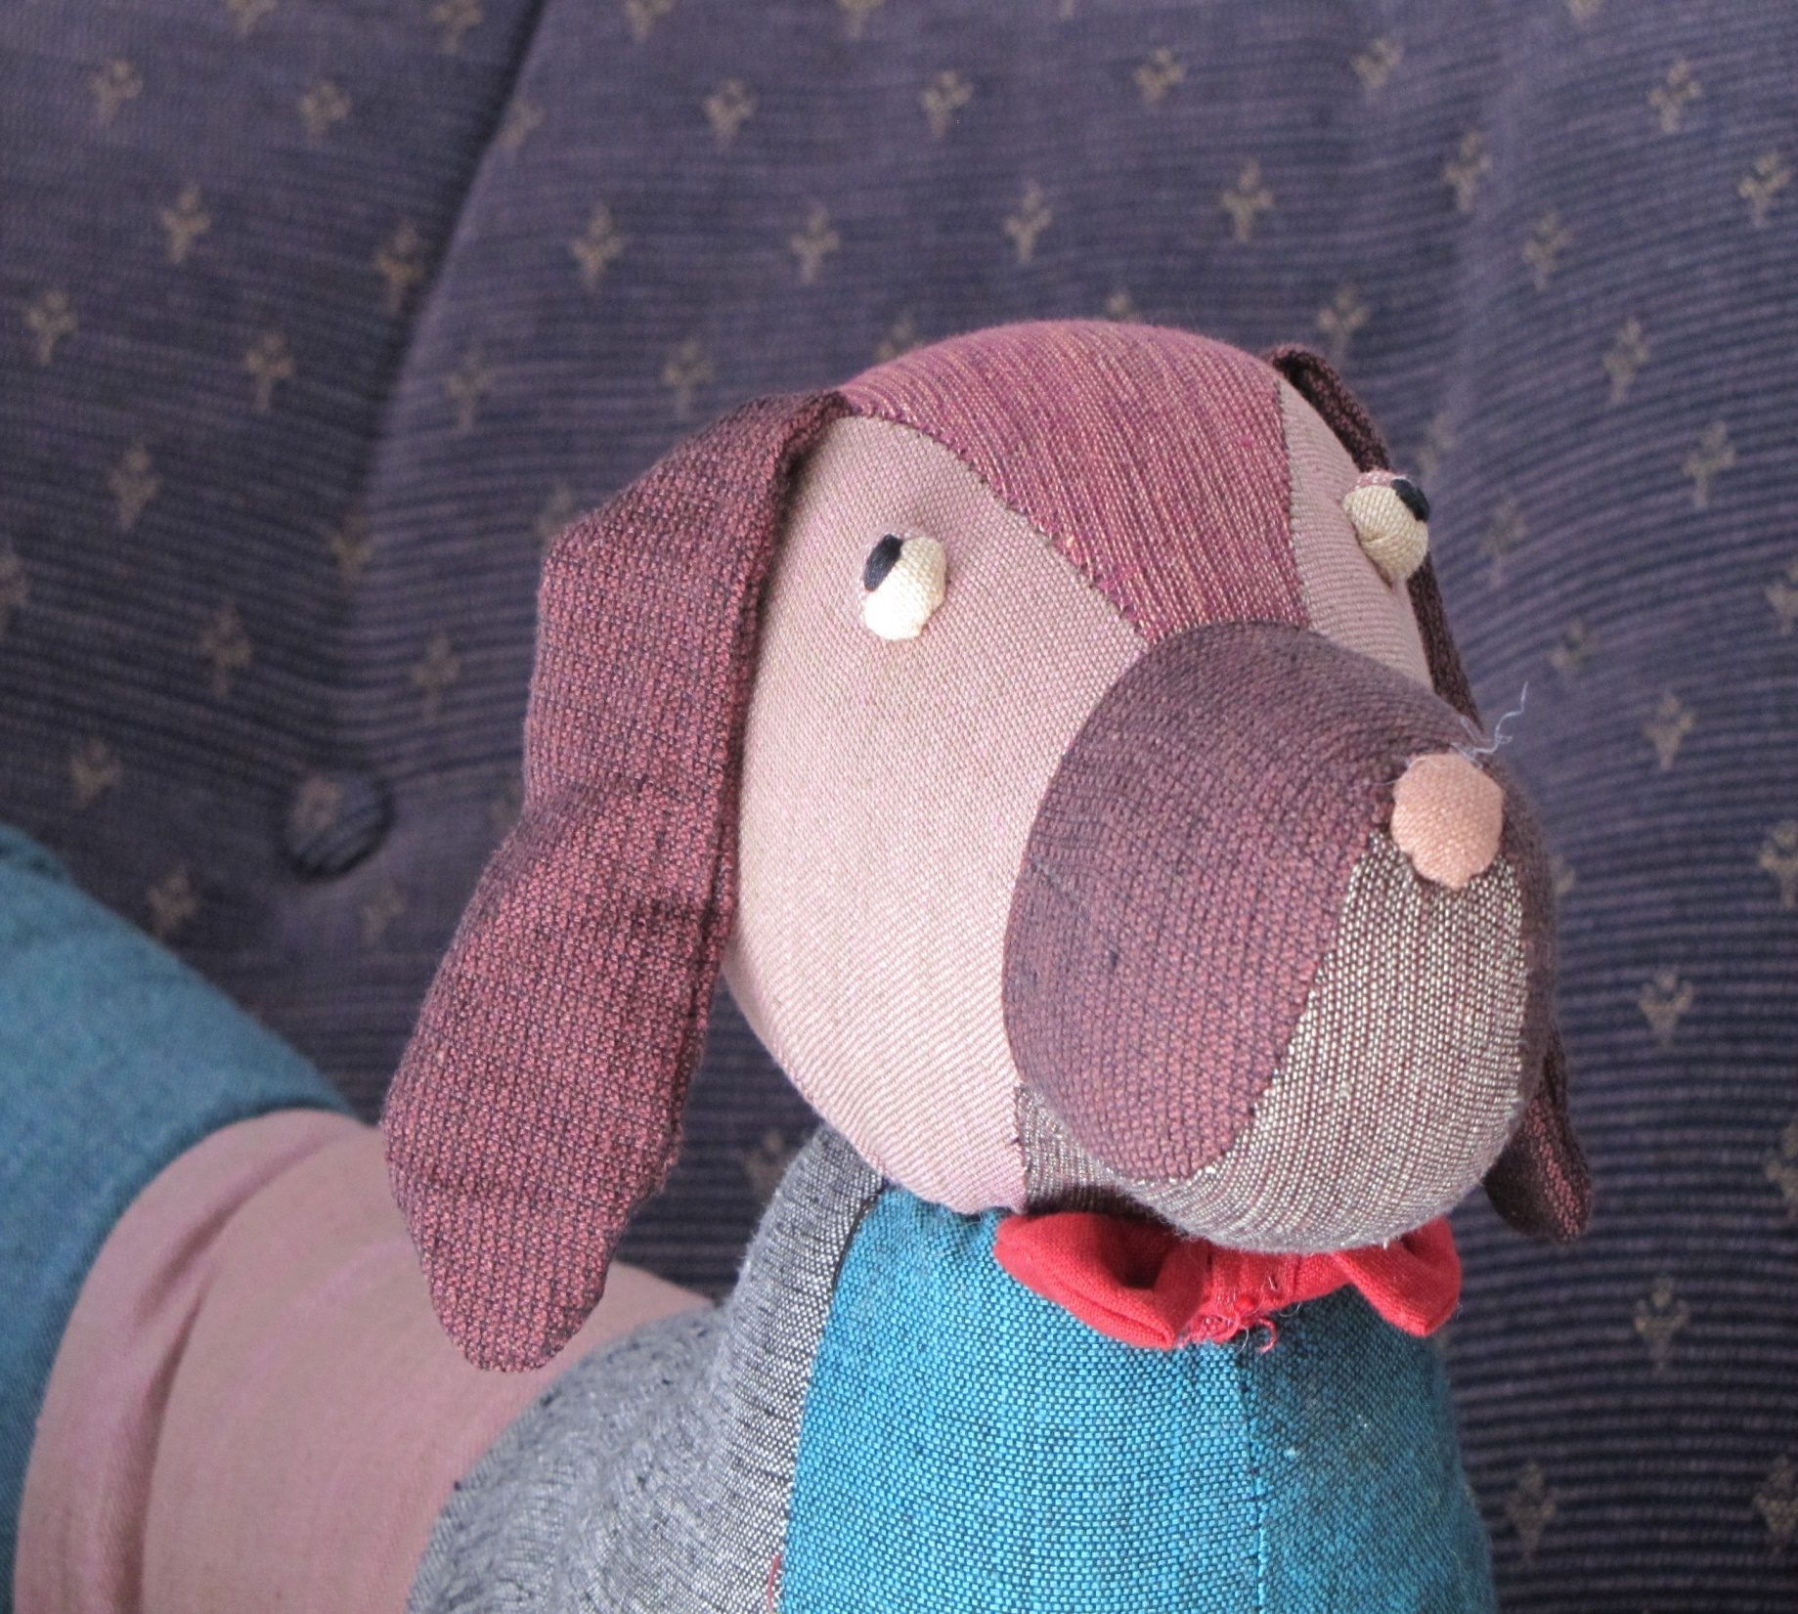
He preferred to be useful indoors where it was warm and the rain did not fall on him.

Slide 22
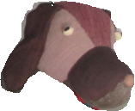
Notes for parents and teachers
Cumberland comes from a Fairtrade cooperative in Nepal and his journey to his
new home was enabled by Traidcraft plc.
This book could be about the usefulness of bricks and the different types of brick
we see around us. It might be about how we feel when we are not wanted or we are told
we are the wrong size, shape or colour to fit in. It could also be about feeling useful, but
most likely the children that you read this story with will have their own ideas on what it is about and these will be both right and more interesting than my ideas.
It might be interesting to talk how many different ways bricks are useful around your area.
This book is one of a series about Cumberland and his world that raise questions about,
love, joy, feeling alone, enjoying company being sad and being happy.

Slide 23
Published 2018 in association with Bear Lands Publishing, St. Mary’s Centre, Llys Onnen, Abergwyngregyn, Gwynedd, LL33 0LD, Wales.
Copyright © 2018 David W Lankshear (text and illustrations).
David W Lankshear has asserted his right under the Copyright, Design and Patents Act 1988 to be identified as the author of this Work.
All rights reserved. No part of this publication may be reproduced, stored in a retrieval system, or transmitted, in any form or by any means, electronic, electrostatic, magnetic tape, mechanical, photocopying, recording or otherwise, without full acknowledgement of Bear Lands Publishing and copyright holders.
First published 2018

