Slide 1
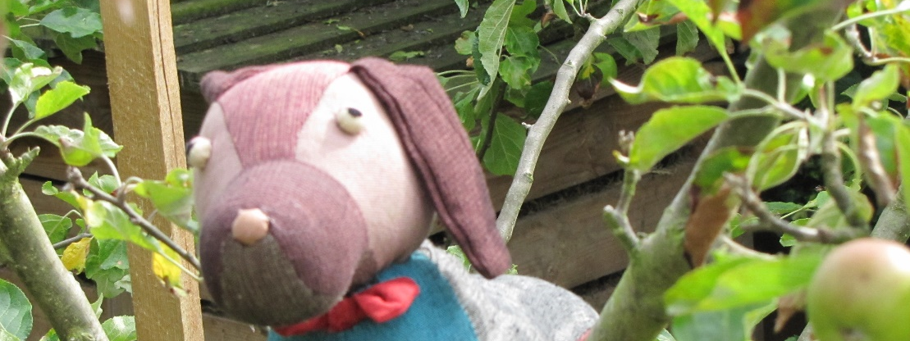
Cumberland and feeling sad
By David W. Lankshear

Slide 2
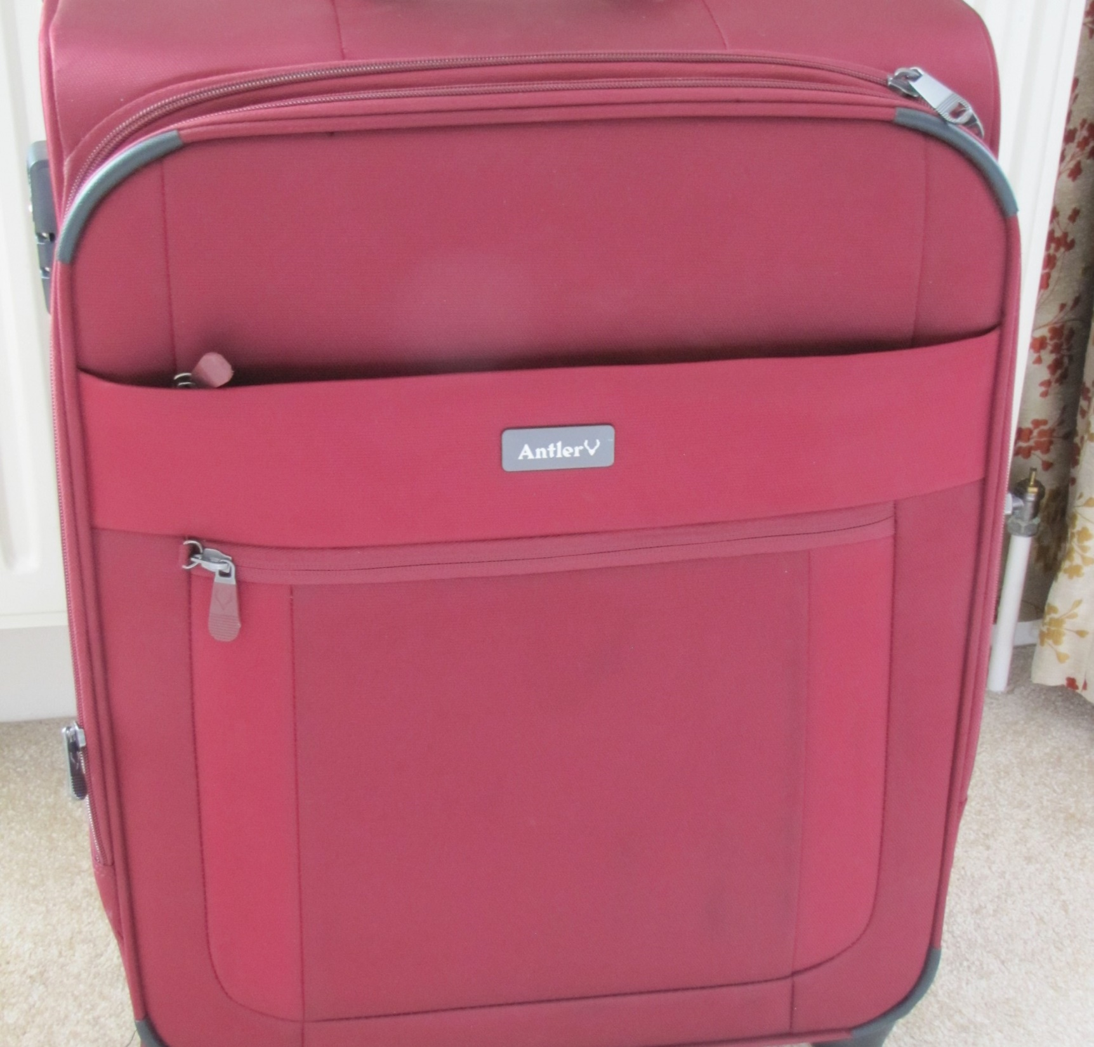
Cumberland saw the suitcase in the hall and knew that Fran and James had come to stay with Granny and Grandad for a few days.

Slide 3
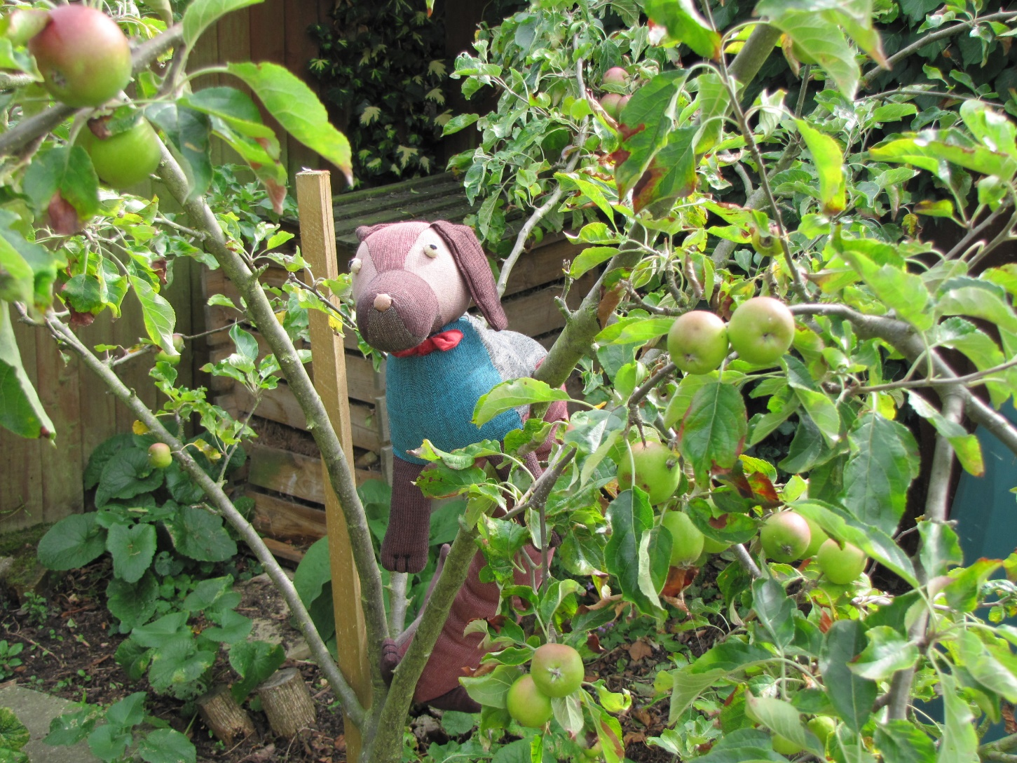
When Fran and James came to visit, Cumberland never knew where he might be put. It might be in the apple tree.

Slide 4
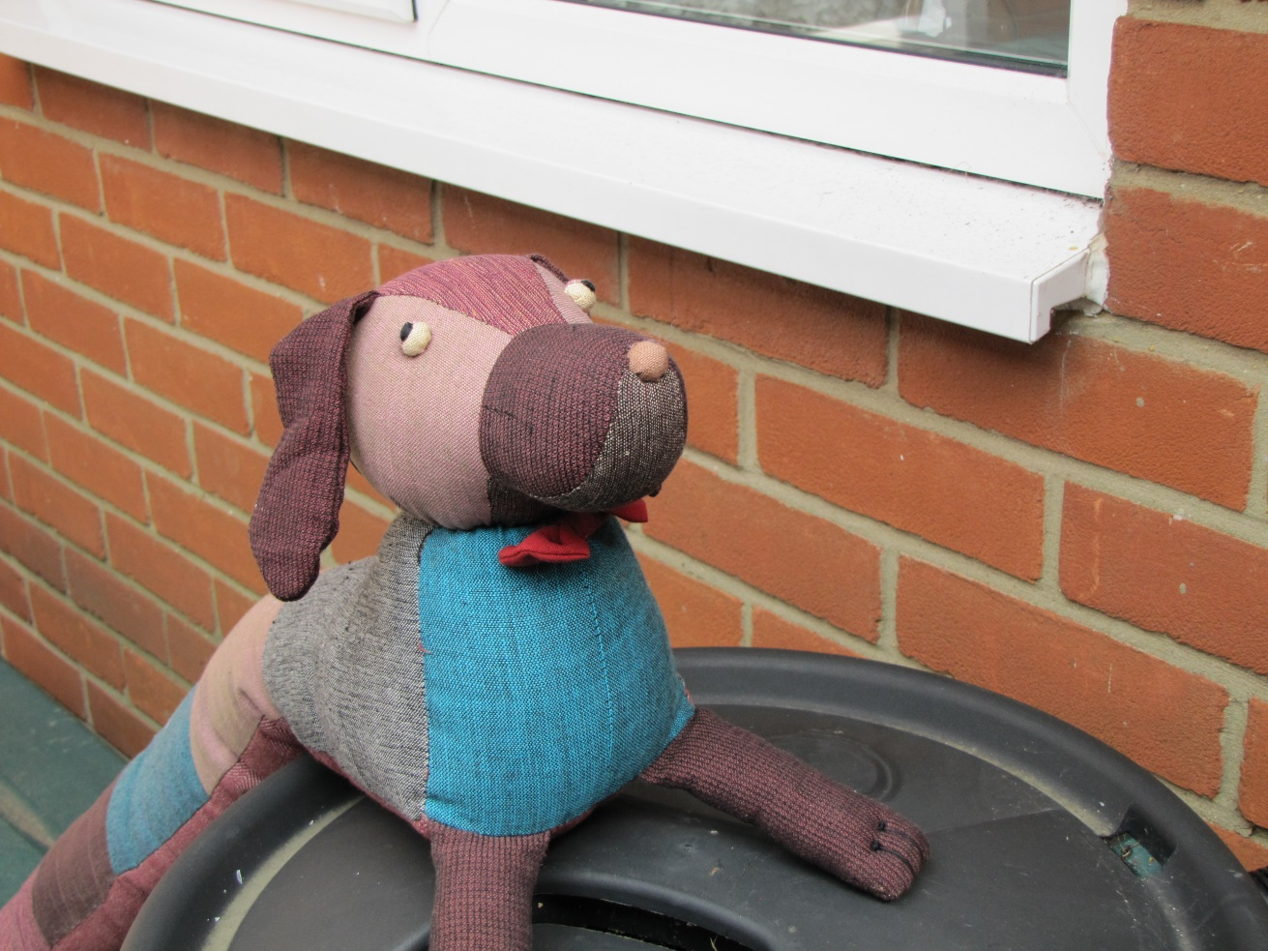
Or he might find himself with his back legs on the wood bunker and his front legs on the water butt. Fran was always taking him to new places.

Slide 5
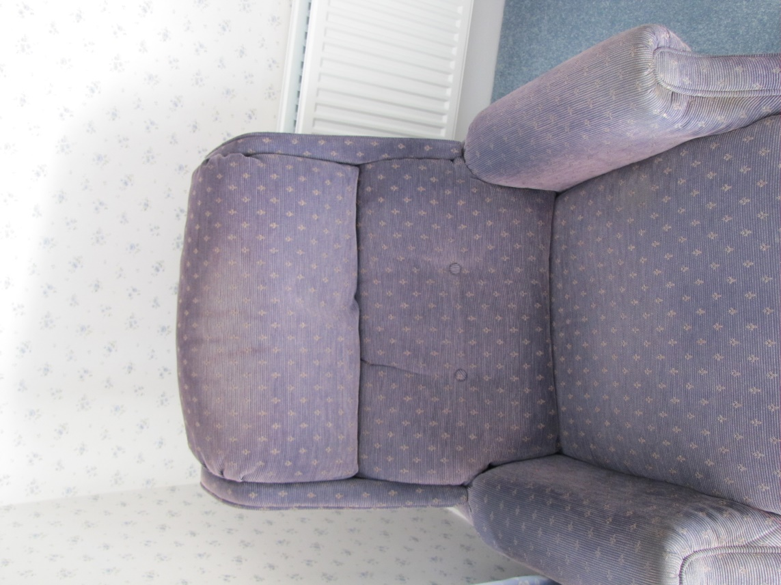
This time Fran did not want to run around. She just sat curled up in Grandad’s big chair with Cumberland wrapped round her neck as she cuddled up to him.

Slide 6
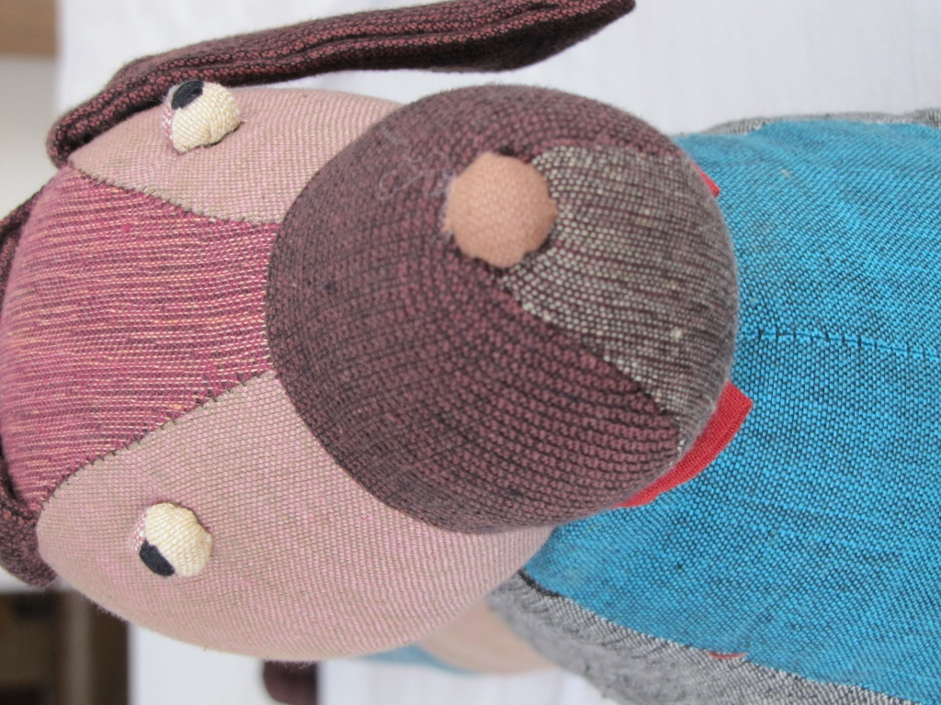
Fran seemed very sad. As they sat there, she told Cumberland all about why she was so unhappy.

Slide 7
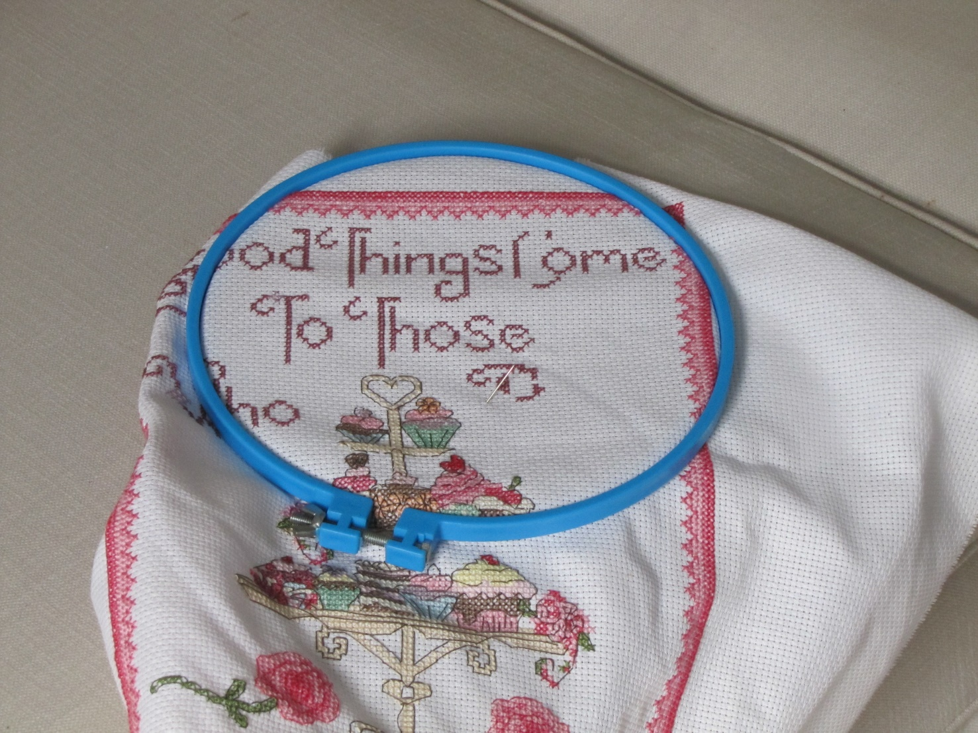
Granny was sitting very quietly on the other side of the room, working on her sewing.

Slide 8
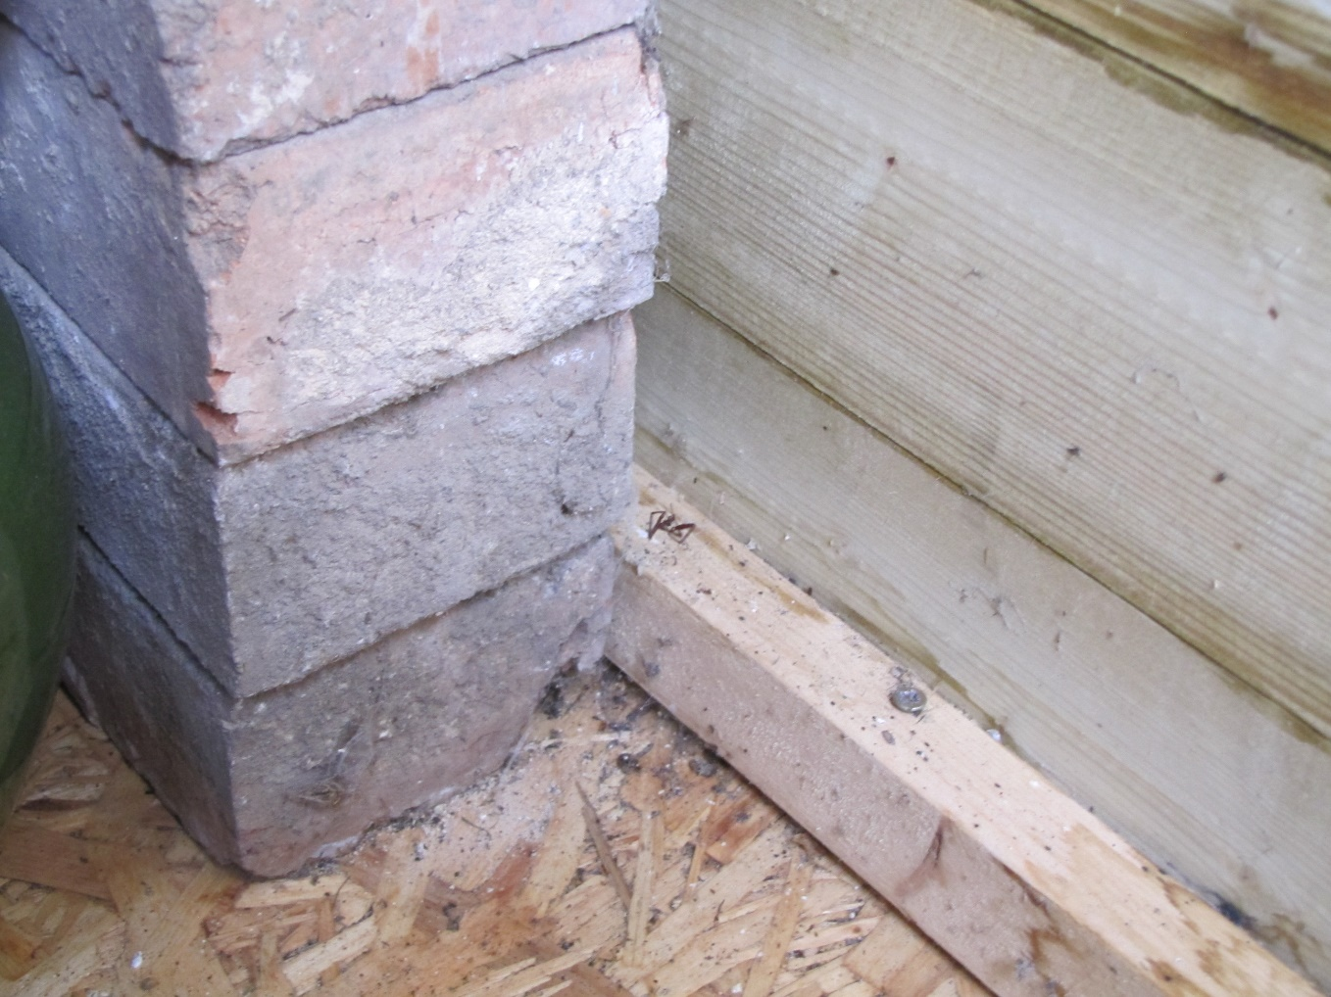
James was outside with Grandad looking for spiders in Grandad’s shed.

Slide 9
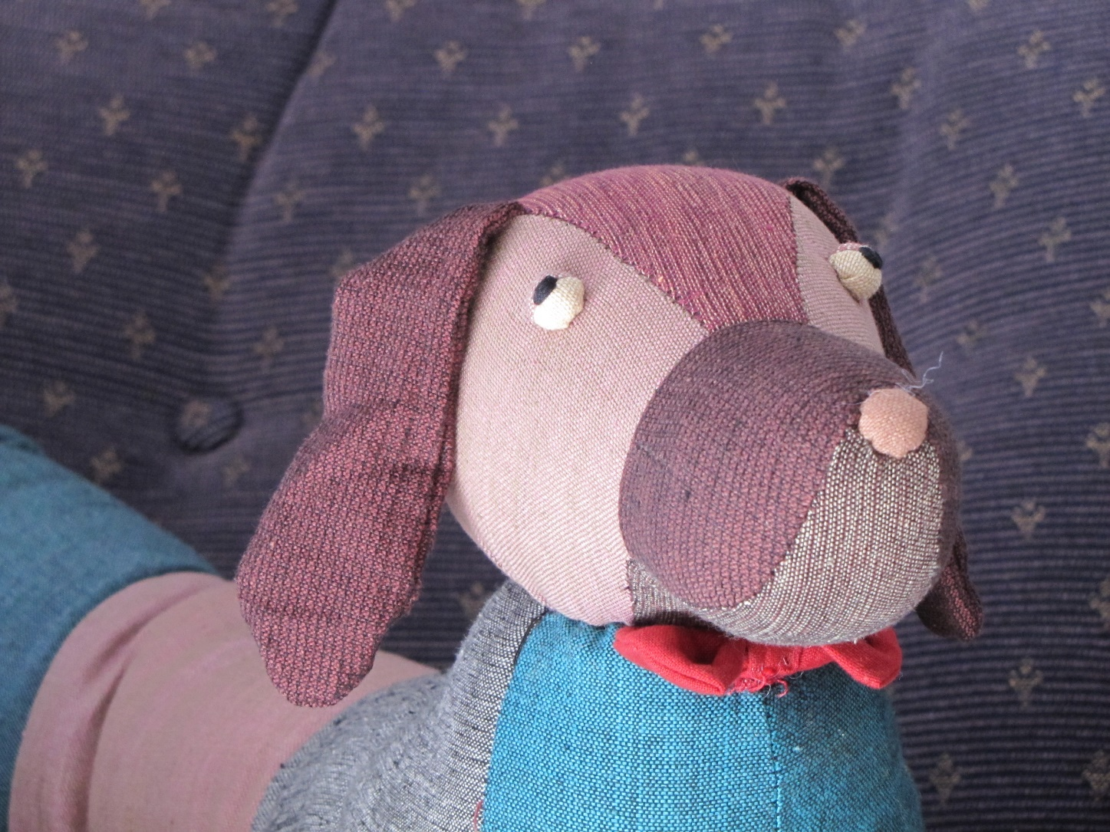
Granny came over to the big chair and said quietly, “It is all right to be a bit sad when people we love are away. When Grandad goes away for his work I am always a bit sad.”

Slide 10
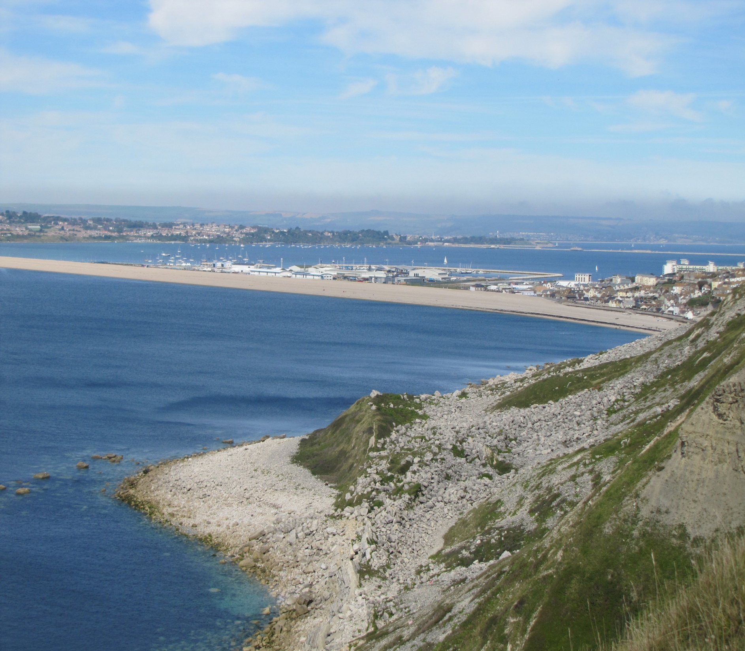
“Your daddy is away because of his job. He drives a big coach to take people on their holidays at the seaside.”

Slide 11
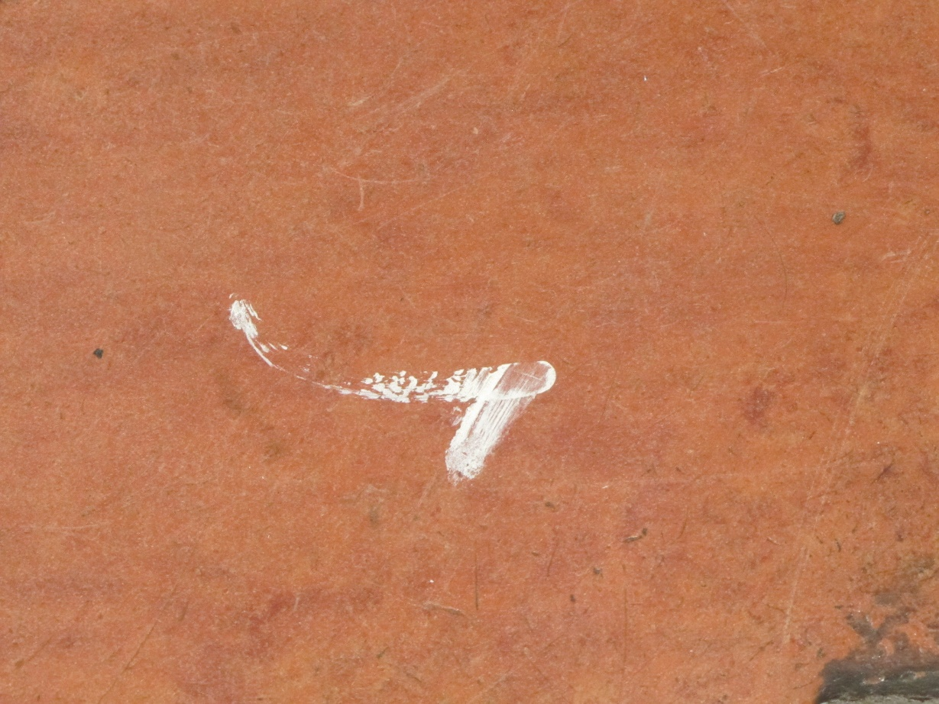
“He didn’t go away because you spilt your paints on the floor or because you made a loud noise when he was trying to have a sleep. He will be back soon.”

Slide 12
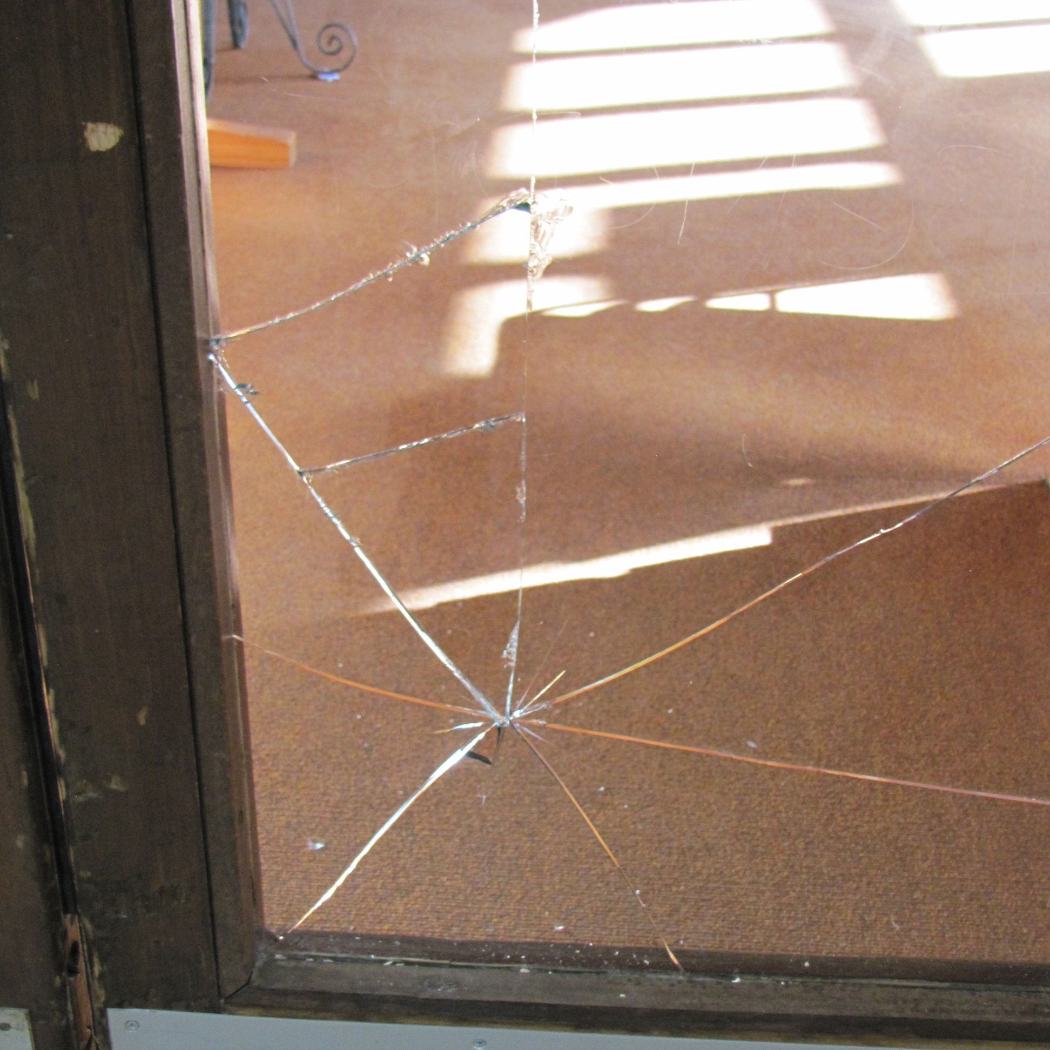
“Your mummy didn’t go away because James broke the glass in the door. She has to learn about a new way of doing things at her work. She will be back soon.”

Slide 13
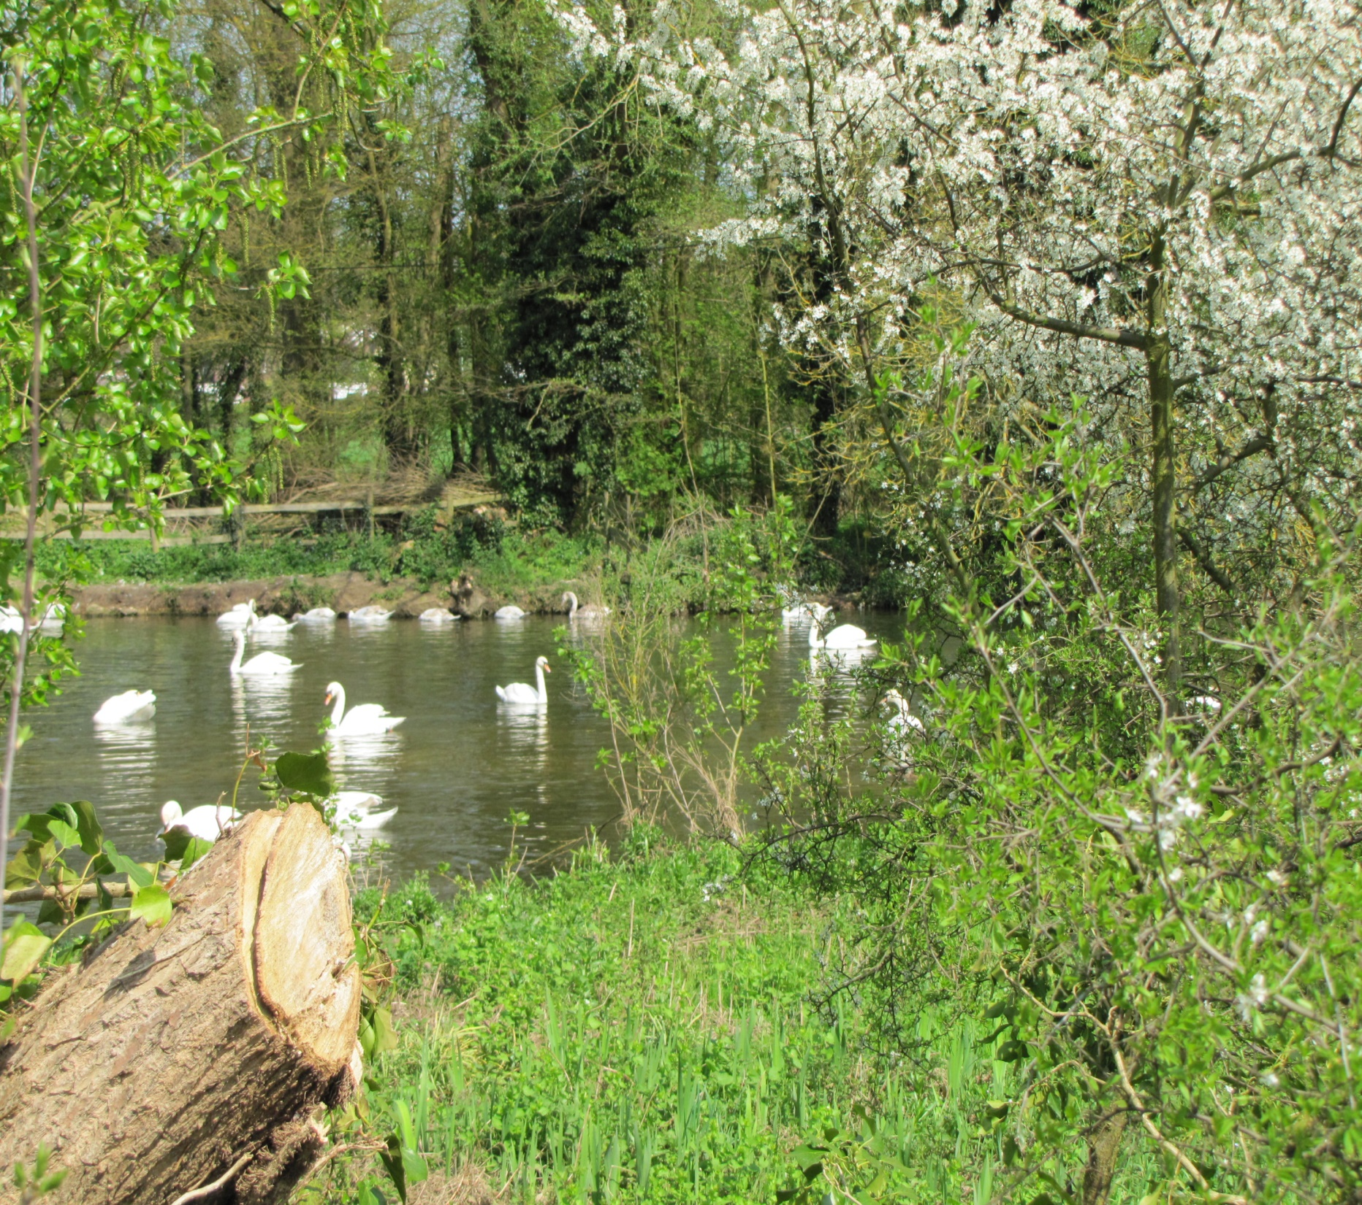
“Why don’t you just sit there and cuddle Cumberland for a while and then maybe we can go to the park. We could see if the swans are still there.”

Slide 14
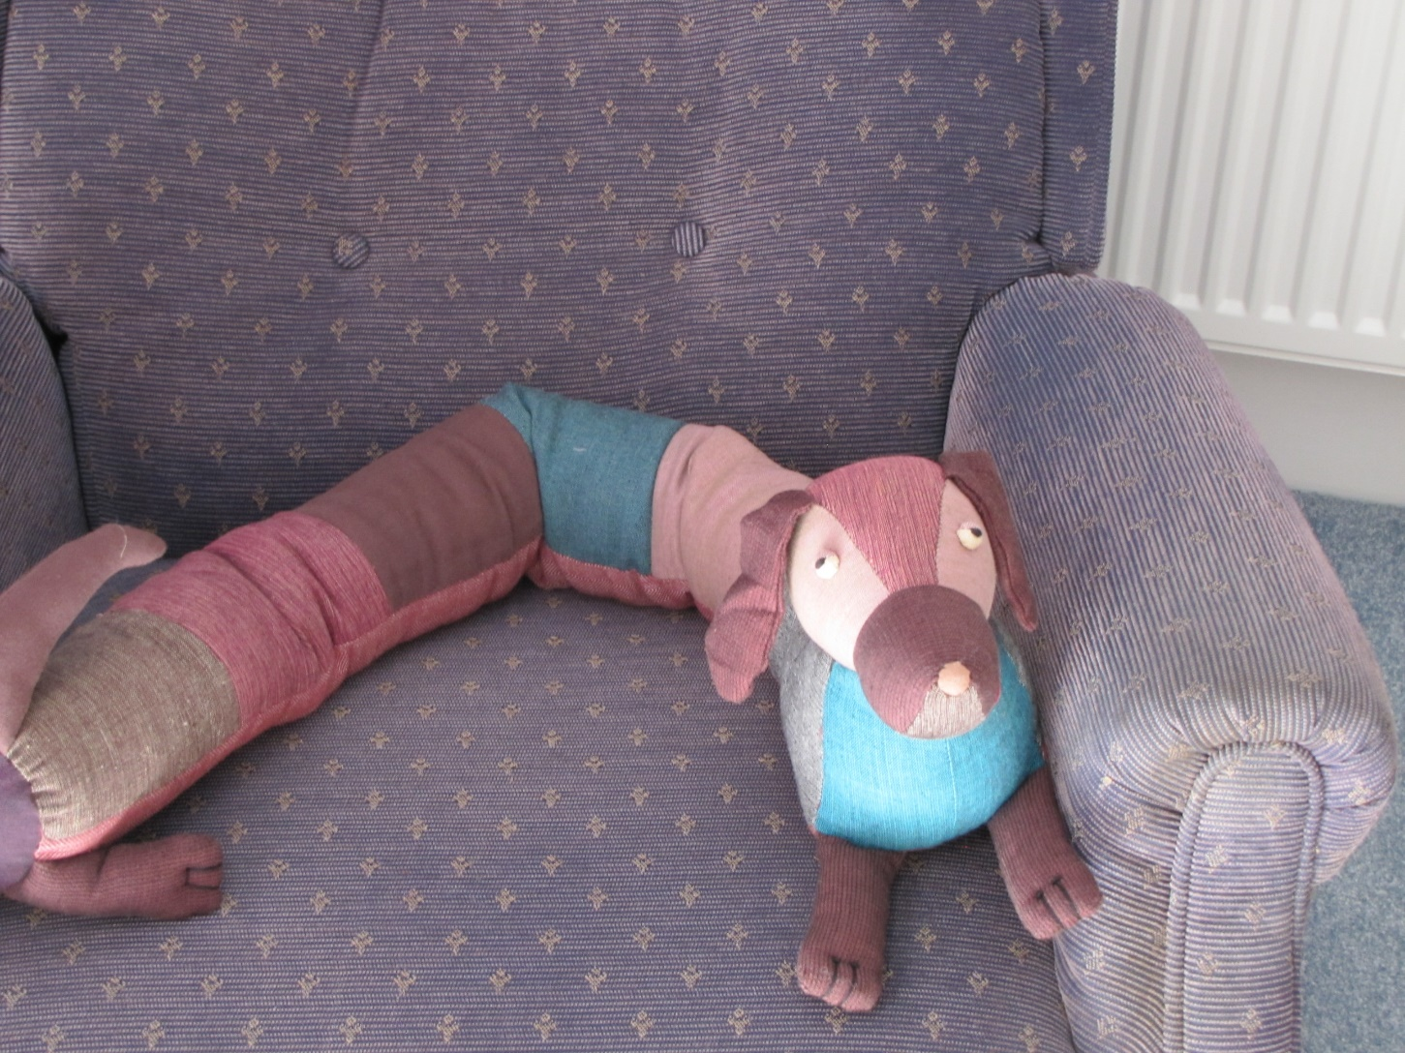
Fran sat there a bit longer after Granny had gone out of the room. She told Cumberland about some of the other things that made her sad.

Slide 15
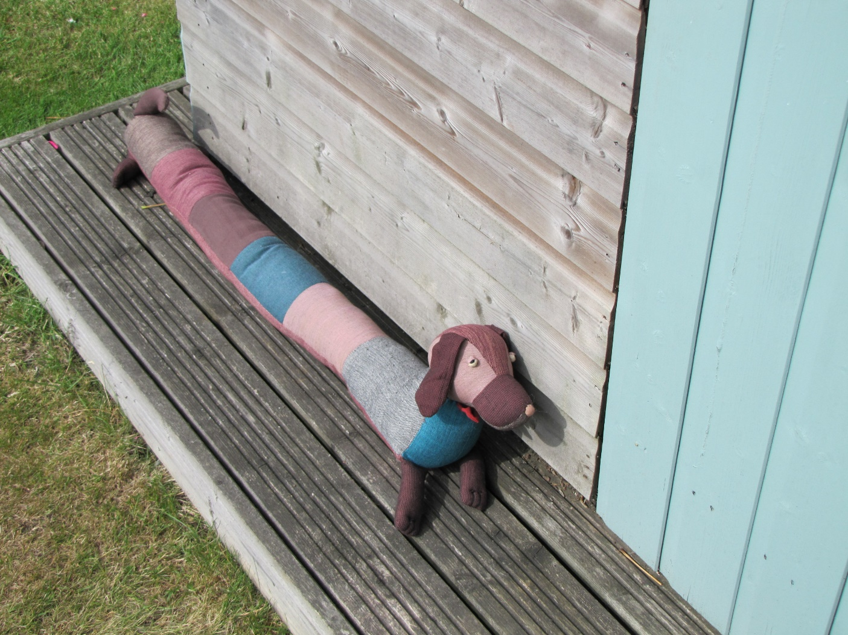
Later Fran went out to look for James and Grandad. She left Cumberland outside Grandad’s shed.

Slide 16
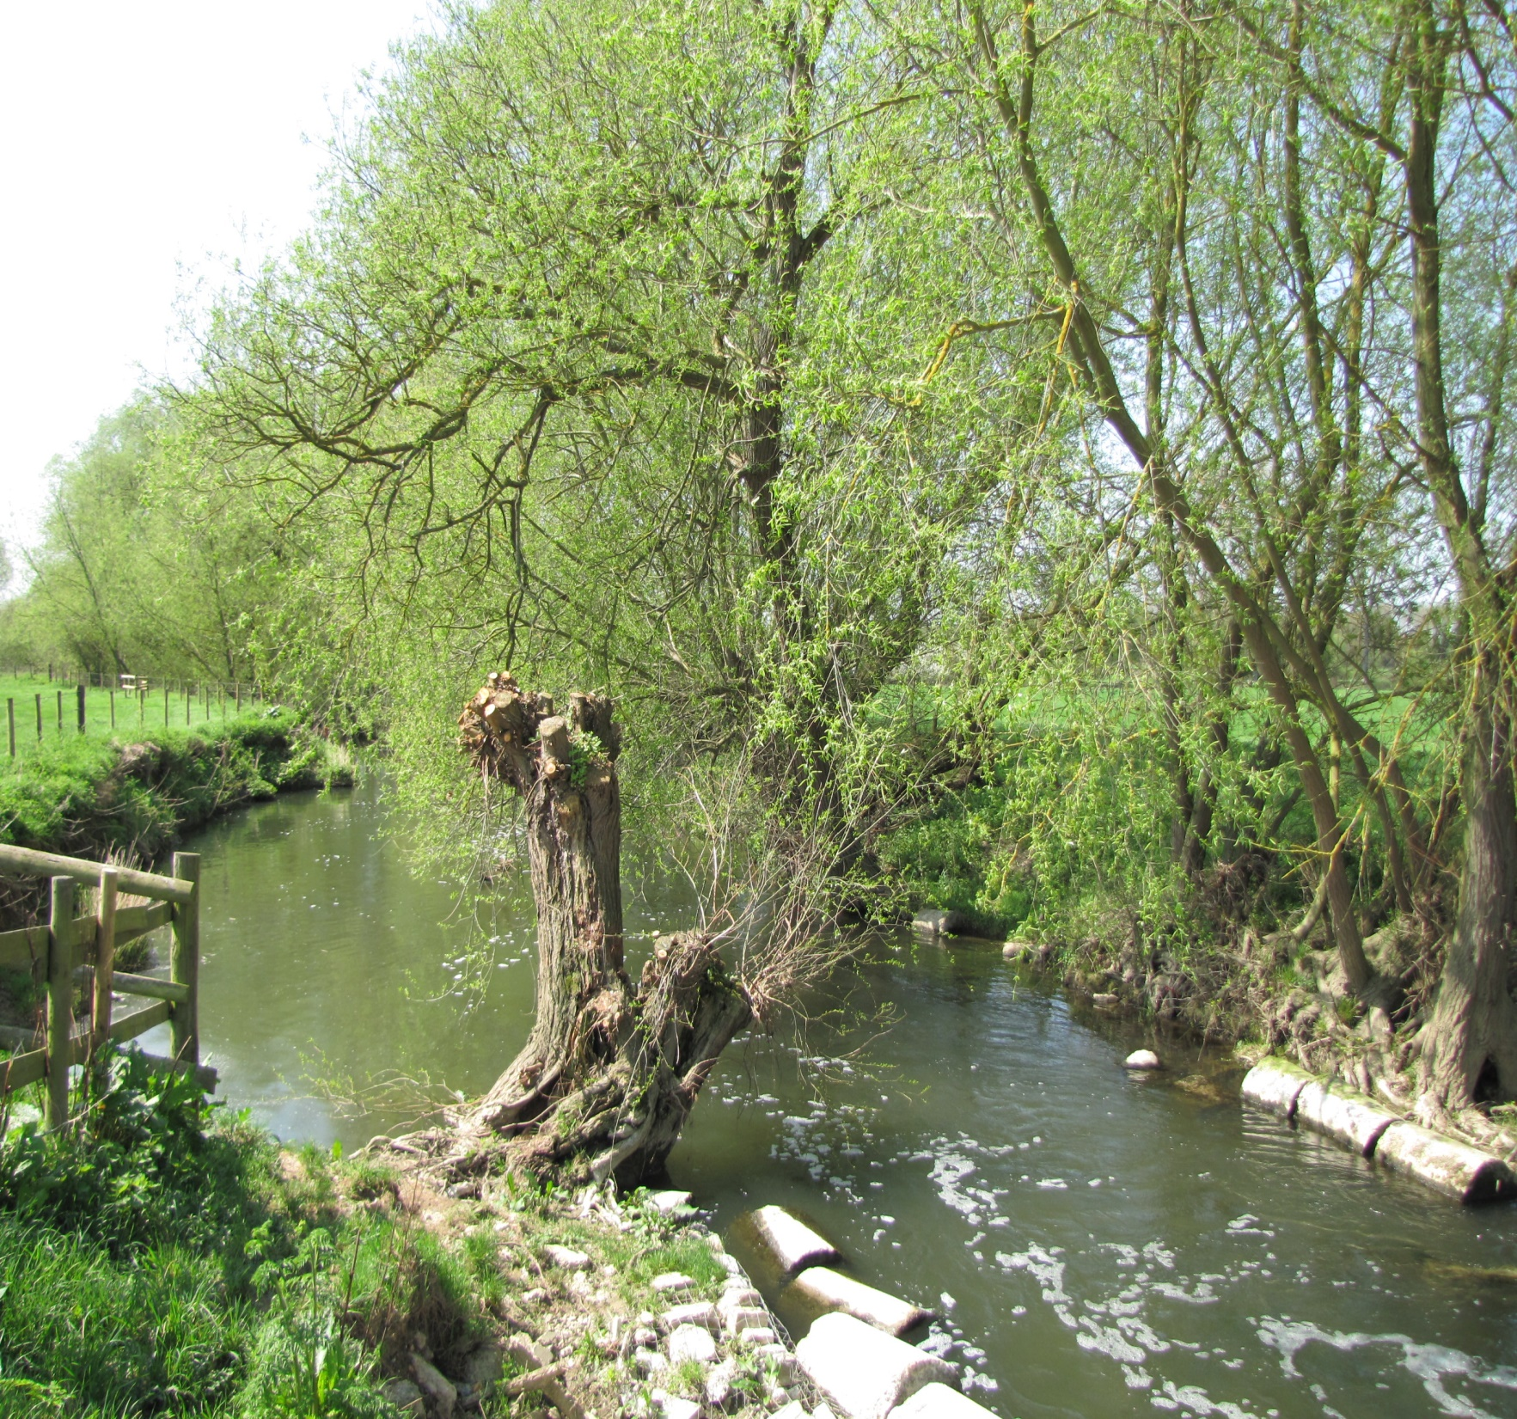
Then Granny called them to go to the park. Fran had told Cumberland that a river flowed through the park, but she didn’t take him to see it.

Slide 17
Cumberland lay by the shed for a long time, waiting for Fran to remember where she had left him.

Slide 18
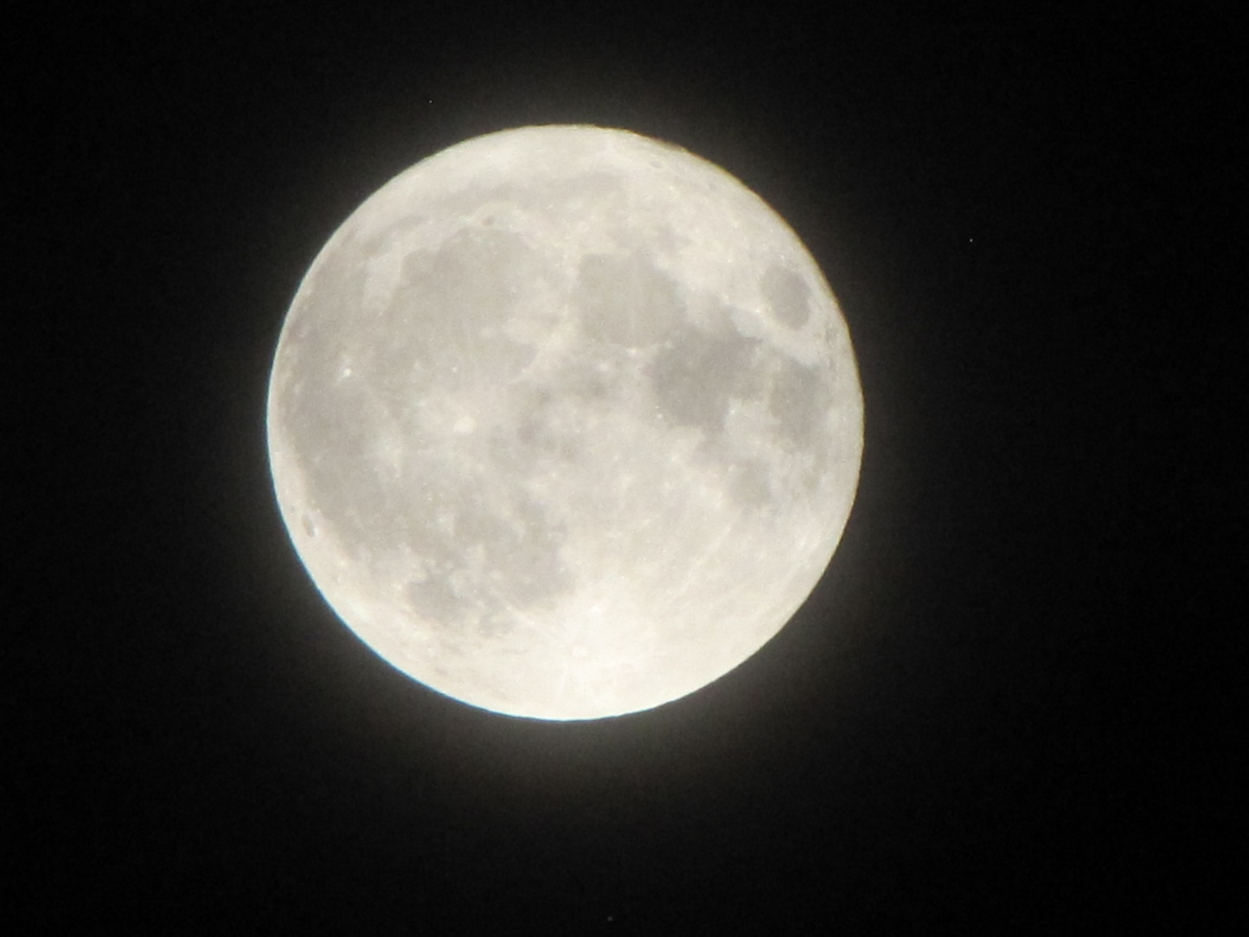
It got quite dark while Cumberland was waiting where Fran had left him. The moon came out. It was getting cold.

Slide 19
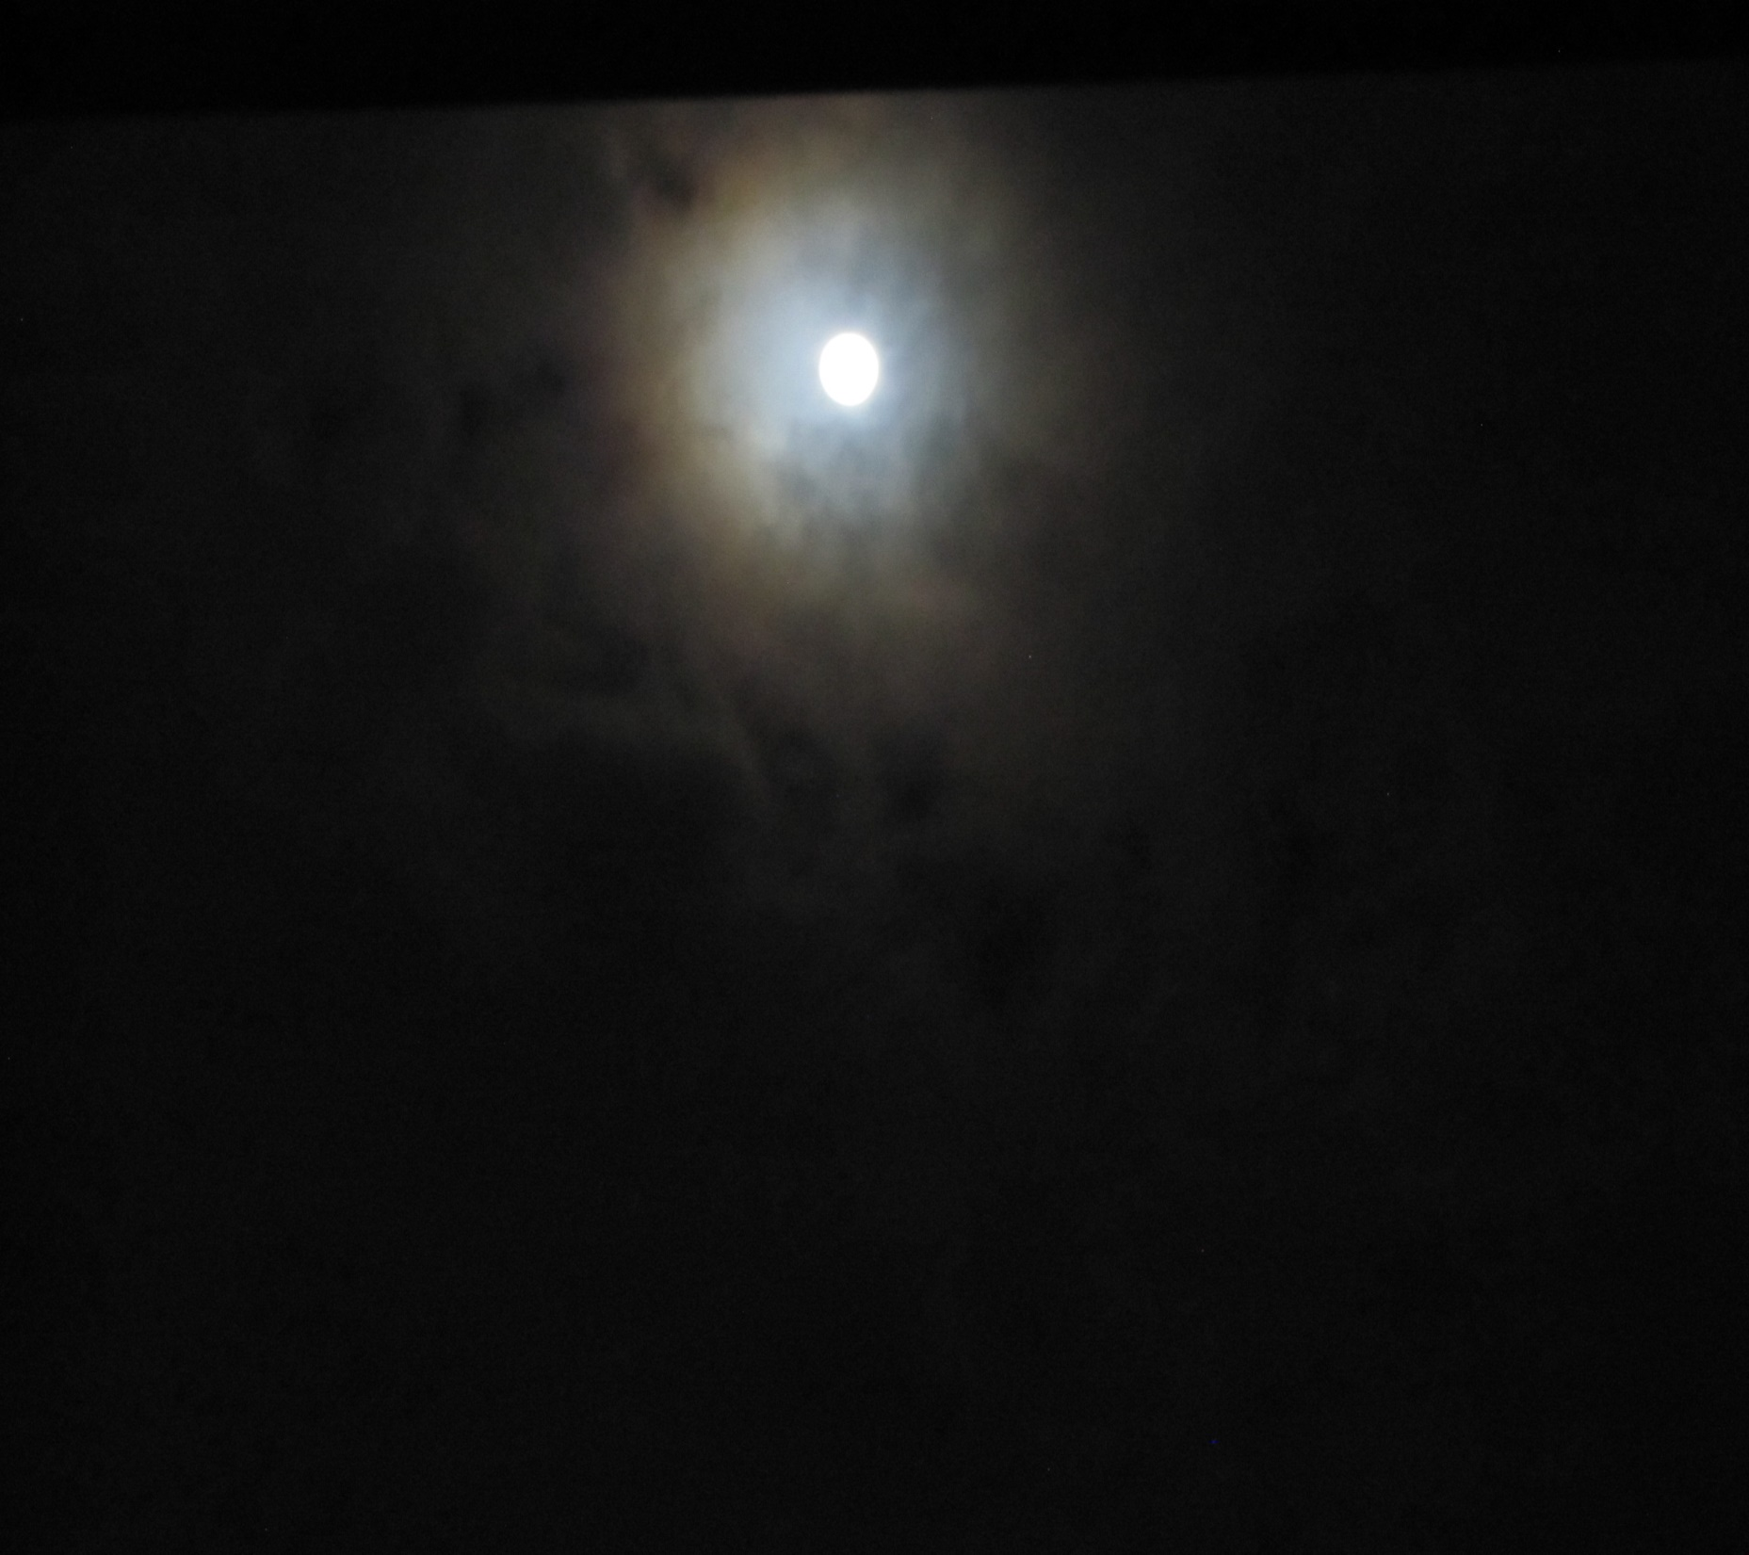
At last Fran came out to get him. She was wearing her pyjamas and dressing gown and was about to go to bed. She was laughing and sounded really happy.

Slide 20
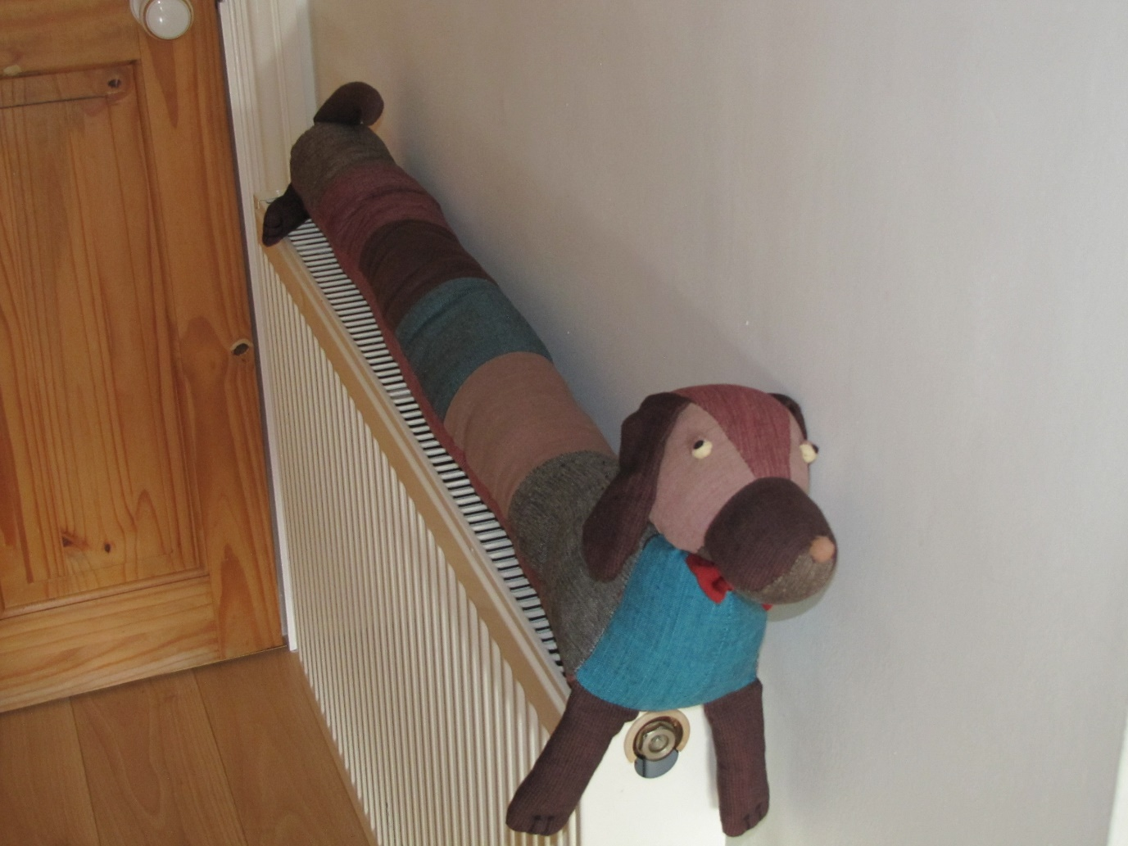
“Sorry Cumberland I forgot where you were,” she said. She put him down on the radiator to warm up while she went upstairs to bed.

Slide 21
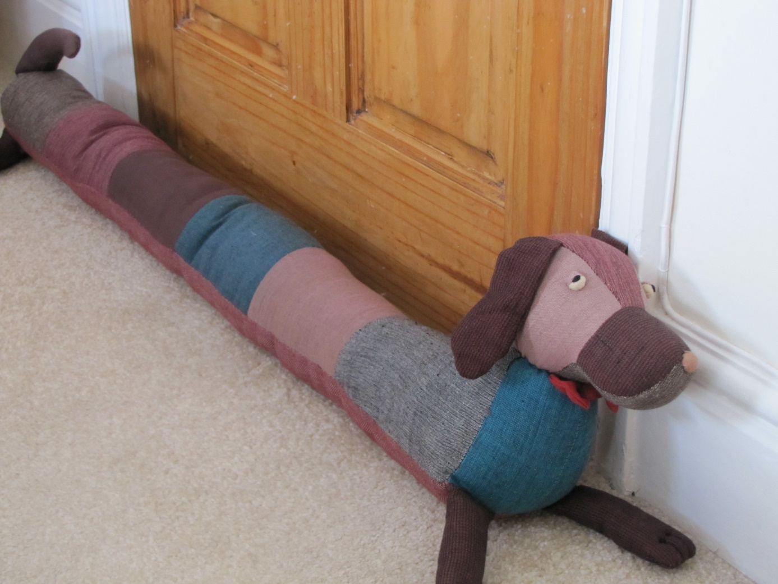
Cumberland was pleased that Fran was happy again. Soon Cumberland was almost too warm, and he was quite pleased when Granny came and moved him back to lie by his door.

Slide 22
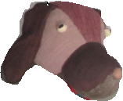
Notes for parents and teachers
Cumberland comes from a Fairtrade cooperative in Nepal and his journey to his
new home was enabled by Traidcraft plc
Children often blame themselves and ‘naughty’ things they have done for experiences that are not caused by them at all but which they feel bad about. This might be one of the things that this story raises as might keeping secrets or leaving toys out in the garden.
Better still it might be about whatever those who hear the story think it is about, but you
will only discover what children think it is about by talking with them.
This book is one of a series about Cumberland and his world that raise questions about,
love, joy, feeling alone, enjoying company being sad and being happy.

Slide 23
Published 2018 in association with Bear Lands Publishing, St. Mary’s Centre, Llys Onnen, Abergwyngregyn, Gwynedd, LL33 0LD, Wales.
Copyright © 2018 David W Lankshear (text and illustrations).
David W Lankshear has asserted his right under the Copyright, Design and Patents Act 1988 to be identified as the author of this Work.
All rights reserved. No part of this publication may be reproduced, stored in a retrieval system, or transmitted, in any form or by any means, electronic, electrostatic, magnetic tape, mechanical, photocopying, recording or otherwise, without full acknowledgement of Bear Lands Publishing and copyright holders.
First published 2018

